Slide 1


ERGONOMICS ON-DEMAND!
Implementing Ergonomics
Overview
Client Collaboration
Problem Solving
Present Like a Pro
Next Steps
Notes:
Implementing Ergonomics
Overview
Client Collaboration
Problem Solving
Present Like a Pro
Next Steps

Slide 2
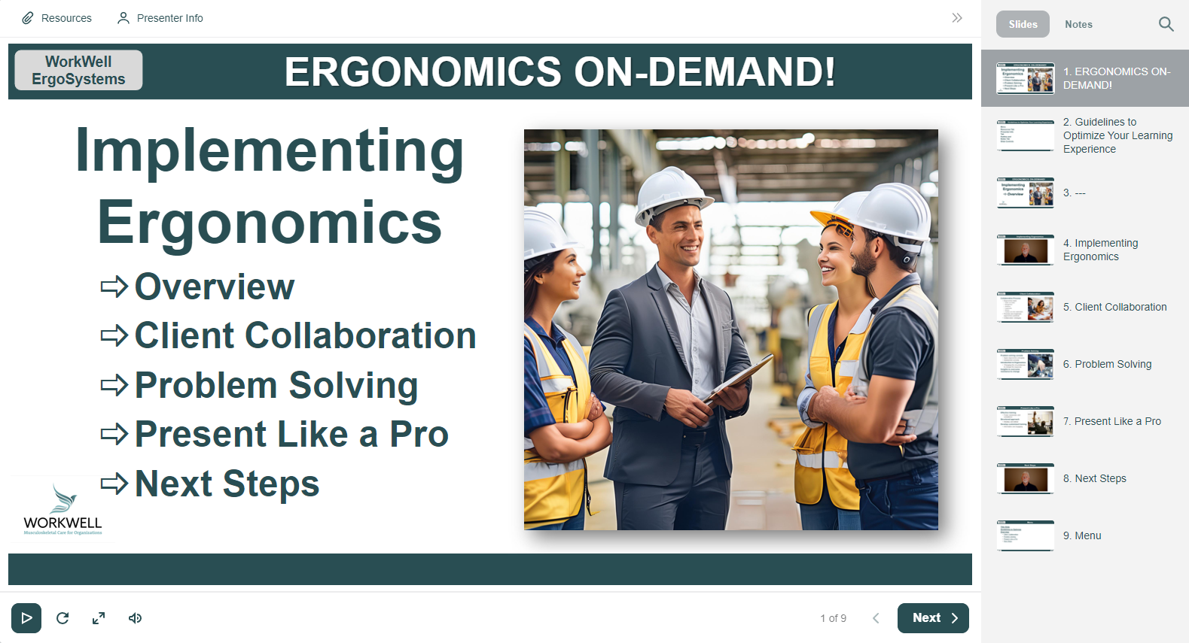
Guidelines to Optimize Your Learning Experience
Menu
Resources Tab
Presenter Info Tab
Outline/Notes Tab
Slide Controls
  Play/Pause
  Replay
  Audio Levels
  Expand
Advance
  Next
  Prev
Notes:
Please use these Guidelines to optimize your learning experience.
Click on the Menu link to access the Menu.
Handouts are available by clicking on the Resources Tab in the upper left.
Presenter Info is available by clicking on the Presenter Tab in the upper left.
Click on the Outline or Notes Tab in the upper right to view the outline or notes.
You can advance through the slide by clicking on the Play or Pause control in the bottom left.
You can also replay the slide, change the audio levels and expand to full screen.
To advance to the next slide, click on NEXT or PREV to return to the previous slide.

Slide 3
ERGONOMICS ON-DEMAND!
Implementing Ergonomics
Overview
Notes:
Implementing Ergonomics
Overview

Slide 4
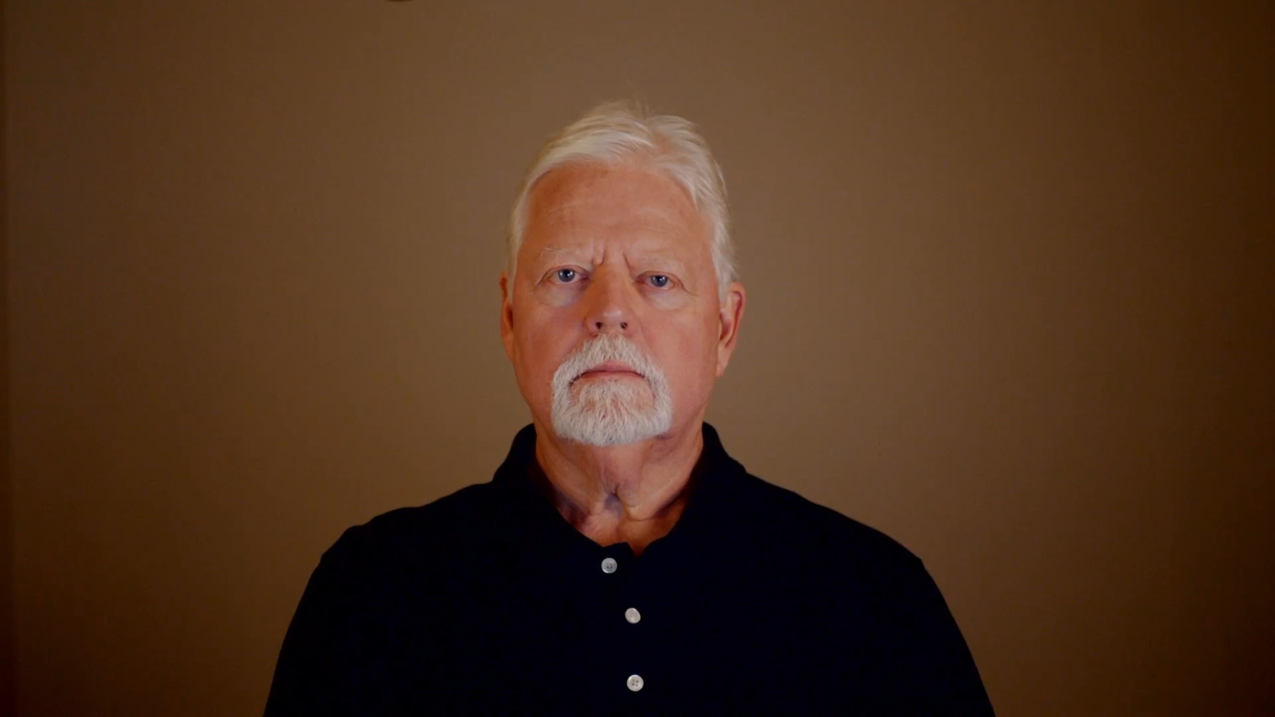
Implementing Ergonomics
Notes:
Let’s talk about opportunities.
What can you do with the information in ERGONOMICS ON-DEMAND! to assist your clients in successfully implementing and sustaining an Ergonomics Process?
The answer of course, depends on you and the direction you’re going with your practice.
I’m Mark Anderson. I’m a Certified Professional Ergonomist and Physical Therapist. I’ve worked in the ergonomics field for more than 35 years.
In the Implementing Ergonomics Track, I’ll offer you some thoughts about collaborating with your clients, ergonomics problem solving strategies, developing and presenting ergonomics training, and ask you to consider your next steps in your ergonomics journey. Here’s an overview of the Modules in the Ergonomics Implementing Track.

Slide 5

Client Collaboration
Collaborative Process
  Ergonomics team
    Health and Safety
    Management
    Workforce
    Engineering
    Medical
    Facilities and other stakeholders
  Promote and implement ergonomics practices
  Collaboration strategies
Notes:
Client Collaboration
Ergonomics, in my experience, is best realized as a collaborative process. As you work with ergonomics as part of your practice, you’ll very likely become part of the ergonomics team that includes Health and Safety, Management, the Workforce, Engineering, Medical, Facilities and other stakeholders.
In the Client Collaboration Module, we’ll delve into the dynamics of the essential role you can play in promoting and implementing ergonomics with your clients. I’ll offer you some strategies I’ve used over the years to add value to collaboration with my clients and you can use with your clients.

Slide 6
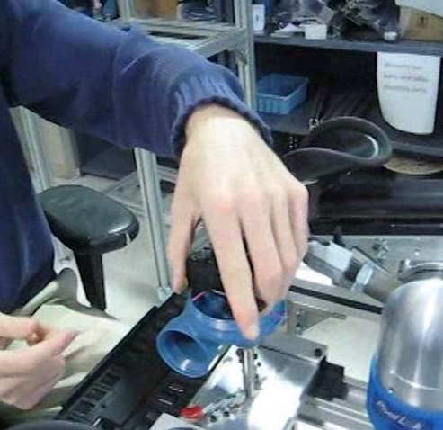
Problem Solving
Problem solving caveats
  Apply ergonomics principles
  Assessment process
Introduction to Ergonomics
  ‘Changing the circumstances to change the response.’
Insights to overcome resistance to change
Notes:
Ergonomics Problem Solving
Ergonomics is all about problem solving! The Ergonomics Problem Solving Module details specific caveats to understand and make use of when applying ergonomics principles as part of the ergonomics assessment process.
In the Introduction to Ergonomics Track, we made the case that, ‘Ergonomics is about changing the circumstances to change the response!’ Change being the operative word.
We all know how difficult change can be for many!
I’ll offer thoughts about adapting circumstances to achieve desired outcomes and offer insights into overcoming resistance to change.

Slide 7

Present Like a Pro
Effective training
  Foster awareness and compliance
Structured approach
  Develop and deliver
Develop customized training
  Informative and engaging
Notes:
Effective training in ergonomics is essential for fostering awareness and compliance among employees. In this module, Present Like a Pro: Develop and Deliver Dynamic Presentations, I’ll offer you a structured approach to consider when developing and delivering comprehensive ergonomics training programs tailored to your client’s needs.
We’ll go through a step-by-step process to develop customized training that is informative and engaging.

Slide 8
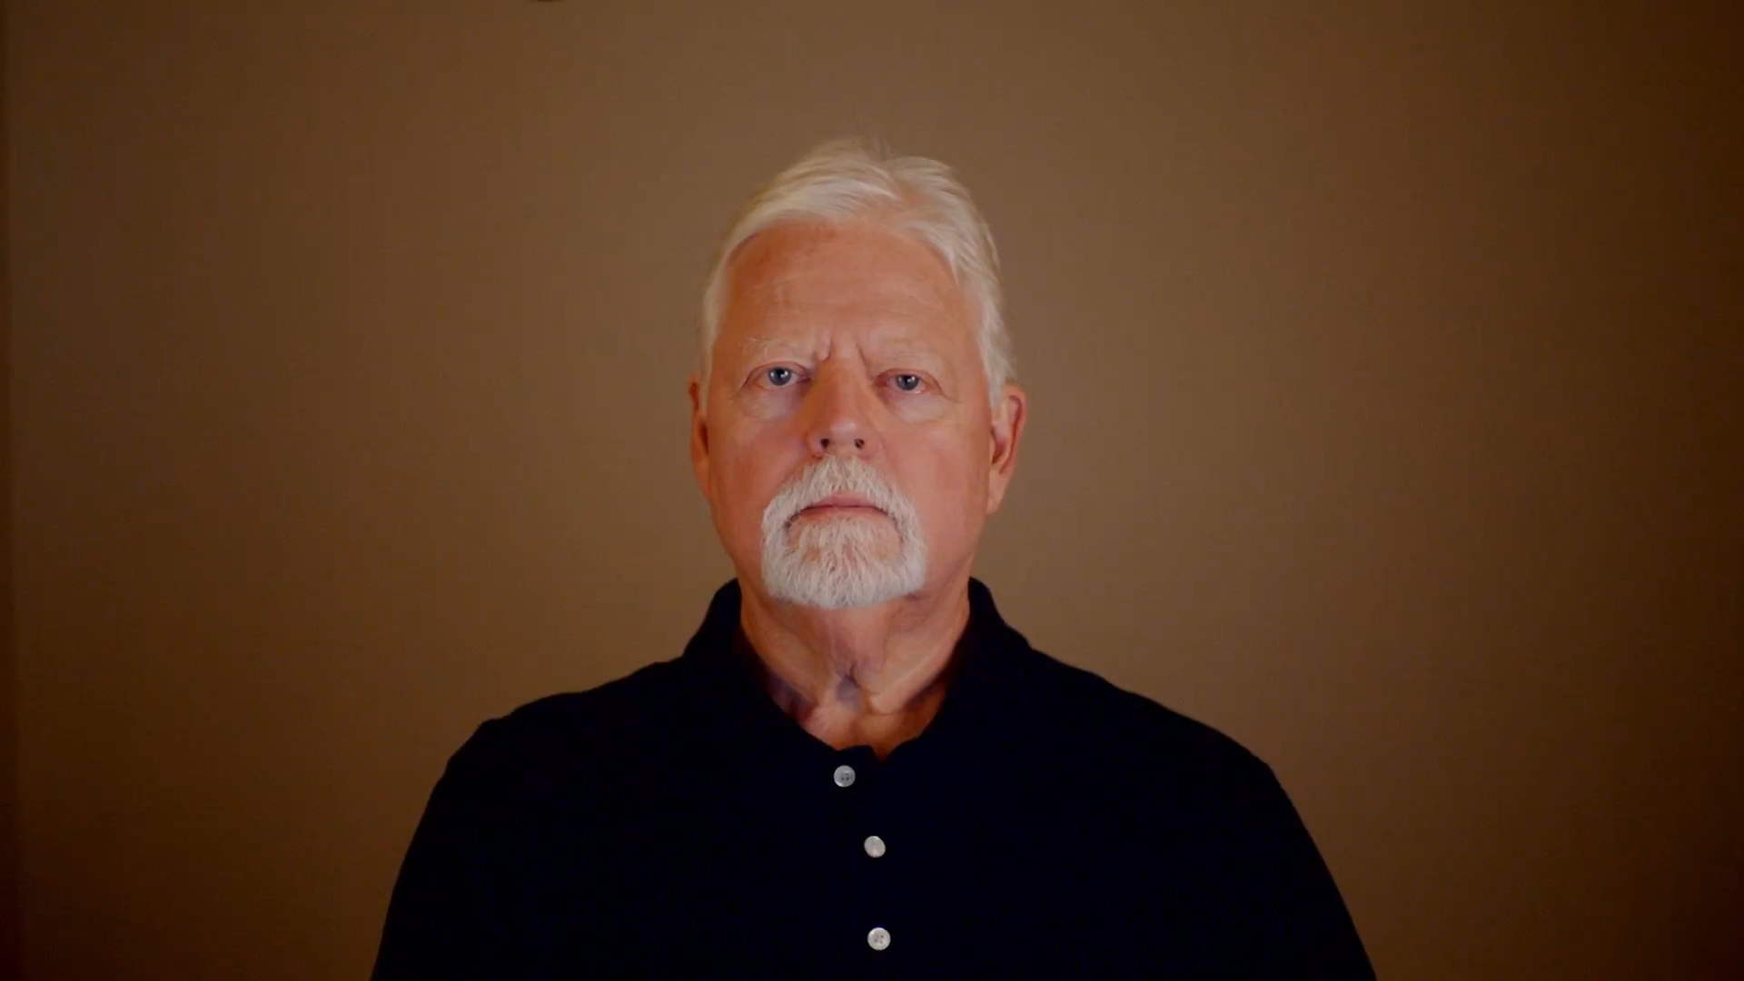
Next Steps
Notes:
Your Ergonomics Journey
My journey as an ergonomist began in Physical Therapy and evolved into a full-time ergonomics consultancy.
I’ll share insights into the practical applications of ergonomics in clinical and corporate settings and I’ll ask you to consider your next steps in your ergonomics journey.
Thanks again for taking the Implementing Ergonomics Track. I hope it adds value to your practice!

Slide 9
Menu
Title Slide
Guidelines to Optimize
Overview
  Client Collaboration
  Problem Solving
  Present Like a Pro
  Next Steps
Notes:
Menu

