Slide 1
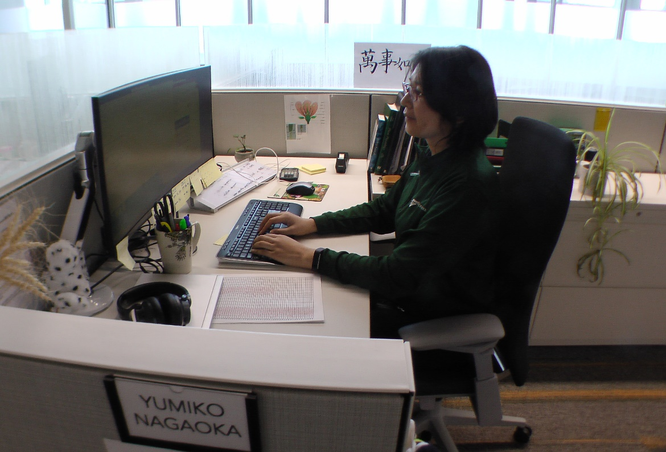
ErgoSystems presents . . .
A Practical Approach to Office and Home Office Ergonomics
Mark Anderson, PT, CPE
Physical Therapist and Ergonomist
ErgoSystems Consulting

Slide 2
Instructor Background/Experience
Mark A. Anderson, MA, PT, CPE
Founder of Minneapolis, Minnesota based ErgoSystems Consulting, LLC
Industrial Rehabilitation clinical practice in mid 1980’s led to interest in ergonomics
Since 1993 certified by Board of Certification in Professional Ergonomics as Certified Professional Ergonomist (www.bcpe.com)
Consulted in ergonomics for over 30 years
Education
Bachelor of Science Degree from University of North Dakota Physical Therapy program
Master of Arts Degree in Physical Therapy from the University of Iowa
Notes:
Instructor Background and Experience
Mark A. Anderson, MA, PT, CPE is the founder of Minneapolis, Minnesota based ErgoSystems Consulting, LLC.
Work in an Industrial Rehabilitation clinical practice in mid 1980’s led to his interest in ergonomics.
Since 1993 Anderson has been certified by the Board of Certification in Professional Ergonomics as Certified Professional Ergonomist (www.bcpe.com).
He has consulted in ergonomics for over 30 years
His education includes a Bachelor of Science Degree from the University of North Dakota Physical Therapy program and a Master of Arts Degree in Physical Therapy from the University of Iowa.
Anderson worked with WorkWell developing the Office and Manufacturing Ergonomics courses and the ERGONOMICS ON-DEMAND series.

Slide 3
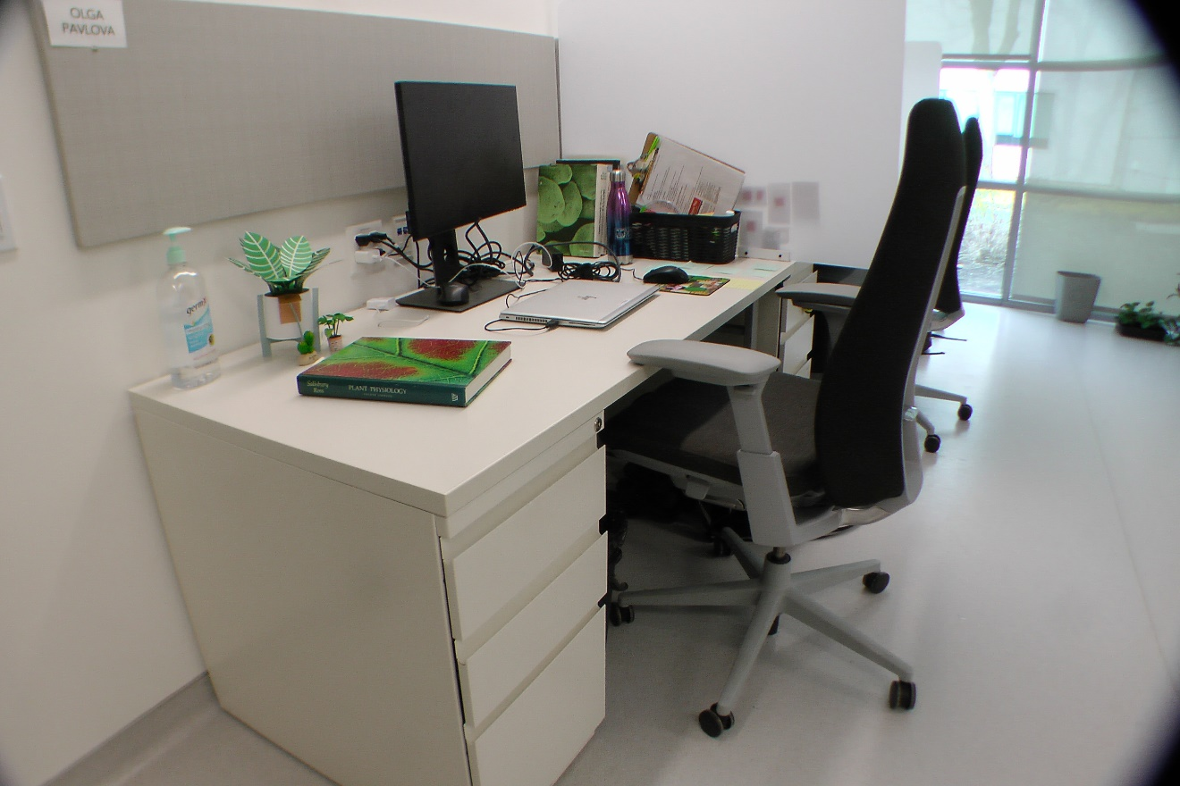
What do you want to accomplish?
Describe successful office workspace . . .

Slide 4
A careful examination
Look carefully at the words
Do you see any pattern or trend?
Is there a predominant theme?

Slide 5
In other words . . .
Words like comfort or comfortable mixed in with:
Productive
Efficient
Satisfying
Effective
Safe and so on
Comfort . . . direct positive relationship to other descriptors

Slide 6
Maximize comfort?
The answer is NO!
Maximizing comfort can be very dangerous thing to do . . .
Optimize comfort in workplace!

Slide 7
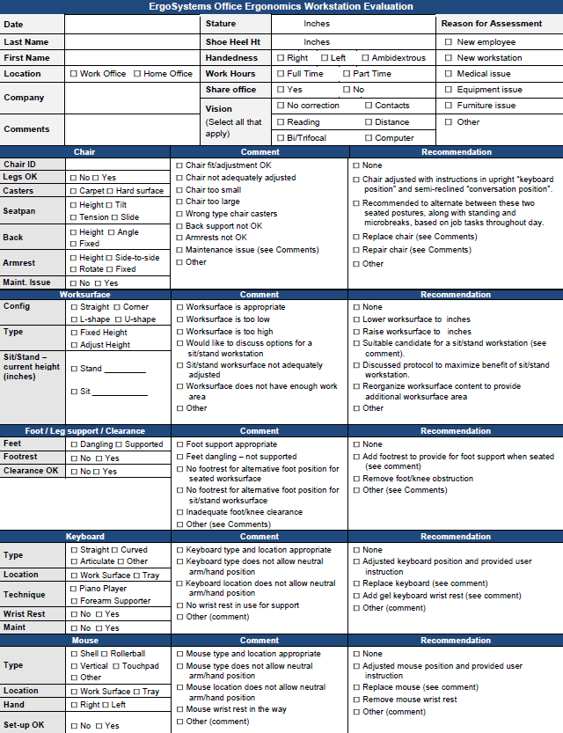
Office Ergonomics Workstation Evaluation Form

Slide 8
Chair
Objectives of chair
Support body and limbs to provide relief from weight bearing
Provide stable base or platform for body and limbs
Position user at correct height and reach relationship to worksurface and tasks at hand
Allow for easy change in position/movement of user

Slide 9
Adjustment anxiety
Chairs can be pretty expensive
All kinds of bells and whistles
Chair only as good as how it is adjusted
Some people have never adjusted their chair
Just sit down and go to work!
Bottom line
Need to initially be able to adjust chair to fit
As well as throughout day

Slide 10
Seatpan Height
Does the chair’s seatpan height adjust up and down?

Slide 11
Seatpan Tilt
Does chair’s seatpan tilt up and down?

Slide 12
Seatpan Tension
Can you adjust seatpan tension?

Slide 13
Seatpan Depth
Does the chair’s seat move forward or backward?

Slide 14
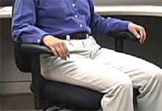
Seatpan Fit
Does chair’s seat fit body size?

Slide 15
Back Support Height
Does chair’s back support move up and down?

Slide 16
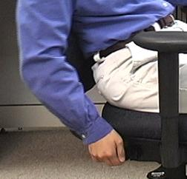
Back Support Angle
Does chair’s back rest angle forward or backward?

Slide 17
Cushion
Suitable cushion
Foam density
Wearability
Breathability
Type of material (fabric or rubberized)

Slide 18
Armrests Adjust
Do chair’s armrests adjust up and down and/or side-to-side?

Slide 19
Maintenance
Is chair functioning properly?
No maintenance problems?

Slide 20
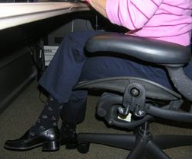
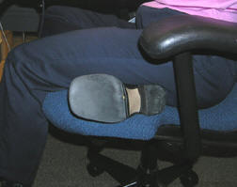
Sitting styles
Sitting styles quite varied from person to person:
Percher
Slouch
Sit crossed leg
Sit on leg

Slide 21
Functional seated positions
Provide for several different acceptable postures
Rotate throughout day on regular basis
Upright “keyboard” position
Semi-reclined/rocking “conversation” position
Standing

Slide 22
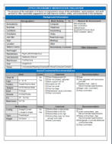
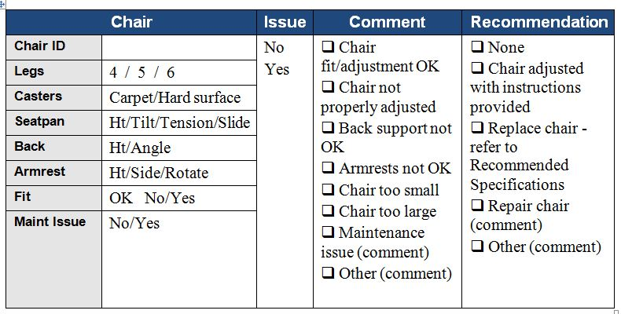
Chair

Slide 23
Worksurface
Worksurface objectives
Provide functional workspace (depth, width)
Support and position equipment
Provide access to work materials
Achieve desired relationship match between user/work

Slide 24
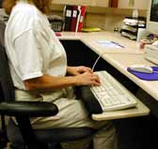
Wrong Desk height
If work height is adjustable, adjust it as needed
Raise height of work surface by putting it up on blocks
Make sure desk or work surface is solidly placed on blocks and won’t fall off!
Adjust chair height
Make sure feet are supported either on floor or with footrest
Add height/angle adjustable keyboard tray
Mounted underneath work surface

Slide 25
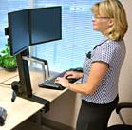
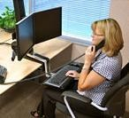
Sit/Stand Workstations
Portable systems placed on desk
Adjustable keyboard/mouse and monitors
Use chair when seated

Slide 26
Sit/Stand Workstations
Height adjustable, user controlled, powered sit/stand workstations

Slide 27
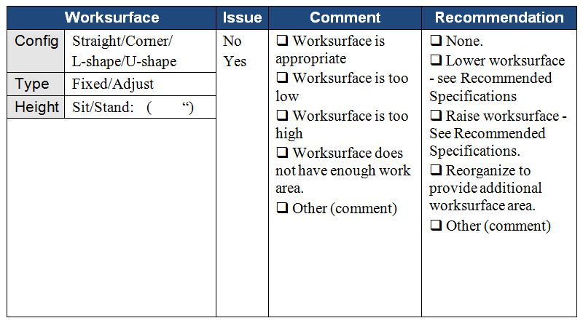
Worksurface

Slide 28
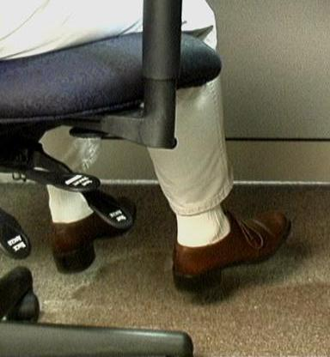
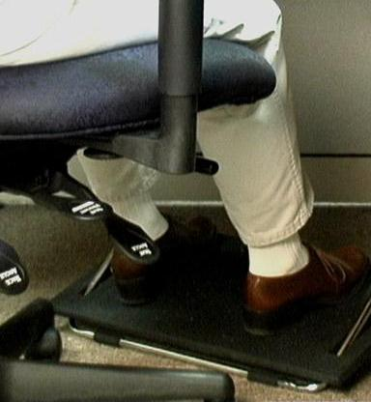
Foot Support
In ideal world best foot support when seated in a chair is floor . . .
However, if needed use proper sized footrest

Slide 29
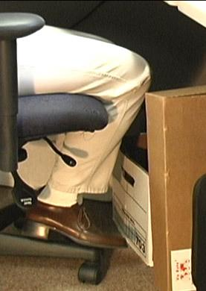
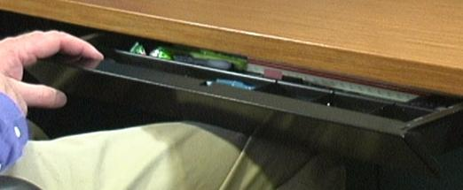
Knee/foot clearance
Move what is not needed to some other storage position or get rid of it
Survey work area and determine what is blocking access

Slide 30
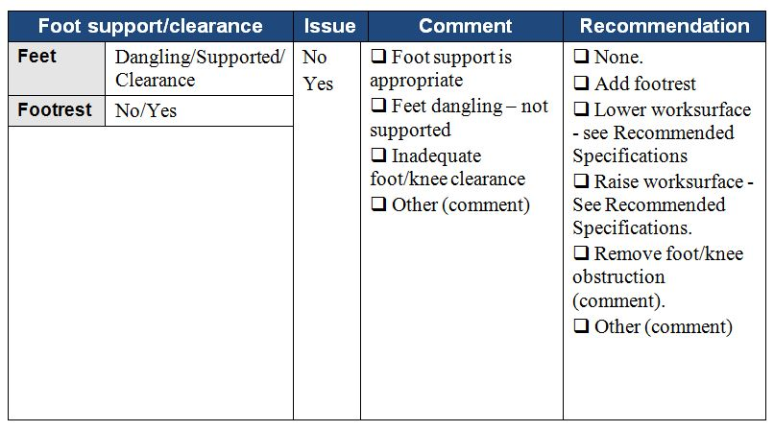
Foot Support/Clearance

Slide 31
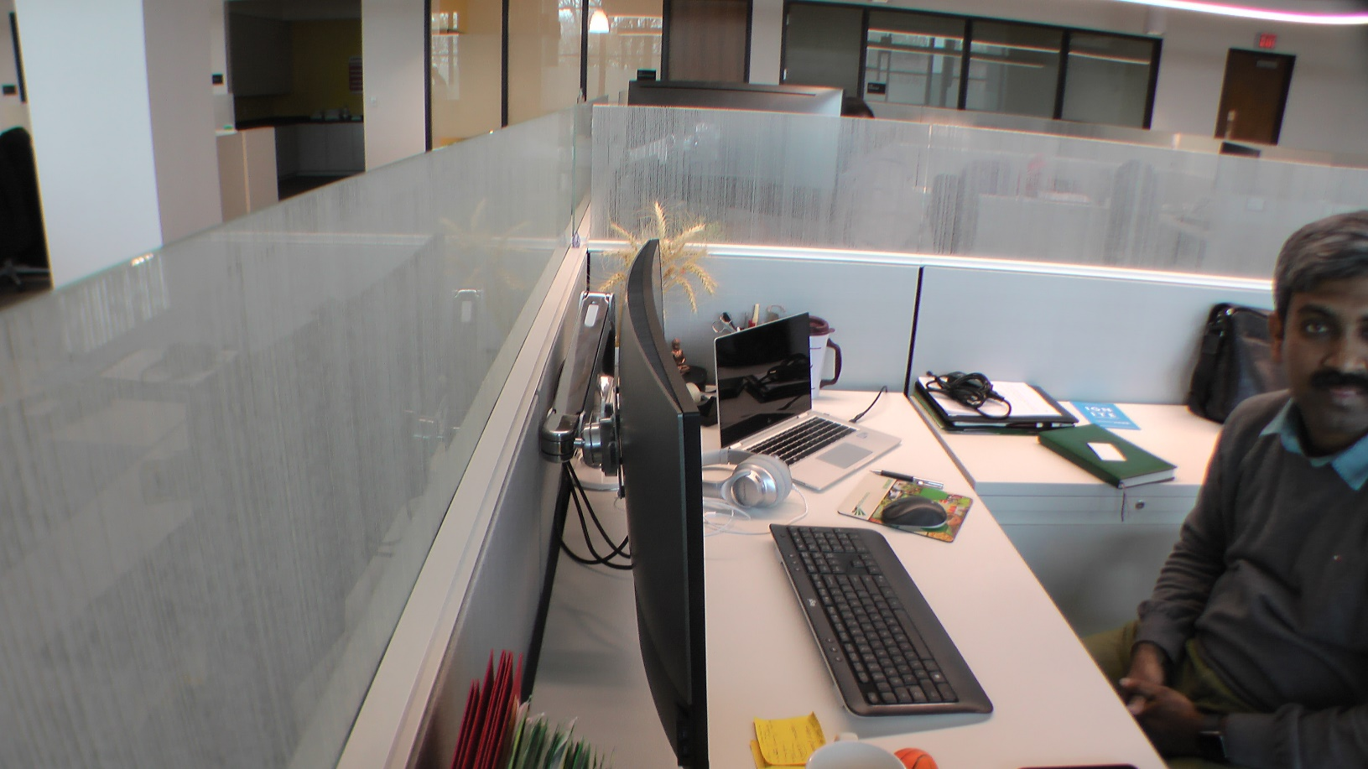
Computer Equipment

Slide 32
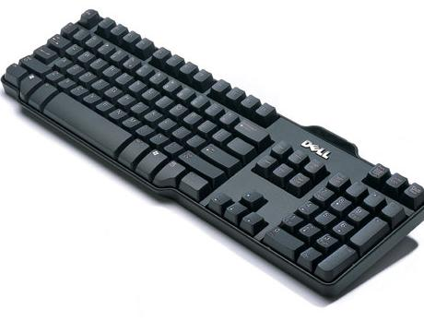
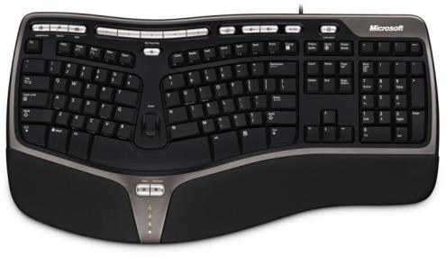
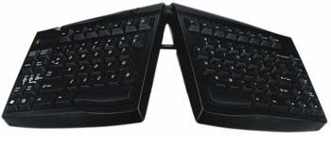
Keyboards
Keyboard configurations
Straight-line
Curved
Articulated
Keyboard surface finish
Keyboard size
Keyboard activation pressure
Layout
Wireless

Slide 33
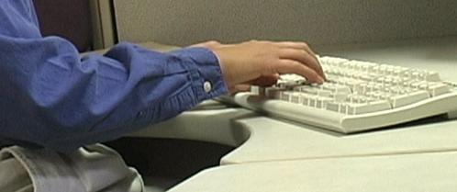
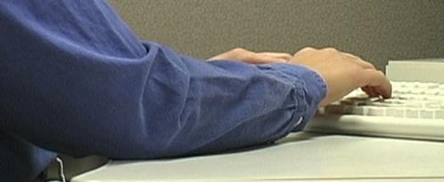
Keyboard Technique
Free float piano playing style
Use of worksurface for forearm support

Slide 34
Keyboard Solutions
Based on technique obtain correct height, reach and angle of keyboard
Adjust keyboard height and position
Adjust worksurface height
Keyboard tray
If cannot adjust keyboard height, position chair height to place hands in neutral posture in relation to keyboard
May require support for feet if no longer touch floor

Slide 35
Take break
Add stretching to day
A little post it note put on computer monitor
Software that reminds you to stretch
Old-fashioned as egg timer
Team up with someone else in office
Take advantage of natural breaks between activities
Remember to Stretch!

Slide 36
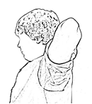
Stretching – Guidelines
Absolutely have to follow doctor's orders for any restricted activities
Technically correct
Energy Input/Output
Neutral Position
Joint Noises
Don’t hold breath
Regular and Consistent
Intensity/Controlled Stretching
Back Bend
Elbow Pull
High Reach
Large Arm Circles

Slide 37
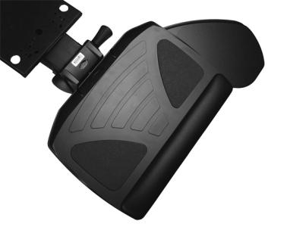
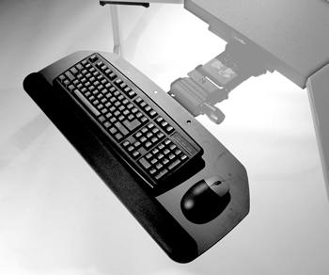
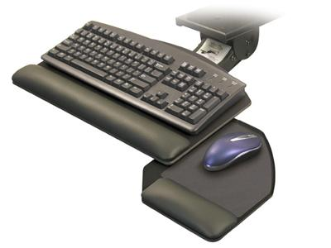
Keyboard Trays
Keyboard tray configurations
Keyboard tray size
Height adjustment
Angle adjustment
Knee clearance

Slide 38
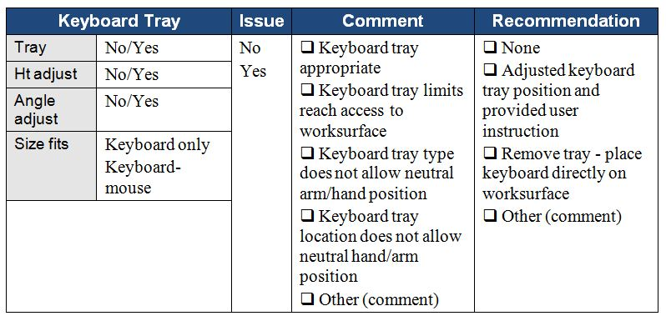
Keyboard Tray

Slide 39
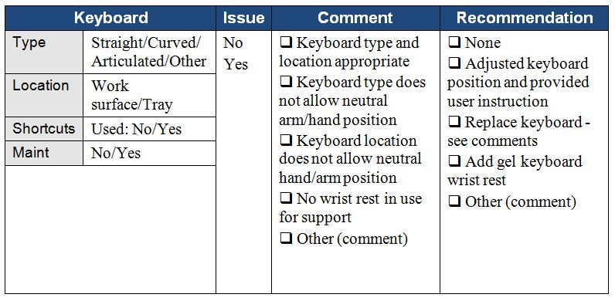
Keyboard

Slide 40
Pointing device
No not that kind of mouse!
Use mouse as little as possible
Keyboard shortcuts

Slide 41
Pointing Device Technique
Neutral positions
Same plane as keyboard
Mousing style or technique
Free float piano playing style
Use of worksurface for forearm support

Slide 42
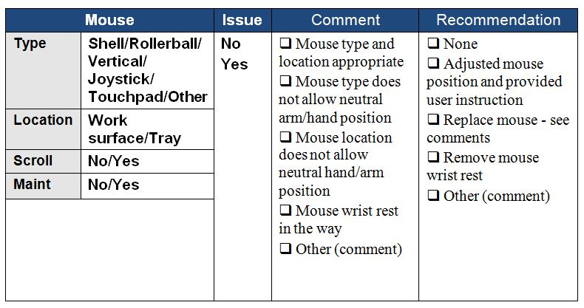
Mouse

Slide 43
Computer
Desktop or laptop
Where?
Easy access

Slide 44
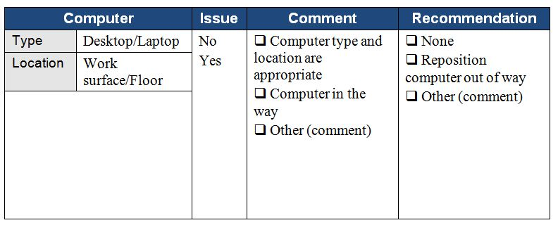
Computer

Slide 45
Monitor
Everything need access to may be viewed through monitor
Watch people looking at their monitors
Almost like monitor is a vacuum cleaner
They turn it on . . . and it sucks their head right in!

Slide 46
Monitor Alignment
Directly face primary work task
Primarily data creation or manipulation
Monitor directly in front

Slide 47
Monitor Height
Where do we naturally read?
We read looking out and down

Slide 48
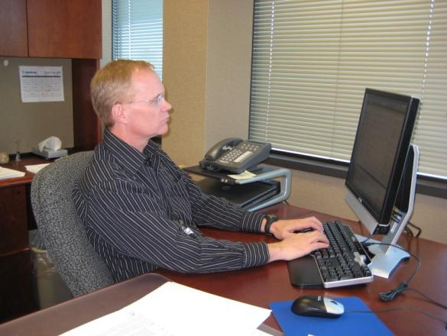
Monitor Height
Top of screen no higher than eye level
Look out and use downward eye movement to look at lower part of screen

Slide 49
Monitor Distance
Eyes
Accommodation and Convergence
Demomstration
Guideline
Get screen as far away from user as possible
At least arm’s length
Still be able to read it clearly with good posture

Slide 50
Monitor Size
Ultra-wide monitors
Position windows as screens
Simulate dual monitors
Primary/Primary
Primary/Secondary

Slide 51
Dual Monitors
Primary/Primary
Primary/Primary

Slide 52
Dual Monitors
Primary/Secondary
Primary/Secondary

Slide 53
Eye Examinations
Regular eye examinations
Eyewear prescriptions changes
Eye health in general
Based on job task

Slide 54
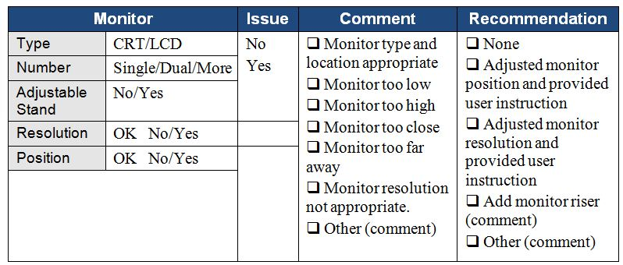
Monitor

Slide 55
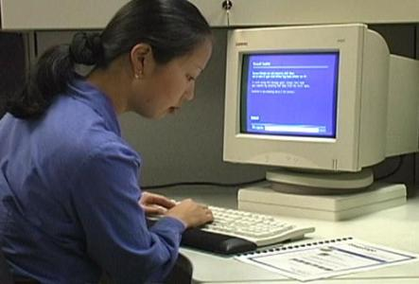
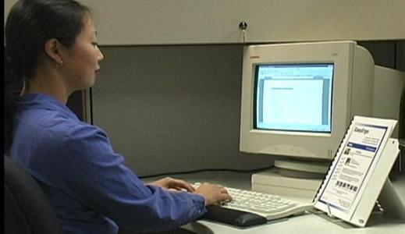
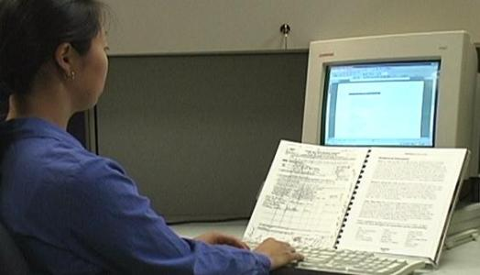
Document holder
Horizontal vs. inclined

Slide 56
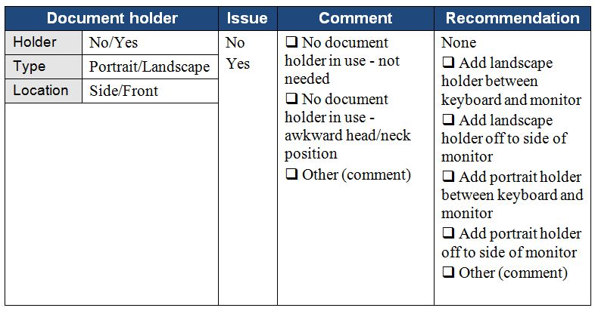
Document Holder

Slide 57
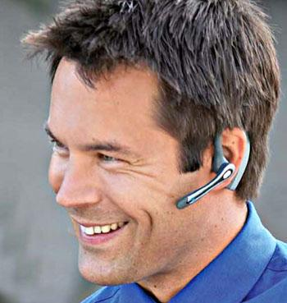
Telephone
Headsets
Wireless
Bluetooth

Slide 58
Webcam
Webcam
Location with comfortable position for head/neck
Laptop or separate camera
Notes:
Webcams have become an important consideration in your office. Whether the webcam is part of your laptop or a separate camera, make sure you are following the ergonomics principles of neutral head and neck position when you setup and use the webcam.
Fill out the Worksheet for Telephone/Webcam Features, Issues and Recommendations.

Slide 59
Telephone/Webcam

Slide 60
Office equipment
Make use of principles to position office equipment
Calculator
Printer
Fax
Writing utensils
Scissors
Paper clips
Stapler
Other Stuff

Slide 61
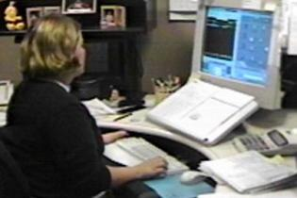
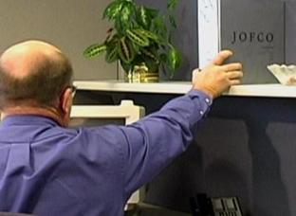
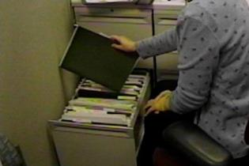
Storage/Reach zone
Primary
Frequently accessed from seating system
Within easy reach
Secondary
Occasionally accessed
Located in gray zone
Danger Zone!
Tertiary
Very occasionally accessed
Have to get up and move to access

Slide 62
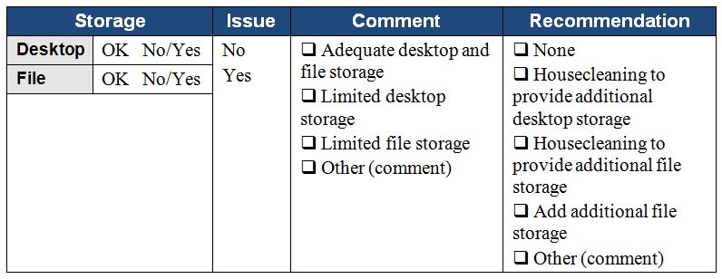
Storage

Slide 63
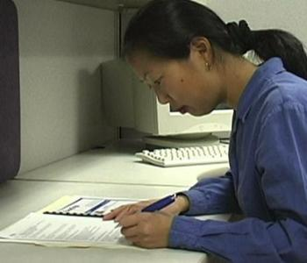
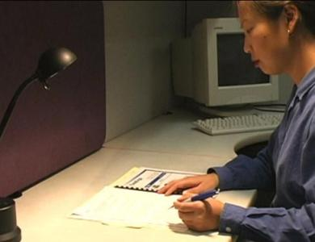
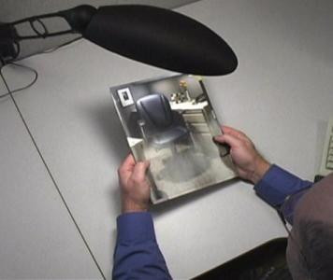
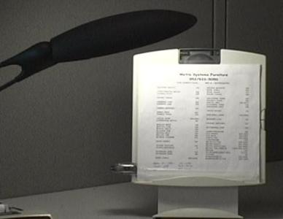
Lighting – General and Task

Slide 64
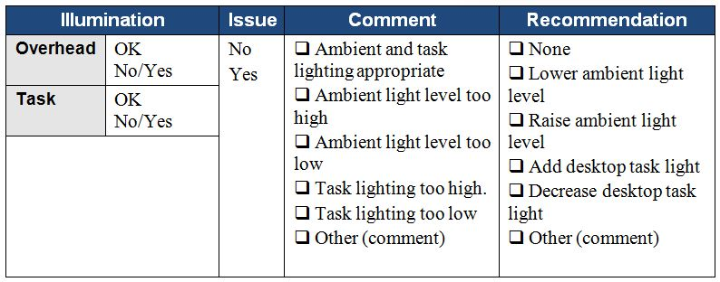
Illumination

Slide 65
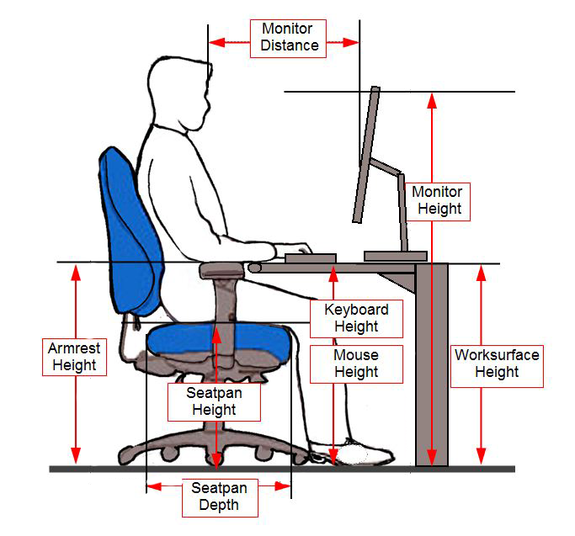
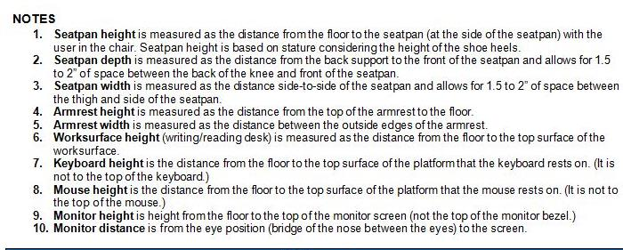
Recommended Specifications

Slide 66
Home Office Ergonomics
Working at home on your computer?
You aren’t alone!
Many people who normally work at desk at work now work at home!
Tips and Techniques

Slide 67
Setup of Your Home Office
Setup considerations:
Location of office
Sharing – partner/kids
Computer equipment
Laptop or desktop
Desk/table
Adjustable or fixed height
Chair
Adjustable or fixed position
Physical comfort - promote
Visual comfort - promote

Slide 68
Step-by-Step Approach
Each setup will be somewhat unique!
Need to consider:
“What is possible!”
“Be creative!”

Slide 69
Step-by-Step Approach - Location
What are your options?
Dedicated space
Yours only or shared space
Partner/kids
Desk/chair
Privacy – visual and auditory
Shared space
Multi-purpose
Kitchen/dining table and chair
Setup and take down

Slide 70
Step-by-Step Approach –Desk/Chair
Work through desk/chair options:
Adjustable height table/desk and adjustable height chair
Fixed height table/desk and adjustable height chair
Fixed height table/desk and fixed height chair
Couch
Standing

Slide 71
Step-by-Step Approach – Desk/Chair
Adjustable height table/desk and adjustable height chair
First adjust chair height to place feet directly on floor
Adjust table/desk height so wrists are straight when hands on keyboard
Adjust monitor appropriately
You are good to go!

Slide 72
Step-by-Step Approach – Desk/Chair
Fixed height table/desk and adjustable height chair
Place keyboard/mouse or laptop on fixed heightdesk/table
Adjust chair height so wrists are straight with hands on keyboard
If feet come off floor, find a box or stool so feet are not dangling
Adjust monitor appropriately
You are good to go!

Slide 73
Step-by-Step Approach – Desk/Chair
Fixed height table/desk and fixed height chair
Sit in chair and able to:
Sit all way back in chair with lower back supported AND
Feet on floor AND
Wrists straight with keyboard use
You are good to go!

Slide 74
Step-by-Step Approach – Desk/Chair
Fixed height table/desk and fixed height chair
Sit in chair, if wrists are not straight with keyboard use
Need to adjust seated height
Look for a different height chair
Put a seat cushion in chair
If this caused feet to come off floor
Find box or stool so feet are not dangling
If you are taller individual and table/desk too low
May be able to put blocks under desk legs to raise it up
Adjust monitor appropriately

Slide 75
Step-by-Step Approach – Couch
Are we saying never sit on couch or easy chair and use laptop?
The answer is no!
You can certainly some of the time use couch or recliner
Use pillows under arms to provide support for arms and shoulders
May place pillow under laptop to ensure straight wrists with keyboard
Angle monitor so for viewing with least amount of head tip forward
Sofa servers may work to position laptop
Make sure feet and legs are well supported

Slide 76
Step-by-Step Approach – Standing
As possible, mix in standing when using laptop or desktop
Look for counter or place box on counter
Stand comfortable tall with elbows about 90 degrees
Wrists straight
Angle laptop monitor
Good shoes are important for standing
Good walking shoes will be good for standing
Use footrest to alternate one foot up on rest

Slide 77
Ergonomics – A Potent Tool!
Great number of factors in office ergonomics workplace!
Use ergonomics process to offer solutions that are practical and effective!
Be more comfortable!

Slide 78
Thanks for your time and attention!

Slide 79
ErgoSystems presents . . .
A Practical Approach to Office and Home Office Ergonomics
Mark Anderson, PT, CPE
Physical Therapist and Ergonomist
ErgoSystems Consulting

