Slide 1
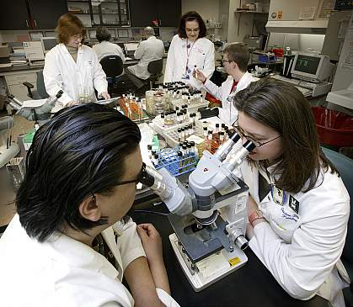
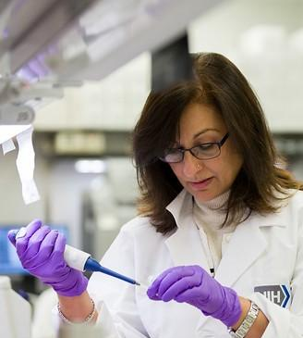
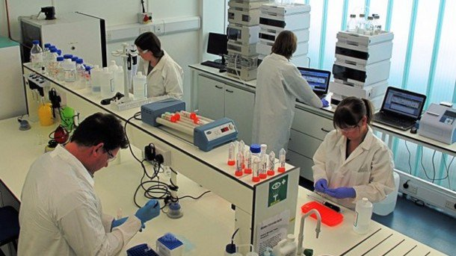
Welcome to USDA ARS MWA Laboratory Ergonomics!
Presented by:
Mark Anderson, PT, CPE
Ergosystems Consulting, LLC
Minneapolis, MN
Notes:
Hello everyone. Welcome to USDA Agricultural Reach Service Midwest Area Laboratory Ergonomics.

Slide 2
Instructor Background/Experience
Mark A. Anderson, MA, PT, CPE
Founder of Minneapolis, Minnesota based ErgoSystems Consulting, LLC
Industrial Rehabilitation clinical practice in mid 1980’s led to interest in ergonomics
Since 1993 certified by Board of Certification in Professional Ergonomics as Certified Professional Ergonomist (www.bcpe.com)
Consulted in ergonomics for over 30 years
Education
Bachelor of Science Degree from University of North Dakota Physical Therapy program
Master of Arts Degree in Physical Therapy from the University of Iowa
Notes:
Instructor Background and Experience
Mark A. Anderson, MA, PT, CPE is the founder of Minneapolis, Minnesota based ErgoSystems Consulting, LLC.
Working in an Industrial Rehabilitation clinical practice in the mid 1980’s led to his interest in ergonomics.
Since 1993, Anderson has been certified by the Board of Certification in Professional Ergonomics as a Certified Professional Ergonomist (www.bcpe.com).
He has consulted in ergonomics for over 30 years
His education includes a Bachelor of Science Degree from the University of North Dakota Physical Therapy program and a Master of Arts Degree in Physical Therapy from the University of Iowa.
Anderson worked with WorkWell developing the Office and Manufacturing Ergonomics courses and the ERGONOMICS ON-DEMAND series.

Slide 3
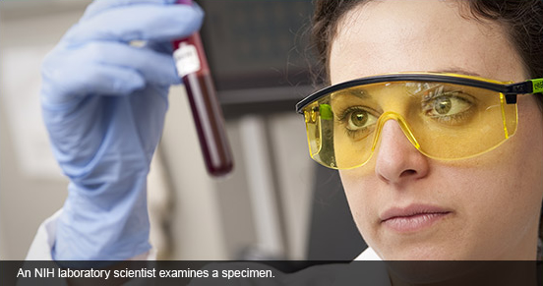
Role of ARS MWA
USDA chief scientific in-house research agency
Find solutions to agricultural problems
Affect Americans every day from field to table
Support overall USDA mission
Protect and promote food, agriculture, natural resources and related issues
Notes:
The Agricultural Research Service (ARS) is the U.S. Department of Agriculture's chief scientific in-house research agency. Our job is finding solutions to agricultural problems that affect Americans every day from field to table.
These efforts support the overall mission of USDA, which is to protect and promote food, agriculture, natural resources and related issues.

Slide 4
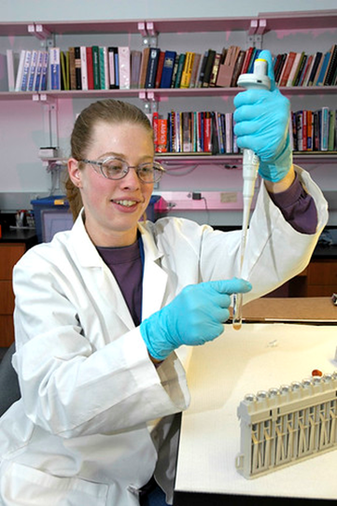
Work in Labs
Critical work in laboratories in the Midwest
Training session details how to perform laboratory tasks
Enhance ARS mission
Facilitate well-being and performance
Application of ergonomics principles
Notes:
A significant portion of this critical work takes place in laboratories in the Midwest.
In this training session we’ll detail how you can perform laboratory tasks that enhance the agency’s mission and facilitate your well-being and performance by the application of ergonomics principles and measures.

Slide 5
Successful Workplace?
Expect to accomplish?
Words describe successful workplace?
Want a workplace that is
______________________
What do you think?
Notes:
First though, what can you expect to accomplish from this training session?
Think for a moment, what words would you use to describe the successful workplace?
You want a workplace that is . . . ., well, fill in the blank. What do you think?

Slide 6
First Word?
If you answered, “Comfortable” you’re not alone
About 9 out of 10 people
Then words like
Productive
Well-organized
Functional
Well lit
Safe
Notes:
Was the first word that came to your mind: “comfortable”?
If you answered, “comfortable”, you’re not alone.
Informal surveys indicate for about 9 out of 10 people “comfortable” is what they want in their workplace.
Then of course, words like “productive”, “well-organized”, “functional”, “well lit”, “safe” and so on follow along.

Slide 7
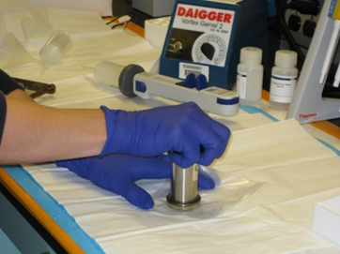
Direct Relationship
Between workplace comfort levels and other descriptors
Workplace more comfortable is also more
Productive
Functional
Safe
Use ergonomics principles and techniques
Enhance comfort level
Enhance safety and productivity
Notes:
We recognize there is a direct relationship between workplace comfort levels and these other descriptors; a workplace that is more comfortable is typically also more productive, functional and safe.
That’s what this training session is all about; how you can use ergonomics principles and techniques in the lab environment to help you enhance your comfort level as well enhance your safety and productivity.

Slide 8
Objectives
Practical definition of ergonomics
Ergonomics principles
Step-by-step ergonomics workstation assessment
Pipetting
Microscopy
Biological safety cabinets/Fume hoods
Set-up workstations
Material Handling
Notes:
Specifically, you’ll learn a practical definition of ergonomics, ergonomics principles, and known common laboratory work-related musculoskeletal disorders (WMSDs) that may occur.
Most importantly, you will learn how to apply a step-by-step ergonomics workstation assessment process to laboratory tasks including pipetting, microscopy, use of biological safety cabinets and fume hoods, the set-up of laboratory workstations and material handling.

Slide 9
Objectives
Personal performance and comfort
Warmup and stretching
Physical fitness
Health and wellness
Apply this assessment process to other work or even home environments
Notes:
We’ll also discuss specific strategies to enhance personal performance and comfort through warmup and stretching activities, physical fitness, and health and wellness activities.
As an additional benefit, people who have attended ergonomics sessions discover they can apply this assessment process to other work or even home environments.

Slide 10
Ergonomics – Definition
Heard word, “ergonomics” before
Marketeers tout product’s “ergonomic” qualities and benefits
Tool with “ergonomic handle”
Car seat with “ergonomic design”
In lab environment how best to define ergonomics?
Any product illustrations do not constitute official USDA endorsement.
Notes:
More than likely you have heard the word, “ergonomics” before.
It seems everywhere you look; marketeers are using the word to tout a product’s “ergonomic” qualities and benefits; a tool with an “ergonomic” handle or a car seat with “ergonomic design”.
Well, in the lab environment how do we best define ergonomics?

Slide 11
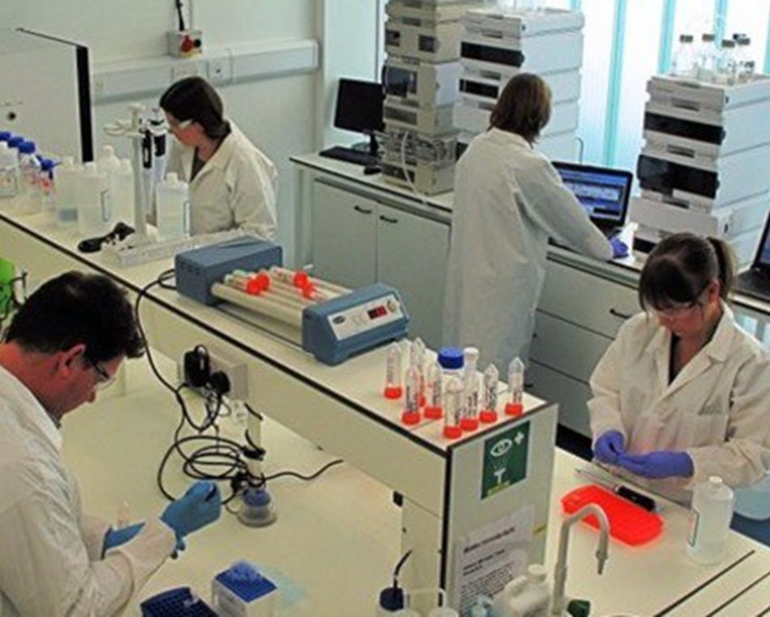
Fit the Job to the Person
Picture people in labs
Very diverse workforce
Accommodate diverse population
“Fit the job to the person”
Not force, “The person to fit the job”
Microscopy
Properly set-up for shorter person
Very uncomfortable for taller person
Potentially lead to musculoskeletal issue
Notes:
Picture for a moment those who work in labs.
Some are taller, some are shorter, some are smaller, and some are larger. In other words, just in terms of size there is a very diverse workforce.
Our challenge is to have a workplace that can accommodate this diverse population. In other words, we want to, “Fit the job to the person.”
This is in direct contrast to forcing, “The person to fit the job.”
A great example is microscopy.
A microscope properly set-up for a shorter person will be very uncomfortable for a taller person and can potentially lead to a musculoskeletal issue.

Slide 12
Work Smarter, Not Harder
Control level of physical stress and exertion
Examine how tasks are accomplished
Craft methods
“Fit the Job to the Person”
“Work Smarter, Not Harder”
Notes:
Another common definition of ergonomics involves controlling the level of physical stress and exertion required to perform the task at hand.
Here, the goal is to figure out methods to control the physical stresses and exertions by examining how tasks are accomplished and then develop methods to optimize performing the tasks.
The expression, “Work smarter, not harder” nicely sums up this concept.
So, our objective is to use the ergonomics assessment process to identify potential risk factors and then craft reasonable and viable methods to better, “Fit the Job to the Person” and “Work Smarter, Not Harder”.

Slide 13
Ergonomics Principles
Neutral Position and Support
Reach Zone
Power Position
Fatigue Control
Ergonomics
Neutral Position
Reach Zone
Power Position
Fatigue Control
Notes:
To help ensure the workplace is the most comfortable and effective possible, we’ll define a set of ergonomics principles.
We’ll focus on four of them:
Neutral Position and Support
Reach Zone
Power Position and
Fatigue Control

Slide 14
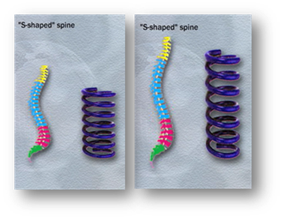
Neutral Position and Support
Spine and pelvis provide foundation
S-shape configuration
Inner curve in lower back and neck
Outer curve in mid-back area
Why S-shape?
Think springs!
Notes:
The first ergonomics principle is Neutral Position and Support.
Although we stand upright on our feet, it's really the spine and pelvis that provide the foundation for our body.
When you hold yourself in the neutral position, your spinal column, when viewed from the side, is actually in an S-shape configuration.
An inner curve in the lower back and neck and an outer curve in the mid-back area.
Why S-shape? Think springs! The S-shape allows the spine to act like a spring and increases the spine’s ability to handle stress.

Slide 15
Mid-range of Joint Position
What position of elbow most functional?
With elbow straight or bent all the way?
About 90 degrees of bend
Greatest strength
Protects joint and surrounding soft tissues
Every joint of body has a “mid-range of joint position”
Notes:
What about the other joints of the body? Every joint has a neutral position.
We call it, “mid-range of joint position”.
Think about your elbow. From a physical performance standpoint, what position of the elbow is the most functional?
With the elbow straight or bent all the way?
The elbow is most functional at about 90 degrees of bend.
This is the position of greatest strength and also protects the joint and surrounding soft tissues like muscles, tendons, ligaments and nerves.
Every joint of the body has a “mid-range of joint position”.

Slide 16
15 % More in Neutral Position
Can’t spend all time in neutral position
Next time in an out-of-neutral position
Identify why out of neutral
Consider options to improve
15% can make a big difference
Notes:
Of course, you can’t spend all your time with your spine and joints in the absolute neutral position.
However, the closer you can position your joints to the “mid-range of joint position”, the better.
The next time you find yourself in an out-of-neutral position, identify why you are out of neutral and consider options to improve the situation to allow you to be more in neutral.
Even if you can spend 15% more time in neutral, that 15% can make a big difference!
We’ll make use of the Neutral Position concept in assessing and setting up lab workstations and equipment.

Slide 17
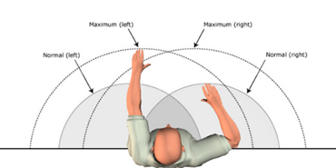
Reach Zone
How long hold 10# load at arm’s length?
Gets heavy quite quickly
Hold as close to your body as you can
Operating range
Determined by arm’s length
Sphere from hip to shoulder level within arm’s reach to the front and side
Notes:
Reach Zone is the second ergonomics principle; it has to do with how far away from your body you need to reach.
For example, how long can you hold a 10# load at arm’s length?
Well, at arm's length, it gets heavy quite quickly.
That’s why, in fact, if you must hold the load at all, you know you want to hold it as close to your body as you can.
Structurally, the body is designed to function within a specific operating range. We call this the Reach Zone.
Determined by your arm’s length, it’s defined by a sphere from hip to shoulder level within arm’s reach to the front and side.

Slide 18
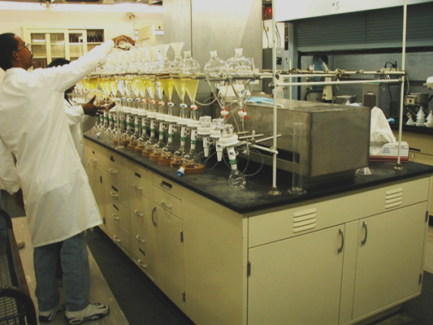
Never Reach Outside Reach Zone?
Of course, the answer is NO!
Find yourself
Reaching way outside reach zone
Heavy load
Awkward position
Set up to work within your Reach Zone
Notes:
Are we saying never reach outside your reach zone? Of course, the answer is NO!
But if you find yourself reaching way outside your reach zone with a heavy load in an awkward position think about ways to decrease the reach distance.
In general, set up as much as possible to work within your Reach Zone. We’ll examine specific lab related situations a little later in the session.

Slide 19
Power Position
Lift or move supplies, containers and equipment?
Neutral Position best position?
As it turns out – it’s not
Power Position is better
Notes:
So far, we have outlined the ergonomics principle of Neutral Position and Support and Reach Zone.
But what about if you have to lift or move supplies, containers and equipment?
Is the Neutral Position really the best position for this kind of activity?
As it turns out – it’s not.
From the body’s perspective the third ergonomics principle, Power Position is a better way to go.

Slide 20
Power Position
Feet shoulder width or slightly wider
Good footing so you don’t slip
Spine maintained in neutral
Hips and knees bent slightly
Head and shoulders upright
Notes:
Here’s what the Power Position looks like:
Feet shoulder width or slightly wider.
Good footing so you don’t slip.
Spine maintained in neutral.
Hips and knees bent slightly.
Head and shoulders upright.

Slide 21
“Ready” Position in Sports
Ready position in sports
Use Power Position
Lifting materials
Using tools and equipment
Setting up the work area
Water fountain
Give it a try!
Notes:
In fact, this position is used in just about any sport as a “ready” position.
We’ll examine how you can use the Power Position in many ways – lifting materials but also, for using tools and equipment and setting up the work area.
You can even use the power position to get a drink at the water fountain! Rather than just bending over at the waist with your knees straight – stressing your lower back – use the power position.
Give it a try!

Slide 22
Fatigue Control
“Control” and not “Eliminate”
Physical fatigue is normal occurrence
Not possible to eliminate fatigue
For overall health and wellness
Recover from fatigue through appropriate rest, hydration and nutrition
Notes:
So far, we have gone over the ergonomics principles of Neutral Position and Support, Reach Zone and Power Position.
The last principle is Fatigue Control.
You’ll notice we’re using the word “Control” and not “Eliminate” when discussing fatigue.
Physical fatigue is a normal occurrence in the routine of our lives. It is not possible to eliminate fatigue.
For overall health and wellness, we need to recover from fatigue through appropriate rest, hydration and nutrition.

Slide 23
Recognize Fatigue?
Physical and/or repetitive tasks
Muscle tiredness
Decrease in general physical strength and coordination
More prone to making mistakes
More likely to experience injuries
Notes:
First, how do you recognize fatigue? Physical fatigue is demonstrated when physical and/or repetitive tasks result in muscle tiredness.
We experience a decrease in general physical strength and coordination.
We are more prone to making mistakes.
We may be more likely to experience injuries.

Slide 24
What Can You Do to Control Fatigue?
Mix up job tasks to provide variety of physical activities
Break larger task into smaller tasks
Alternate lab tasks, like pipetting between right and left hands
Appropriate recovery breaks
Replenish energy supplies and fluid intake
Try to not skip breaks and lunch
Notes:
What can you do to control fatigue?
Try to mix up job tasks to provide a variety of physical activities. This is called job rotation. Break a larger task into smaller tasks.
For example, when possible alternate lab tasks, like pipetting between right and left hands.
Make sure you take appropriate recovery breaks to give your body a chance to replenish energy supplies and fluid intake.
In other words, try to not skip breaks and lunch.

Slide 25
What Can You Do to Control Fatigue?
Drink plenty of fluid on periodic basis
Stretching
Promote blood circulation and joint lubrication
Consciously work to identify and control fatigue at work!
Notes:
Drink plenty of fluid on a periodic basis. If you are thirsty you are on your way to dehydration.
Use stretching to promote blood circulation and joint lubrication.
Look at the Physical Fitness, Health and Wellness and Stretching sections for details about using stretching as a part of your overall fatigue control strategy.
Consciously work to identify and control fatigue at work.

Slide 26
Use Ergonomics Principles
Ergonomics is all about “fitting job to the person” and “working smarter not harder”
Four ergonomics principles
Neutral Position and Support
Reach Zone
Power Position
Fatigue Control
Guide how to safely and effectively do your work
Notes:
So, ergonomics is all about fitting the job to the person and working smarter not harder.
We’ve discussed four ergonomics principles:
Neutral Position and Support
Reach Zone
Power Position and
Fatigue Control
You can use these principles to help guide how to safely and effectively do your work.
Check out the Tips and Techniques Section for additional examples.

Slide 28
Warm-up and Stretching
Benefits
Minimizes likelihood of injury
Enhances performance
Specifically doing to warm up and stretch as part of job?
If the answer is . . . nothing
Increasing risk of suffering musculoskeletal disorder
Limiting level of job performance
Notes:
Anyone who plays a sport knows the importance of warming up and stretching for two primary reasons:
It minimizes the likelihood of injury and enhances performance.
Your job certainly involves physical activity. What are you doing specifically to warm up and stretch as part of your job?
If the answer is . . . nothing, you are increasing the risk of suffering a musculoskeletal disorder and limiting the level of your job performance.

Slide 29
Warm-up and Stretching
Stretching not only primes body:
Increases blood flow to working tissues providing more oxygen and nutrition
Loosen joints to decrease stiffness
Improve alertness levels through increased levels of oxygen in blood going to brain
Think of it, all of this just from stretching!
Notes:
Stretching not only primes the body:
It also increases blood flow to the working tissues providing more oxygen and nutrition
It helps to loosen the joints to decrease stiffness and
It helps to improve alertness levels through increased levels of oxygen in the blood going to the brain.
Think of it, all of this just from stretching.

Slide 31
Physical Fitness and Health and Wellness
Well-balanced Physical Fitness Program
Job provide all components of well-rounded, well-balanced physical fitness program?
More than likely the answer is NO
Individuals with balanced personal physical fitness less likely to sustain injury
Strength, flexibility and aerobic endurance
Notes:
When we talk about overall personal physical fitness does your job provide all the components of a well-rounded, well-balanced physical fitness program?
Does it provide all the strength, flexibility and heart and lung fitness you need?
More than likely the answer is NO.
Many studies have shown that individuals with balanced personal physical fitness are less likely to sustain an injury.
So, physical fitness is a combination of strength, flexibility and aerobic endurance. To better meet your job demands you can perform a variety of exercises at home or a fitness center.

Slide 32
Very Important Point
If you have any health concerns about starting a physical fitness program you should always consult with your health care professional before starting.
Notes:
HERE IS A VERY IMPORTANT POINT: If you have any health concerns about starting a physical fitness program you should always consult with your health care professional before starting.

Slide 33
Personal Health and Wellness
Factors
Adequate diet and nutrition
Body weight control
Stress management
Smoking cessation
Blood pressure control
Adequate rest from sleep and
Fluid intake to avoid getting dehydrated
Factors under our control
Personal physical fitness and health and wellness
Notes:
In addition to physical fitness what about overall personal health and wellness?
It’s up to you: Your personal health and wellness, just like your personal physical fitness, is your personal business.
Here is a list of health and wellness factors to consider:
Adequate diet and nutrition
Body weight control
Stress management
Smoking cessation
Blood pressure control
Adequate rest from sleep and
Fluid intake to avoid getting dehydrated
These are all factors under our control that can help us be healthy and well.
No doubt . . . personal physical fitness and health and wellness are part of an overall strategy for a healthy and safe place to work.

Slide 34
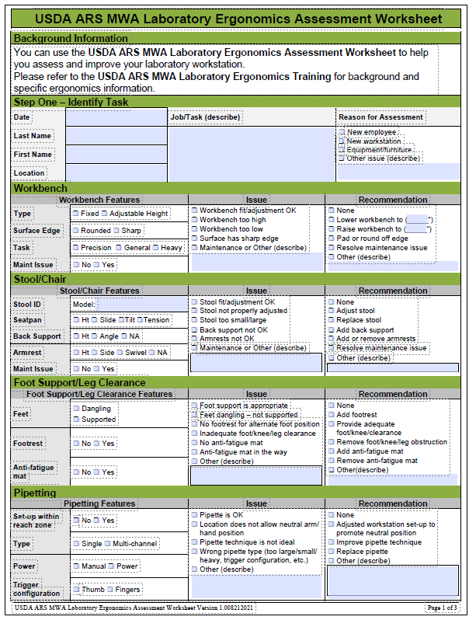
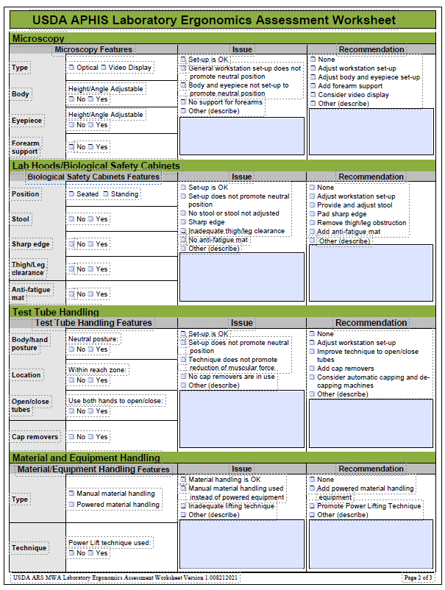
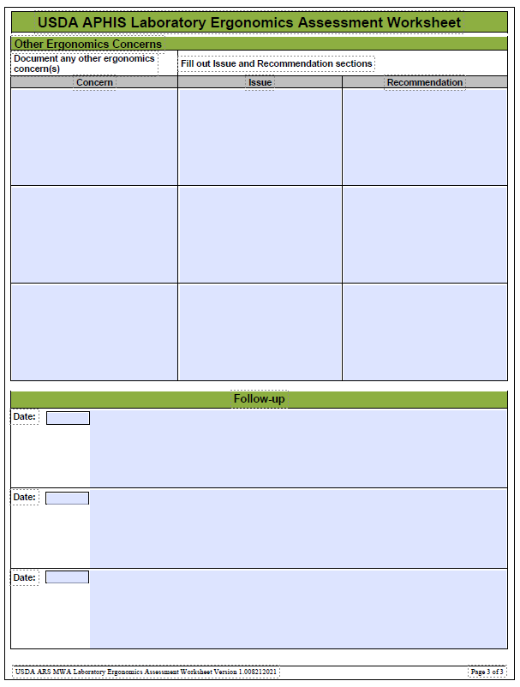
Ergonomics Workstation Assessment
USDA ARS MWA Laboratory Ergonomics Assessment Worksheet
Notes:
Now that you have a handle on the ergonomics principles of Neutral Position, Reach Zone, Power Position and Fatigue Control let’s pull it all together into the ergonomics problem solving approach.
Whether it’s a task you’ve done many times or a brand-new one, take yourself through this step-by-step approach.
We have included the Ergonomics Workstation Assessment Worksheet for you to fill out to complete the assessment.

Slide 35
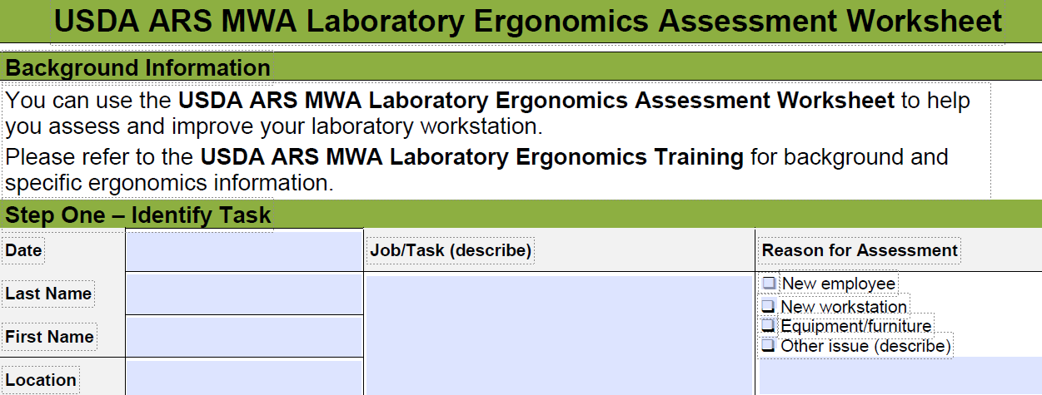
Step One – Identify Task
First step is to identify workstation or task want to analyze
Existing workstation or task
One that is new
Notes:
An obvious first step is to identify the workstation or task you want to analyze.
This could be an existing workstation or task or one that is new.

Slide 36
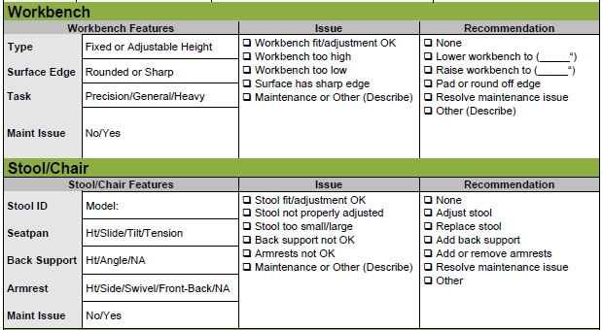
Step Two – Apply Ergonomics Principles
Neutral Position and Support
What is your body and limb position?
Able to reasonably work in Neutral Positions (able to support body and limbs in neutral position)?
If not, try to identify why not
Notes:
What is your body and limb position? Are you able to reasonably work in Neutral Positions (think about the mid-range of joint position concept)?
Are you able to support your and body and limbs in the neutral position?
If not, try to identify why not.

Slide 37
Step Two – Apply Ergonomics Principles
Neutral Position and Support
For example
Is worksurface too low?
Is chair or stool not properly adjusted?
Does tool or equipment not allow neutral position?
Then think about how you can make it better!
Notes:
For example:
Is the worksurface too low?
Is your chair or stool not properly adjusted?
Does the tool or equipment not allow a neutral position?
Then think about how you can make it better.

Slide 38
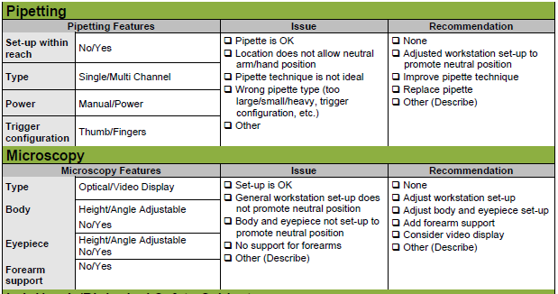
Step Two – Apply Ergonomics Principles
Reach Zone
Where are you using hands?
Primarily use them in Reach Zone?
If not, try to identify preventing factor
For example:
Is work too far away?
Physical barrier that limits access?
Then think about how you can make it better!
Notes:
Where are you using your hands? Are you able to primarily use them in your Reach Zone?
If not, try to identify the preventing factor.
For example:
Is the work too far away?
Is there a physical barrier that limits access?
Then think about how you can make it better.

Slide 39
Step Two – Apply Ergonomics Principles
Power Position
Use Power Position to accomplish task?
If not, try to identify what is the limiting factor
For example:
Is material being handled too low or too high?
Does equipment in use not allow power position?
Then think about how you can make it better
Notes:
Are you able to use the Power Position to accomplish the task?
If not, try to identify why.
For example:
Is the material being handled too low or too high?
Does the equipment in use not allow a power position?
Then think about how you can make it better.

Slide 40
Step Two – Apply Ergonomics Principles
Fatigue Control
Able to Control Fatigue through-out work shift?
If not, what are inhibiting factors
For example:
Using wrong tool or incorrectly
Not taking recovery breaks?
Becoming dehydrated?
Not using stretching as micro-breaks through-out shift?
A combination of above?
What actions can you take to control fatigue?
Notes:
Are you able to Control Fatigue through-out the work shift?
If not, what are the inhibiting factor or factors.
For example:
Using the wrong tool or using a tool incorrectly?
Not taking appropriate recovery breaks?
Becoming dehydrated?
Not using stretching as micro-breaks through-out the shift?
A combination of the above?
What actions can you take to control fatigue?

Slide 41
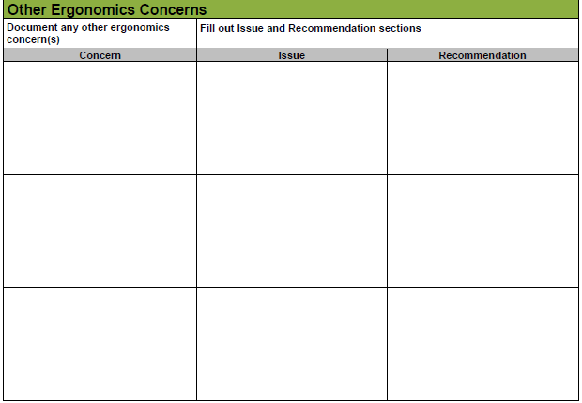
Step Three – Recommend/Implement Improvements
List of potential improvements
Workstation set-up
Particular use of a tool or piece of equipment
Change of workstation, tool or equipment
Notes:
As you were performing the assessment you also were generating a list of potential improvements.
They might consist of workstation set-up improvement, particular use of a tool or piece of equipment or a change of the workstation, tool or equipment.

Slide 42
Practice
Choose a task you would like to analyze
Go through USDA ARS MWA Laboratory Ergonomics Assessment Worksheet
Notes:
Choose a task you would like to analyze and go through the USDA ARS MWA Laboratory Ergonomics Assessment Worksheet.

Slide 44
Laboratory Ergonomics – Tips and Techniques
Ergonomics principles
Neutral Posture, Reach Zone
Power Position, Fatigue Control
Warm-up and Stretching
Physical Fitness and Health and Wellness
Step-by-step ergonomics problem solving approach
Laboratory Ergonomics Tips and Techniques
“Fit the Job to the Person!”
“Work Smarter, Not Harder!”
Notes:
We’ve covered a lot of information . . . the ergonomics principles of Neutral Posture and Support, Reach Zone, Power Position and Fatigue Control as well as information about Warm-up and Stretching, Physical Fitness and Health and Wellness.
We went through a specific step-by-step ergonomics problem solving approach to apply the ergonomics principles.
Next, let’s look at specific Laboratory Ergonomics Tips and Techniques.
See if they can work for you and apply them across the board to, “Fit the Job to the Person!” and “Work Smarter, Not Harder!”

Slide 45
Laboratory Workbenches, Stools and Footrests
Workbenches at fixed height
Workbench user-controlled height adjustable
Stools available
Ensure surface decontamination
Footrests for foot support
Set up workbench, stool and footrest
Neutral position
Reach zone
Power position
Fatigue control
Notes:
Workbenches are commonly used in the lab to support equipment and perform procedures.
In many cases, laboratory workbenches are at a fixed height (typically about 36”) and have been designed using general guidelines suggested by the National Institute of Occupational Safety and Health (NIOSH). In some cases, the workbench may be user-controlled height adjustable.
Generally, stools are available to allow for a seated body position when working at the workbench.
Footrests are also included to provide for foot support when seated on the stool.
Recalling the goal is to “Fit the Job to the Person”, consider how to set up the workbench, stool and footrest to follow the ergonomics principles of neutral position and support, reach zone, power position and fatigue control.

Slide 46
Workbench/Elbow Height Relationship
Based on tasks you are performing
Precision work, need to precisely view hands
Fixed height workbench
Elbow height about 2 to 4 inches above workbench height
Adjustable height workbench
Workbench height so elbows are about 4 to 6” above resting elbow height (this is with arms at sides)
Notes:
First, recognize the relationship between your body and extremity position and the workbench is based on what tasks you are performing.
For a fixed height workbench, for precision work where you need to precisely view your hands, the recommended relationship is with elbow height about 2 to 4 inches above the workbench height.
For an adjustable height workbench, for precision work, adjust the workbench height so the elbows are about 4 to 6” above resting elbow height (this is with the arms at the sides).

Slide 47
Workbench/Elbow Height Relationship
Based on tasks you are performing
General light work
Handling test tubes, pipetting, etc.
Heavy work
Downward force exerted (pushing down on tool or other materials)
Notes:
For general light work (handling test tubes, pipetting, etc.) have the relationship so the workbench is at or slightly below elbow height, about 1 to 2 inches below.
For heavy work where a downward force needs to be exerted (pushing down on a tool or other materials) establish the relationship so the workbench is about 4 to 6 inches below elbow height.

Slide 48
Workbench/Stool/Footrest Adjustment Strategies
Once you understand task to be performed
Follow adjustment strategies based on whether workbench
Fixed height or height adjustable
Notes:
Once you understand the task to be performed follow these adjustment strategies based on whether the workbench is fixed height or height adjustable.

Slide 49
Workbench Fixed Height
Adjust Stool Height
Use height adjustment feature
Establish desired physical relationship between elbow height and workbench height
Other Stool Adjustments
Seat tilt forward and backward
Back support height and angle adjustable
Armrests, height adjustable to provide for forearm support
Notes:
With a fixed height workbench (typically about 36” from the floor), use the height adjustment feature of the stool to establish the desired physical relationship between elbow height and workbench height.
Two to 4 inches above elbow height for precision work, about elbow height or slightly lower for light work and 4 to 6 inches below elbow height for heavy work.
In other words, you use the workbench height as the reference point and adjust the stool and footrest to match.
Check out what other adjustments are on the stool. The seat may be able to tilt forward and backward. The back support may be height and angle adjustable. Armrests may be attached to the stool; if so determine if they are height adjustable to provide for forearm support.
Apply the Neutral Position and Support and Reach Zone ergonomics principles to improve your overall position and support when setting up the stool.

Slide 50
Workbench Fixed Height
Most important guideline for stool use
Get out of it on a regular basis!
Limit sustained seated positions to 30 minutes or less
Leg/Foot Clearance
Foot Support
Foot ring primarily there to help you get on and off seat of stool
Adjust footrest height
Footrest and foot ring should be about same height
Notes:
Remember the most important guideline for stool use is . . . get out of it on a regular basis! Try to limit sustained seated positions to 30 minutes or less. This is part of the Fatigue Control principle.
You may find obstacles (drawers, supplies and other materials) underneath workbenches that limit leg and foot access.
They need to be removed or relocated.
While most stools do have a foot ring under the seat, it does not provide for comfortable, long-term foot support.
The foot ring is primarily there to help you get on and off the seat of the stool.
Use a height adjustable footrest to provide for foot and leg support. Adjust the footrest height so when your feet are supported on the footrest you have even body weight through your thighs and hips on the seat of the stool. The footrest and foot ring should be about the same height.

Slide 51
Workbench Adjustable Height
Adjust Stool Height
Stool may not go lower enough to get feet on floor
Need footrest for adequate foot support
Other Stool Adjustments
Seat tilt forward and backward
Back support height and angle adjustable
Armrests, height adjustable to provide for forearm support
Adjust Workbench Height
Notes:
In some labs, the workbench may be height adjustable and now the floor becomes the reference point for workbench set-up.
Follow this strategy.
Determine if you can adjust the stool height to get your feet directly on the floor.
This eliminates the need for foot support on a footrest.
Now, in some cases the stool may not go lower enough to get your feet on the floor, and you will still need a footrest for adequate foot support.
Next, adjust the workbench height based on the task at hand to establish the desired physical relationship between elbow height and workbench height.
For precision work, adjust the workbench height so the elbows are about 2 to 4” above resting elbow height (this is with the arms at the sides), for light work about elbow height or slightly lower and for heavy work about 4 to 6 inches below elbow height.
Check out what other adjustments are on the stool.
The seat may be able to tilt forward and backward.
The back support may be height and angle adjustable.
Armrests may be attached to the stool; if so determine if they are height adjustable to provide for forearm support.
Apply the Neutral Position and Support and Reach Zone ergonomics principles to improve your overall position and support when setting up the stool.
Remember the most important guideline for stool use is . . . get out of it on a regular basis!
Try to limit sustained seated positions to 30 minutes or less.
This is part of the Fatigue Control ergonomics principle.

Slide 52
Workbench Adjustable Height
Leg/Foot Clearance
Removed or relocated
Foot Support
Best place is on the floor
Footrest may be required
Provide for adequate foot support
Notes:
You may find obstacles (drawers, supplies and other materials) underneath workbenches that limit leg and foot access. They need to be removed or relocated to provide for the needed clearance.
Ideally, the best place for the feet is directly on the floor; however, even with height adjustable workbenches this may not be possible. In this case a footrest will be required to provide for adequate foot and lower extremity support.

Slide 53
Standing at a Workbench
Standing makes sense
Spending only a short time (a few minutes)
Move frequently between different locations at workbench
Handle heavier items (more than 5 pounds)
Need to exert significant downward force (more than 10 pounds of force)
Notes:
Some tasks may involve standing at a workbench.
Typically standing makes sense if you are spending only a short time (a few minutes) in the standing position, move frequently between different locations at the workbench, handle heavier items (more than 5 pounds) at the workbench or when you need to exert significant downward force (more than 10 pounds of force) at the workbench.

Slide 54
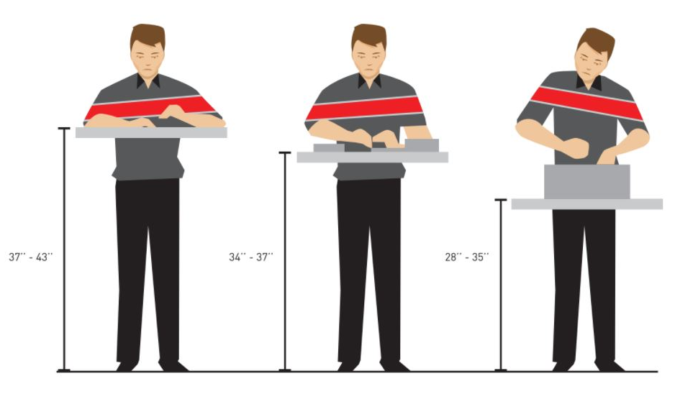
Workbench Height – Standing
Apply same elbow and workbench height relationships for standing as for seated
Precision work: 2 to 4” above elbow height
General light work: about elbow height or slightly lower
Heavy work: 4 to 6 inches below elbow height
Notes:
As possible, try to apply the same elbow and workbench height relationships for standing as for seated workbenches: 2 to 4” above elbow height for precision work, about elbow height or slightly lower for light work and 4 to 6 inches below elbow height for heavy work.

Slide 55
Workbench Height – Standing
Too low fixed height workbench
Build up workbench height
Platform on workbench top to position tools, equipment or materials
Entire workbench itself raised on permanent basis
Notes:
For a fixed height workbench that is too low for the needed task, it may be possible to build up the workbench height by placing a platform on the workbench top to position the tools, equipment or materials at the desired height.
In some instances, the entire workbench itself can be raised on a permanent basis.
Of course, before doing this consult with others in the lab to make sure it won’t raise unintended consequences for others using the workbench.
And of course, if it is raised up ensure it is stable at the higher height.

Slide 56
Footrests – Standing
Promote neutral position and increased comfort when standing
Footrest to put one foot up on footrest and then alternate with other foot
Utilize footwear with significant cushioning and support
Good walking shoes are good standing shoes
Shift weight forward to balls of feet and backwards to heels
Perform “heel lifts” frequently
Notes:
A great way to promote neutral position and increased comfort when standing is to provide a footrest that will allow you to put one foot up on the rest and then alternate with the other foot.
This promotes varied standing postures and intermittently redistributes weight-bearing stresses.
Utilize footwear that has significant cushioning and support.
If they are good walking shoes, they will also be good standing shoes.
Shift weight forward to the balls of the feet and backwards to the heels when standing on both feet or alternately when standing with one foot in front of the other.
Perform “heel lifts” frequently. This will improve lower extremity circulation.

Slide 57
Anti-fatigue Mats – Standing
Anti-fatigue standing mats cushion feet and joints of ankles, knees, hips and back
Large enough to allow for at least shoulder width foot placement
Beveled mat edges to eliminate any trip hazard
Adequate cleaning of mat and underlying floor
Notes:
At workbenches where sustained standing is performed, consider adding anti-fatigue standing mats to cushion the feet and weight bearing joints of the ankles, knees, hips and back.
Mats should be large enough to allow for at least shoulder width foot placement.
Mat edges should be beveled to eliminate any trip hazard.
Adequate cleaning of the mat and underlying floor on a regular basis is necessary to provide for appropriate hygiene.

Slide 58
Anti-fatigue Mats – Standing
Stools and mats
Most stools will not roll easily on mats
Mat is pushed out of the way and not used as it should be
More sustained standing than is recommended occurs
Notes:
A last comment about mats; mats and stools don’t play well together in the same neighborhood.
Most stools will not roll easily on the mats and the result is either the mat is pushed out the way and not used as it should be or more sustained standing than is recommended occurs because of the difficulty in rolling the stool into place.
In this case, eliminating the mat and ensuring footwear with significant cushioning and support is a viable option.
Another option is to secure a mat that can easily be moved and replaced by using your foot, rather than bending over.

Slide 60
Pipetting
Pipetting – Common Task
Pipetting is very common task in lab
Repetitive nature, can be a source of hand and shoulder problems
Notes:
Pipetting is a very common task in the lab.
Because of the repetitive nature of pipetting, it can be a source of hand and shoulder problems.

Slide 61
Pipettes – Workstation Set-up/Work Practices
Equipment, tray and supply heights
About same height
Within easy reach in logical work order
Prevent twisting and bending of wrist, neck and arms, elevation of shoulders and overreaching
Adjusting height and position of tools and equipment
Notes:
To set-up the pipetting workstation, equipment, tray and supply heights should all be approximately the same and these items should be within easy reach in a logical work order.
Prevent twisting and bending of the wrist, neck and arms, elevation of the shoulders, and overreaching, by adjusting the height and position of various tools and equipment.

Slide 62
Pipettes – Workstation Set-up/Work Practices
Adjusting height and position of various tools and equipment
Sample holders (placed on tilt)
Solution container positioned within reach
Waste receptacles – kept at low height (no higher than top of tube being filled)
Work with arms close to body
Avoid arm elevation without support for lengthy periods
Keep samples and instruments within easy reach
Notes:
This can include:
Sample holders (placed on a tilt)
Solution containers positioned within reach
Waste receptacles – kept at a low height (no higher than top of tube being filled)
Work with the arms close to the body
Avoid arm elevation without support for lengthy periods
Keep samples and instruments within easy reach

Slide 63
Pipette Design – Choices
Hand size
Correlating hand size to pipette size
Different sizes available
Correct size pipette will allow hand to comfortably grasp/manipulate pipette
Weight
Light weight as possible
Force
Little force required as possible
Notes:
Considerations for pipette design choices are highly individual:
Correlating hand size to pipette size is most important.
Different sizes are available.
The correct size pipette will allow your hand to comfortably grasp and manipulate the pipette.
As possible use a lightweight pipette; this requires less force to hold.
As possible use a pipette that requires as little force as possible to control.

Slide 64
Pipette Design – Choices
Location of Controls
Multi-finger pipette controls help distribute force
Among several fingers rather than continuously using same finger
Button on top requires thumb to be repeatedly extended out of a relaxed, neutral position
Try to avoid
Limit sustained use as possible
Notes:
Multi-finger pipette controls help distribute the force among several fingers rather than continuously using the same finger.
Some pipettes have a button on the top which may require the thumb to be repeatedly extended out of a relaxed, neutral position.
Try to avoid this type and if not possible to avoid entirely, remember to limit sustained use as possible.

Slide 65
Pipette Design – Configuration Choices
Shorter vs Longer
Longer pipettor with longer handle
Better on shoulder and arm
Using 50-100 ml
Multi-channel pipettes
Microtiter plates
Robotics
Notes:
Pipettes
The longer pipettor with longer handle versus the standard is better on the shoulder and arm when using 50-100 ml pipettes.
Multi-channel pipettes are good for microtiter plates and also robotics.

Slide 66
Pipetting – Guidelines
Pipettes where thumb dispenses and index finger aspirates
Pipette usage alternated between right and left hand
Clean pipettes regularly to reduce "sticking" and improve quality of work
Use thin-walled pipette tips that are easy to eject
Notes:
In general, here are some overall guidelines for pipette use:
Pipettes where the thumb dispenses, and the index finger aspirates are best
Pipette usage should be alternated between the right and left hand
Clean pipettes regularly to; reduce "sticking" and improve quality of work
Use thin-walled pipette tips that are easy to eject

Slide 67
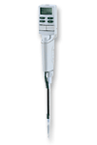
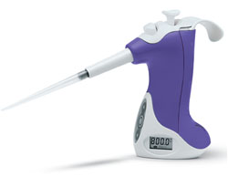
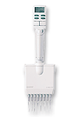
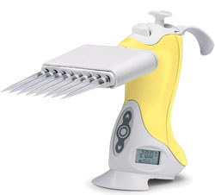
Manual vs Power Pipettes
Power pipettes rather than manual pipettes help to reduce hand stress and exertion
Electronic operated or a latch-mode pipette to replace manual plunger-operated pipettes
Electronic pipette with mixing functions for tasks such as mixing or aliquotting
Multichannel pipette for large aliquotting tasks
Notes:
Power pipettes rather than manual pipettes can help to reduce hand stress and exertion.
If possible, use an electronic operated or a latch-mode pipette to replace manual plunger-operated pipettes, use an electronic pipette with mixing functions for tasks such as mixing or aliquotting and use a multichannel pipette for large aliquotting tasks.

Slide 68
Microbreaks and Task Rotation
Focus on Fatigue Control throughout day
Micro-breaks of 2 minutes for every 20 minutes of pipetting
Perform hand stretches frequently
Rotate pipetting activities
Between right and left hands
Among different laboratory tasks
Different people
Notes:
Focus on Fatigue Control throughout the day.
Take micro-breaks of 2 minutes for every 20 minutes of pipetting.
Perform hand stretches frequently.
Rotate pipetting activities between right and left hands, among different laboratory tasks and different people to reduce the overall exposure to the task.

Slide 70
Microscopy
Microscopy – Common Task
Operating microscope is very common task Potential exists for strain
Neck
Shoulders
Eyes
Lower back
Arms
Wrists
Notes:
Operating a microscope is a very common task in the lab.
Potential exists for strain of the neck, shoulders, eyes, lower back, arms and wrists.

Slide 71
Microscope Set-up Before and After Example
Working at microscope that is not at correct height and angle results in
A hunched-forward position, uncomfortable position of neck, shoulders, arms, back and hips
Contact stress on forearms from work surface edge
Before
After
Notes:
Look at the before and after microscope set-up example.
Very apparent, isn’t it, which one looks comfortable, safe and productive.
Working at a microscope that is not at the correct height and angle results in:
A hunched-forward position, uncomfortable position of the neck, shoulders, arms, back and hips.
Contact stress on the forearms from the work surface edge.

Slide 72
Microscopy – Workstation Set-up
Multi-user
Variety of individuals in lab
Critically important each user take time to set-up microscopy workstation for their unique needs
Notes:
Most microscopes will be used by a variety of individuals in the lab.
As a result, it is critically important that each user take the time to set-up the workstation for their unique needs.
Applying the ergonomics principles of Neutral Position and Support, Reach Zone, Power Position and Fatigue Control to the set-up process will enhance the comfort, safety and productivity of microscope use.

Slide 73
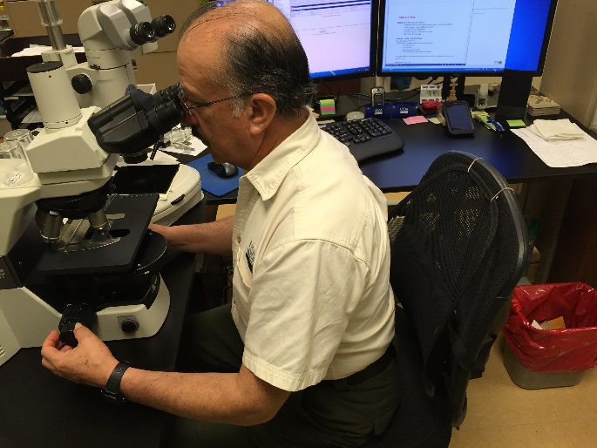
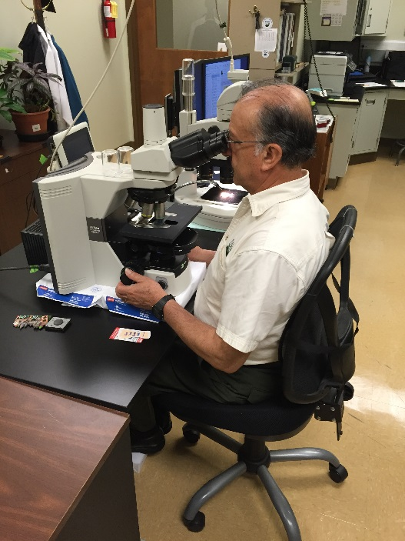
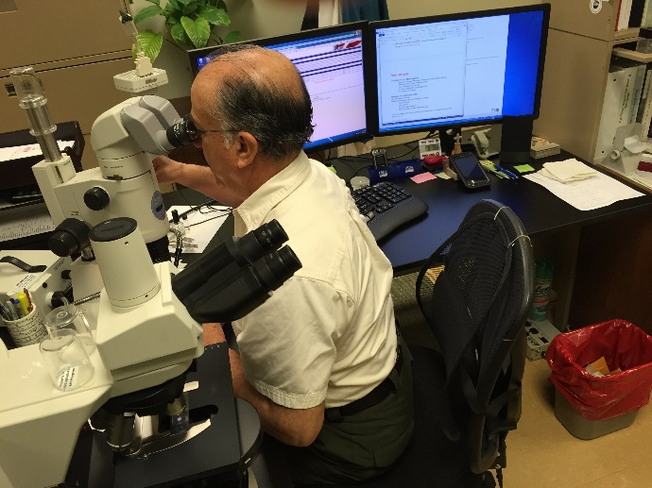
Microscope Step-by-Step Set-up Protocol
Understand Adjustment Options
Analyze current set-up to make sure you fully understand what adjustment options exist
Height and angle of microscope itself
Microscope eyepiece height and angle
Stool or chair seat height, back support and armrests
Worksurface
Notes:
Follow this step-by-step set-up protocol for microscope use.
First analyze the current set-up to make sure you fully understand what adjustment options exist. For example, can you adjust the height and angle of the microscope itself, the microscope eyepiece height and angle, the stool or chair seat height, back support and armrests and/or the worksurface?

Slide 74
Neutral Position/Support, Reach Zone
Microscope adjustment
Adequate room for legs so you can sit directly under microscope
Adjust stool or chair
If needed, provide footrest
Position microscope towards edge of work surface
Position head upright and line of sight approximately 20 to 30º below straight-ahead vision
Notes:
Once you have a handle on what adjustment options exist:
Position the scope so you have adequate room for your legs so you can sit directly under the microscope
Adjust the stool or chair to enhance neutral body position and support
Provide a footrest if needed to ensure adequate foot and leg support
Position the microscope towards the edge of the work surface to allow for neutral head and neck position
Position your head upright and your line of sight approximately 20 to 30º below straight-ahead vision

Slide 75
Neutral Position/Support, Reach Zone
Microscope adjustment
Adjust microscope to match neutral head and neck position
Adjust eyepieces and angle of view
Use chair armrests to support forearms with elbows at sides
Apply padding (foam rolls or padded edge protectors) to edge of work surface
Padded angled microscope forearm supports to relieve fatigue and strain
Notes:
Adjust the height of microscope to match your neutral head and neck position; the microscope maybe on a vertical support bar or an adjustable height platform.
Adjust the eyepieces and angle of view to allow for a balanced position of your head on your shoulders.
If they can be adjusted, use chair armrests to support your forearms with elbows at your sides.
If your forearms are in contact with edge of the worksurface, apply padding (foam rolls or padded edge protectors) to the edge of the work surface.
If chair armrests interfere with your arms, remove them from chairs and consider use of padded angled microscope forearm supports to relieve fatigue and strain.

Slide 76
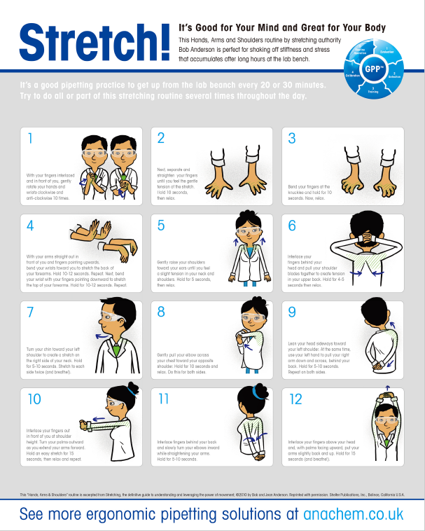
Fatigue Control
Employ fatigue control measures
Take 2-minute micro-breaks every 20 minutes of microscope use
Stretch to promote circulation and reduce joint stiffness
Rotate between variety of laboratory tasks
Mix it up throughout day
Notes:
Employ your fatigue control measures.
Take a 2-minute micro-break every 20 minutes of microscope use.
Stretches are beneficial to promote circulation and reduce joint stiffness.
Rotate between a variety of laboratory tasks.
Mix it up throughout the day.

Slide 77
Microscopy – Other Tips
Other Tips
Tilt storage bins toward you
Enlarge handle diameter of small hand tools by placing cylindrical foam around them
Make simple tool modifications
Notes:
Here are some other tips.
Tilt storage bins toward you to reduce awkward postures while reaching for supplies.
Enlarge the handle diameter of small hand tools by placing cylindrical foam around them.
Make simple tool modifications if you are not able to keep your wrists straight.

Slide 78
Microscopy – Control Eye Strain
Visually intensive
Scope is clean
Lighting is adequate
Microscope lamp and optical pathway correctly aligned
Looking at distance point (more than 10 to 15 feet away) allows eyes to relax
Notes:
Microscope use is obviously very visually intensive.
Work to control eye strain.
Make sure the scope is clean, lighting is adequate, and the microscope lamp and optical pathways are correctly aligned.
Give your eyes a break by periodically looking at a distance point (more than 10 to 15 feet away).

Slide 79
Microscopy – Control Eye Strain
Control excessive glare and reflections from overhead lighting
Adjust internal microscope light
Temperature and humidity conditions affect eyes
Ambient temperature range of 66 to 73º Fahrenheit is suggested
Eye drops can be beneficial for some, but should not be applied in the lab environment
Notes:
Check the lab environment for excessive glare and reflections from overhead lighting and adjust the internal microscope light to compensate.
Temperature, humidity, air currents, ventilation, excessive noise, and ambient lighting levels affect operator comfort and fatigue.
Temperature range of 66 to 73º Fahrenheit is suggested.
Low humidity conditions lead to drying of the eyes; eye drops can be beneficial for some but should not be applied in the lab environment.

Slide 80
Video Display Microscopy
Becoming more viable with technological improvements
When possible, use video display terminal to view sample
Monitor placement
Top of screen is about at eye level
Viewing distance about 24 to 28 inches
Positioned directly in front
Notes:
Video display microscopy is becoming more viable with technological improvements.
When possible, use a video display terminal to view the sample.
Place the display monitor so the top of the screen is about at eye level, viewing distance is about 24 to 28 inches and the display positioned directly in front of you so you can look straight ahead, not turning your head to the side
Overall, take the time to set-up the microscope workstation for your unique needs. It is time well spent!

Slide 82
Lab Hoods or Biosafety Cabinets
An integral part of lab
Similar hazards as for microscope work
Hunched postures
Forward reaches
Ergonomics principles enhance use
Notes:
An integral part of the lab is the use of lab hoods or biosafety cabinets (BSCs).
Similar hazards as for microscope work are seen with hunched postures and forward reaches.
Ergonomics principles of Neutral Position and Support, Reach Zone, Power Position and Fatigue Control go a long way to enhance BSC use.

Slide 83
Lab Hoods or BSCs – Work Practices and Tips
Work practices and tips
If standing at lab hood or BSC, use anti-fatigue matting and wear supportive shoes
Position materials as close as possible to avoid extended reaching
Use a turntable to store equipment close at hand, this prevents reaching and twisting
Notes:
Follow these work practices and tips.
If standing at the BSC, use anti-fatigue matting and wear supportive shoes.
Position materials as close as possible to avoid extended reaching.
Use a turntable to store equipment close at hand. This prevents reaching and twisting.

Slide 84
Lab Hoods or BSCs – Work Practices and Tips
Reduce contact stress to forearms & wrists
Apply closed-cell foam padding to the front edge of lab hood or BSC
Make sure padding can be decontaminated
Armrests
Support arms at correct height and angle
Do not restrict air flow
Bubble wrap that is disposable and inexpensive
Notes:
To reduce contact stress to forearms and wrists:
Apply closed-cell foam padding to the front edge of the BSC.
Make sure the padding can be decontaminated.
Attach external armrests to the cabinet to support the arms at the correct height and angle.
Make sure they do not restrict air flow. Where decontamination is a problem, consider the use of bubble wrap that is disposable and inexpensive.

Slide 85
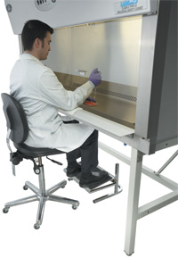
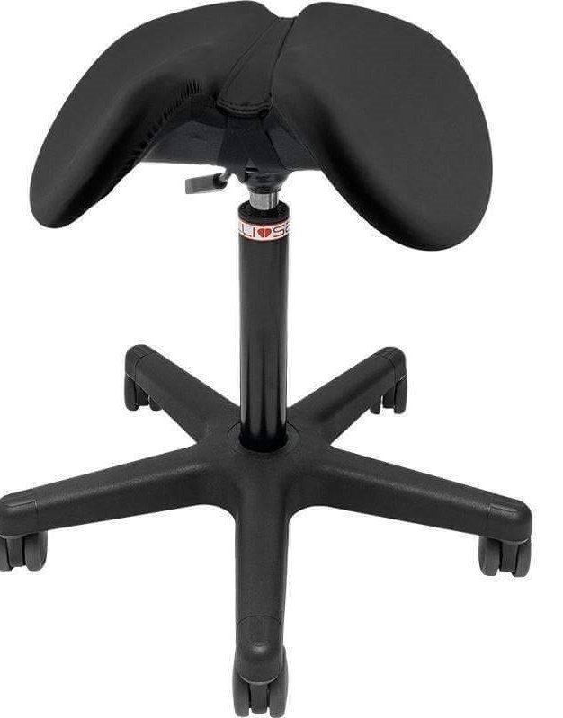
Lab Hoods or BSCs – Work Practices and Tips
Seated at BSC
Fully adjustable chair or stool
Provides adequate back support, adjustable seat angle, and height adjustability
Adequate leg and thigh clearance under cabinets
Raise cabinet couple of inches if necessary and possible
Use footrest to provide stability in leaning forward from hips
Chair/stool options
Sit-stand stools (Salli or Bambach)
Notes:
If seated at the BSC, use a fully adjustable chair or stool that provides adequate back support, adjustable seat angle, and height adjustability.
Ensure adequate leg and thigh clearance under the cabinet.
Raise the cabinet a couple of inches if necessary and possible
Use a footrest, not the chair ring, to provide stability in leaning forward from the hips.
This reduces pressure on the back of the legs.
Consider the use of a seat height and angle adjustable sit-stand stool such as the Salli or Bambach Stool.

Slide 86
Newer BSCs
Height adjustable tables with downdraft or backdraft
Eliminate bent, forward posture of traditional BSCs
Other improvements
Perforated front grill reduced by 1-2 inches allows work platform to be closer to worker
Non-glare glass on sash window
Adjustable plexiglass barriers
Platform with wells for placement of tall containers to reduce reaching
Notes:
Newer BSCs that have height adjustable tables with downdraft or backdraft rather than the traditional updraft exhausting are being seen more and more.
They eliminate the bent, forward posture of traditional BSCs.
Other improvements are a perforated front grill reduced by 1-2 inches that allows the work platform to be closer to the worker, non-glare glass on the sash window, adjustable plexiglass barriers and a platform with wells for placement of tall containers to reduce reaching.
Use ergonomics to your advantage when using BSCs.

Slide 87
Test Tube Handling Tips
Body posture
Adjust chair properly to provide adequate back support
Remove chair arms if interfere with ability to get close to work
Arrange tubes
Open/close test tubes
Use both hands to open and close
Rotate cap in one direction with one hand while rotating tube in opposite direction with other hand
Notes:
Handling test tubes is a very common task in the lab. Here are some ideas to enhance test tube handling.
Whole body posture comes into play. Adjust the chair properly before you start work so it provides adequate back support.
Remove the chair arms if they interfere with the ability to get close to your work.
Arrange tubes to minimize reaching and twisting by placing them as close as possible to you. Use a container to raise test tube racks when necessary.
When possible use a vortexer mixer rack instead of holding tubes by hand.
Use both hands to open and close test tubes to lessen the stress on one hand or the other.
Rotate the cap in one direction with one hand while rotating the tube in the opposite direction with the other hand.

Slide 88
Test Tube Handling Tips
Cap Removers
Use cap removers to minimize pinch grip and stress on fingers
Example is Gilson's Jimmy microtube opener
https://www.pipettesupplies.com/product/jimmy-microtube-opener-for-pipetman-pipettes-3-pack-gilson/
Automatic/powered capping/decapping equipment
If screwing many similar microtubes, automatic/powered capping and de-capping equipment may be appropriate
Notes:
Use cap removers to minimize pinch grip and stress on the fingers.
An example is the Gilson's Jimmy microtube opener. See Resources page for link.
If screwing many similar microtubes, automatic or powered capping and de-capping tools and equipment may be appropriate.

Slide 89
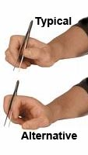
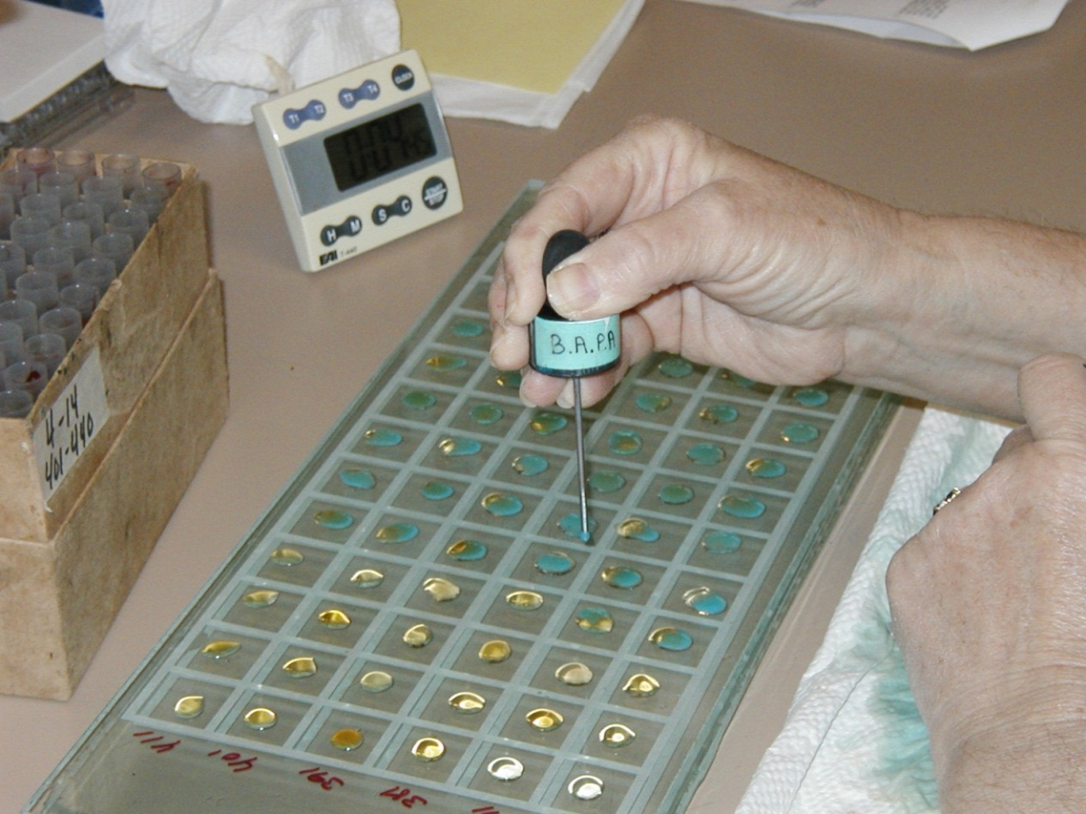
Micro-manipulation & Fine Motor Skills
Considerations
Use plastic vials with fewer threads to reduce twisting motions during capping and uncapping lids
Tilt storage bins toward you to reduce wrist flexion while reaching for supplies
For forceps manipulation, use small pieces of foam, like type used on pencils and pens
Practice using forceps between index and middle fingers instead of using thumb and index finger
Notes:
Here are some miscellaneous tips for micro-manipulation of materials and tools that involves fine motor skills.
Use plastic vials with fewer threads to reduce twisting motions during capping and uncapping lids.
Tilt storage bins toward you to reduce wrist flexion while reaching for supplies.
For forceps manipulation, use small pieces of foam, like the type used on pencils and pens to prevent soreness on the fingertips.
Practice using forceps between the index and middle fingers instead of using the thumb and the index finger.

Slide 91
Material and Equipment Handling
What is very first guideline for safe material handling?
What is the safest lift you can do?
It’s the one you don’t do!
As appropriate, make sure you use equipment available to assist with or accomplish lift
Notes:
Next let’s get into the specifics of using ergonomics principles for material and equipment handling.
Lifting, pushing, pulling, carrying.
First though, what is the very first guideline for safe material handling?
Think of it this way.
What is the safest lift you can do? It’s the one you don’t do!
As appropriate, make sure you use the equipment available to assist with or accomplish the lift.

Slide 92
Material and Equipment Handling
Lift cart
Pneumatic lift for heavy objects to move around the lab
Notes:
Lift cart with pneumatic lift for heavy objects to move around the lab.

Slide 93
Material and Equipment Handling
Assistive devices that may be appropriate
Better to have a device do the lift than the human
Notes:
With any situation, always please use lift assistive devices that may be appropriate, for example hydraulic or pneumatic lifts.
Better to have a device do the lift than the human.

Slide 94
Material and Equipment Handling – Tools
Correct tool for the job
Compressed gas cylinder wrench
Notes:
Correct tool for the job used correctly. For example a compressed gas cylinder wrench.

Slide 95
Up-front Planning with Manual Handling
Front planning minimizes stress and strain
Allows you to get assistance if you need it
Understand your personal physical performance limit
If you exceed your limit, significantly increase risk of injury
Literally takes only a quarter of a second for a life-changing injury to take place
If you need help. . . get it!
Notes:
When you do any type of material handling, up front planning goes a long way to minimize stress and strain and allows you to get assistance if you need it.
Understand what your personal physical performance limit truly is.
If you exceed your limit, you significantly increase your risk of injury. It can literally take only a quarter of a second for a life-changing injury to take place.
If you need help. . . get it!

Slide 96
Power Lift Technique
Task within your personal performance limit
What is best technique?
Professional weightlifters
Power Lift makes use of Power Position
Up-front planning
Need to use mechanical equipment or get someone to help you
You have thought through where material is going to end up
You have anticipated any surprises
Notes:
So, at this point you have determined the manual material handling task is within your personal performance limit and you are going to handle it.
What is the best technique to use?
Let’s turn to the technique commonly used by professional weightlifters.
They call it the Power Lift. It makes use of the ergonomics principle of the Power Position.
Remember you have done your up-front planning to decide if you need to use mechanical equipment or get someone to help you.
You have thought through where the material you are gong to handle is going to end up.
You have anticipated any surprises.

Slide 97
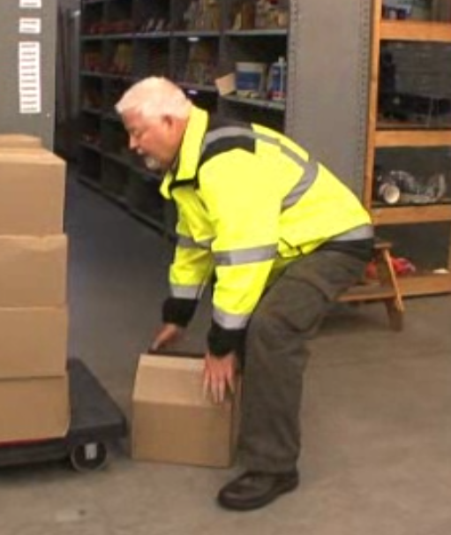
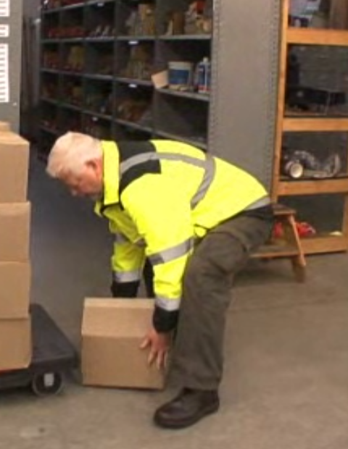
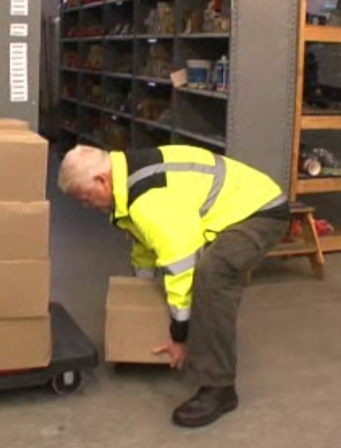
Power Lift – Step-By-Step Details
Power Lift
Approach object with feet slightly wider than shoulder width
Good footing
Straddle object
Bend hips and knees somewhat, reach hands to object
Grip object, might be at a diagonal
Build “bridge” with elbow on knee to unload back
Notes:
All right, first step . . . approach the object with your feet slightly wider than shoulder width.
Make sure you have good footing.
Straddle the object as much as possible almost making it a part of you.
Now bend your hips and knees somewhat and reach your hands to the object.
Figure out the best way to grip the object. This might be at a diagonal.
You can also build a bridge with your elbow on your knee to unload your back as you get your grip.

Slide 98
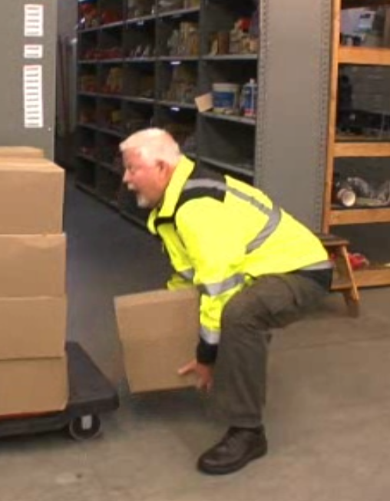
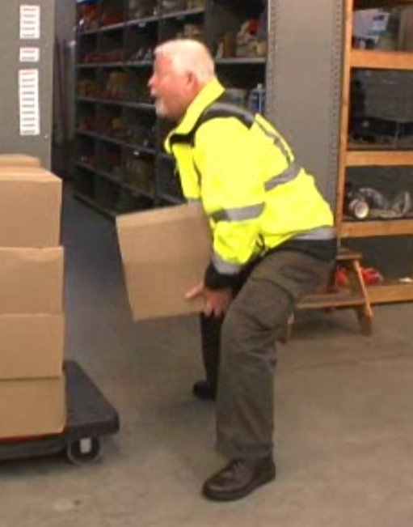
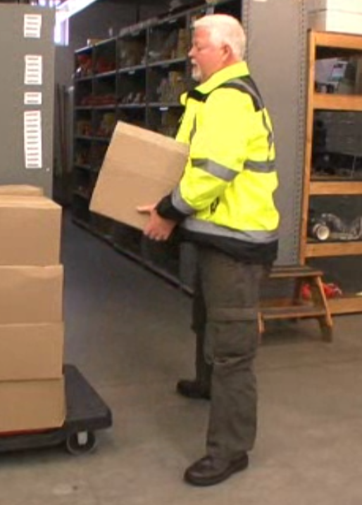
Power Lift – Step-By-Step Details
Power Lift
Keep object as close as possible
Tighten up stomach muscles
At moment of exertion . . . LOOK UP!
Why LOOK UP
Automatically puts you into Power Position
Use large muscles of legs and thighs to accomplish lift
Back muscles work with stomach muscles to stabilize your spine
Notes:
Your goal is to keep the object as close as possible to you.
Tighten up your stomach muscles.
You are now ready to lift!
One last critical step. . . at the moment of the exertion . . . LOOK UP.
Look up as you lift.
Looking up will automatically put you into the Power Position and you will use the large muscles of your legs and thighs - not your back to accomplish the lift.
Your back muscles will work with your stomach muscles to stabilize your spine in the neutral position.

Slide 99
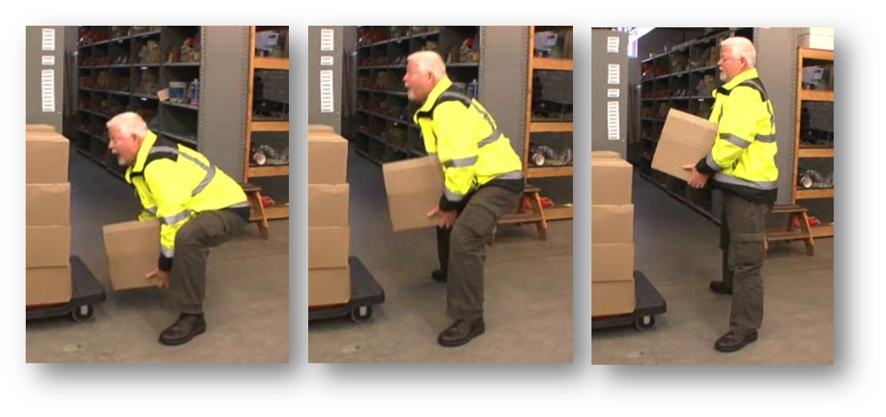
Practice Power Lift
Practice Power Lift technique to get comfortable with it
May seem a bit strange at first
Make it a habit and you will be amazed at the difference it makes
Feel stronger and more powerful using technique
That must be why it’s called the “Power Lift”!
Notes:
Practice the Power Lift technique to get comfortable with it. It may seem a bit strange at first.
Make it a habit and you will be amazed at the difference it makes.
Many people who use the power lift say they feel stronger and more powerful using the technique.
That must be why it’s called the, “Power Lift”!

Slide 100
Golfer’s Lift
Lighter weight item that you can handle with one hand
Lift one leg back as you bend over at hip to reach to the item
Counterbalances trunk
Practice using Golfer’s Lift
Notes:
If you have a lighter weight item that you can handle with one hand use the Golfer’s Lift.
Lifting one leg back as you bend over at the hip to reach to the item counterbalances the trunk and works well.
Practice using the Golfer’s Lift as it makes sense for you.

Slide 101
Two Stage Lift
Item to higher level
Use power position to bend hips/ knees to start at higher position
As you stand upright item is already at height you need it to be
Makes good use of leg strength and not just arm strength
Legs are stronger than arms!
Item at a distance
Slide item to edge, first stage of lift
Once its closer, use power lift technique to lift
Notes:
A very effective technique is to break the lift into stages.
For example, let’s say you have an item on a cart at about waist level that you need to get onto a higher level.
You could try to muscle it up with your arms and shoulders . . . but that can put stress into the back.
With the two-stage lift, you actually use the power position.
You bend your hips and knees to start the item at a higher position, for example at chest or shoulder level.
Then as you stand upright the item is already at the height you need it to be.
You make good use of leg strength and not just arm strength. Legs are stronger than arms!
Or let’s say you are reaching away from you to pick up an item.
Maybe a box on a workbench.
Slide the box to the edge as the first stage of the lift and then once its closer, use the power lift technique.

Slide 102
Bottom Line
Always use lift assistive devices that may be appropriate
Better to have a device do the lift than the human
Keep in mind
Knowledge of your personal limit
Always get assistance if needed!
Notes:
But with any situation, always please use lift assistive devices that may be appropriate, for example hydraulic or pneumatic lifts.
Better to have a device do the lift than the human.
Keep in the front of your mind your knowledge of your personal limit and always get assistance if you need it.

Slide 104
Successful Ergonomics
Defined ergonomics
“Fit the Job to the Person”
“Work Smarter, Not Harder”
Outlined ergonomics principles
Lab Ergonomics Assessment Process
Notes:
We’ve covered a lot of ground in the USDA ARS MWA Laboratory Ergonomics Training session.
We defined ergonomics as, “Fit the Job to the Person” and “Work Smarter, Not Harder”.
We outlined a set of ergonomics principles and we went through how to use the Lab Ergonomics Assessment Process.

Slide 105
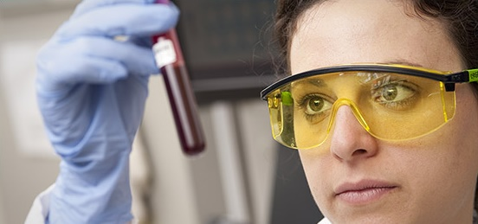
Successful Ergonomics
Personal physical fitness and health and wellness
Learned a series of stretches
Specific ergonomics tips and techniques:
Pipetting
Microscopy
Biological safety cabinets
Test tube handling
Set-up of laboratory workstations
Notes:
We outlined the benefits of personal physical fitness and health and wellness and you learned a series of stretches.
We detailed specific ergonomics tips and techniques for common laboratory tasks: pipetting, microscopy, use of biological safety cabinets, test tube handling and the set-up of laboratory workstations.

Slide 106
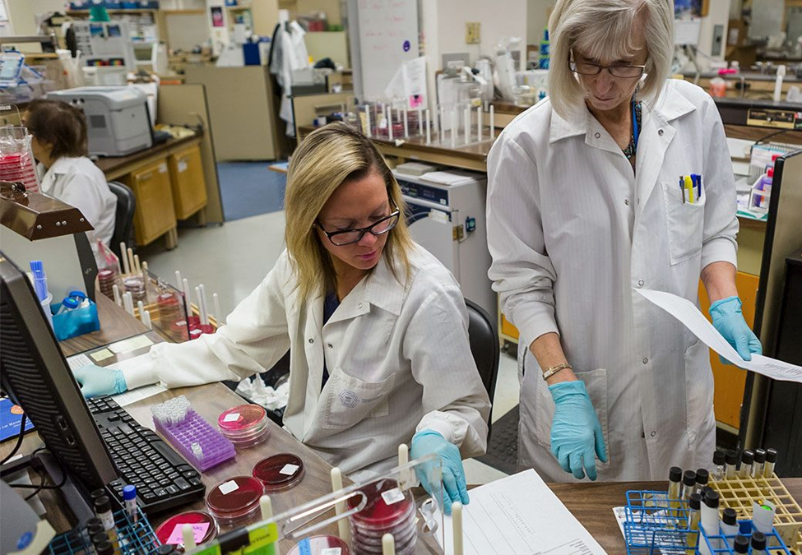
Successful Ergonomics
All in all, we hope this information helps you be more comfortable, safe and productive in the lab!
Thanks for your time and attention!
Notes:
All in all, we hope this information helps you be more comfortable, safe and productive in the lab.
Thanks for your time and attention!

Slide 107
Resources
APHIS Ergonomics Website
https://www.aphis.usda.gov/aphis/ourfocus/emergencyresponse/emergency_management/ergonomics_program/services
Mayo Clinic- video discusses creative solutions to control risk factors
https://youtu.be/hB_k8_W1KjA2
Mayo Clinic - video discusses a lift assist device that can be used in a lab
https://youtu.be/llQ8Pa3IwmM
Mayo Clinic - video addresses a screw cap tube device that can help with tube capping
https://youtu.be/o2cy6p8uURg
Pipetting safety from UCLA
https://youtu.be/bqAsXMSs27s
Electronic pipetting
https://youtu.be/vBMhtiypVuc
Jimmy Microtube Opener
https://www.pipettesupplies.com/product/jimmy-microtube-opener-for-pipetman-pipettes-3-pack-gilson/
OSHA Fact Sheet: Laboratory Safety Ergonomics
https://www.osha.gov/Publications/laboratory/OSHAfactsheet-laboratory-safety-ergonomics.html
UCLA Tips For Lab Workers
https://www.ergonomics.ucla.edu/laboratory-ergonomics/tips-for-lab-workers
OSHA Lab Fact Sheet – Prevention of Musculoskeletal Disorders
https://www.osha.gov/Publications/laboratory/OSHAfactsheet-laboratory-safety-ergonomics.pdf
Lab Manager – Laboratory Ergonomics
https://www.labmanager.com/lab-health-and-safety/laboratory-ergonomics-20312
Laboratory Checklist
http://www.wsha.org/wp-content/uploads/Worker-Safety_Lab-Ergo-Checklist-HumanFit.pdf
Notes:
Resources

Slide 108
Menu
Title Slide
Welcome – Role of APHIS
Successful Workplace
Objectives
Ergonomics Defined
Ergonomics Principles
Neutral Position and Support
Reach Zone
Power Position
Fatigue Control
Warm-up and Stretching
Physical Fitness Health/Wellness
Ergonomics Workstation Assessment
Workbenches, Stools and Footrests
Pipetting
Microscopy
Biological Safety Cabinets
Test Tube Handling
Material and Equipment Handling
Power Lift Technique
Summary and Close
Resources
Instructor Bio
Stretching
Notes:
Menu

Slide 109
Instructor Background/Experience
Mark A. Anderson, MA, PT, CPE
Founder of Minneapolis, Minnesota based ErgoSystems Consulting, LLC
Industrial Rehabilitation clinical practice in mid 1980’s led to interest in ergonomics
Since 1993 certified by Board of Certification in Professional Ergonomics as Certified Professional Ergonomist (www.bcpe.com)
Consulted in ergonomics for over 30 years
Education
Bachelor of Science Degree from University of North Dakota Physical Therapy program
Master of Arts Degree in Physical Therapy from the University of Iowa
Notes:
Instructor Background and Experience
Mark A. Anderson, MA, PT, CPE is the founder of Minneapolis, Minnesota based ErgoSystems Consulting, LLC.
Working in an Industrial Rehabilitation clinical practice in the mid 1980’s led to his interest in ergonomics.
Since 1993, Anderson has been certified by the Board of Certification in Professional Ergonomics as a Certified Professional Ergonomist (www.bcpe.com).
He has consulted in ergonomics for over 30 years
His education includes a Bachelor of Science Degree from the University of North Dakota Physical Therapy program and a Master of Arts Degree in Physical Therapy from the University of Iowa.
Anderson worked with WorkWell developing the Office and Manufacturing Ergonomics courses and the ERGONOMICS ON-DEMAND series.

Slide 110
30/30/30 Micro-breaks
Micro-breaks
Frequent and regular body movement is basic ergonomics principle
30/30/30 Rule of Physical Movement
Physically active micro-breaks 30 seconds in length
About every 30 minutes
30 days to make it a habit
Benefits
Reduce tissue compression and joint stiffness,
Enhance circulation
Practice what we preach!
Introduce basic stretch
Notes:
Micro-breaks
As we have discussed, frequent and regular body movement is a basic ergonomics principle to promote health and safety in the workplace.
You may already be familiar with the 30/30/30 Rule of Physical Movement that encourages physically active micro-breaks of about 30 seconds in length taken about every 30 minutes and do it for 30 days to make it a habit! I want to emphasize the concept because benefits include reducing tissue compression and joint stiffness and enhancing circulation.
Let’s practice what we preach by introducing a basic stretch, the Back Bend.

Slide 111
Micro-breaks – Guidelines
Guidelines
Absolutely have to follow doctor's orders
Technically correct
Energy input/output
Neutral Position
Joint noises
Don’t hold breath
Regular and consistent
Intensity/controlled stretching
Back Bend
Notes:
Guidelines
Before we try out the Back Bend here are the essential guidelines for safe and effective performance.
Absolutely have to follow any doctor's orders for restricted activities
Perform the stretches in a technically correct manner
Energy input is related to the benefit; be as vigorous as possible
Start the stretch from the Neutral Position
Joint noises, ‘snap, crackle and pop’ are normal
Don’t hold your breath, breath in with the stretch and out with the relaxation
Regular and consistent performance is the way to obtain the benefits
Always control the intensity of the stretch based on your response to the stretch
Back Bend
If you choose to do the Back Bend, follow along with the video. Roll the curser over the video to play.

Slide 112
Take break
Add stretching to day
A little post it note put on computer monitor
Software that reminds you to stretch
Old-fashioned egg timer
New-fashioned FitBit
Team up with someone else in office
Take advantage of natural breaks between activities
Drink lots of water!
Remember to Stretch!
Notes:
Take a break
One of the biggest problems with the modern computer is that it does not cue us to take a break. There are a number of human movements, such as reaching our arms over head, arching the back or rotating the neck, that are normal human movements, but are not a normal part of the day.
The computer workstation is notorious for discouraging much movement. For that reason, people need to recognize the need for adding stretching to the day.
Add stretching to day
A little post it note put on the computer monitor
Software that reminds the person to stretch
Old-fashioned egg timer
New-fashioned FitBit
Team up with someone else in office
Take advantage of natural breaks between activities
Drink lots of water!

Slide 113
Micro-breaks – Guidelines
Guidelines
Absolutely have to follow doctor's orders
Technically correct
Energy input/output
Neutral Position
Joint noises
Don’t hold breath
Regular and consistent
Intensity/controlled stretching
Elbow Pull
Notes:
Guidelines
Before we try out the Elbow Pull review the essential guidelines for safe and effective performance.
Elbow Pull
If you choose to do the Elbow Pull, follow along with the video.
Roll the curser over the video to play.

