Slide 1



Ergonomics for
Engineers
Notes:
Hello and welcome to Medtronic Environmental, Health and Safety training on Ergonomics for Engineers.

Slide 2
Our employees are central to our mission
This content will eventually be replaced by the VP video message
EHS partnering with businesses
to ensure health and safety are integrated into business processes
Training ensures employees
are aware of risks and are prepared
+
  CARDIAC AND VASCULAR GROUP
  Restorative Therapies Group
  Diabetes
  Group
+
Training!
Employees around the globe receive the same level of protection from risk
Notes:
Before we begin, let’s consider the importance of health and safety at Medtronic. Central to our Mission is the recognition of the personal worth of our employees. We are committed to providing all employees with safe and healthy work environments. Our Environmental, Health, and Safety teams are partnering with businesses to ensure health and safety are integrated into business processes. In addition, EHS training programs ensure employees are aware of workplace risks and are armed with strategies to minimize those risks.

Slide 3
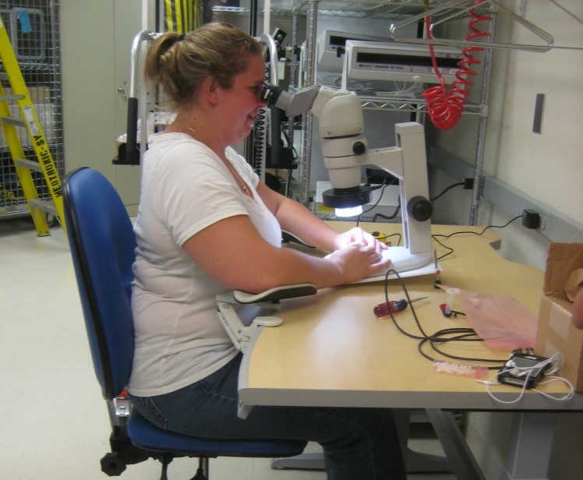
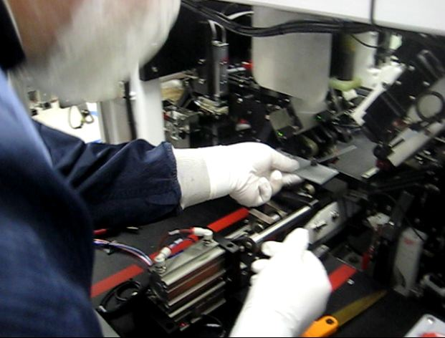
Ergonomics for Engineers
Lean Manufacturing
  Integrate Ergonomics
  Product design
  Manufacturing processes
  Benefits
  Ensure employee health and safety
  Enhance productivity and quality
Notes:
Now that you have a better understanding of the importance of health and safety at Medtronic, let’s turn to the subject of this training: Ergonomics for Engineers.
In concert with lean manufacturing principles, integrating ergonomics into product design and manufacturing processes is essential to ensure employee health and safety. Enhanced productivity and quality are also proven benefits.

Slide 4
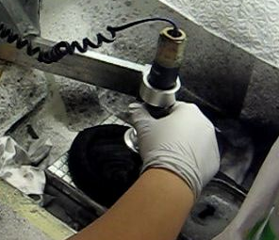
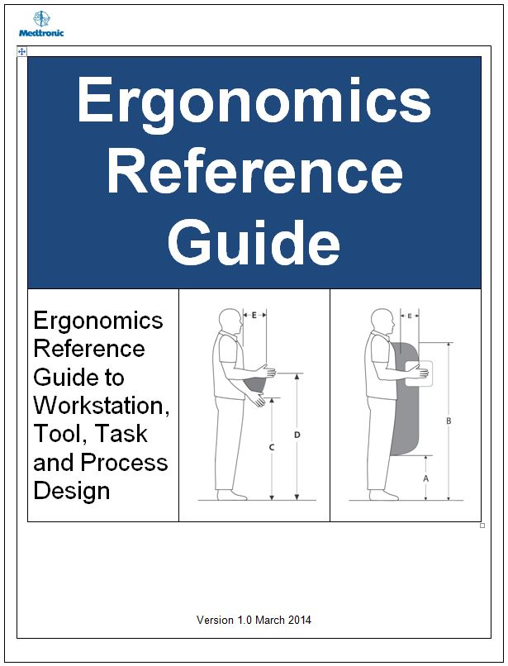
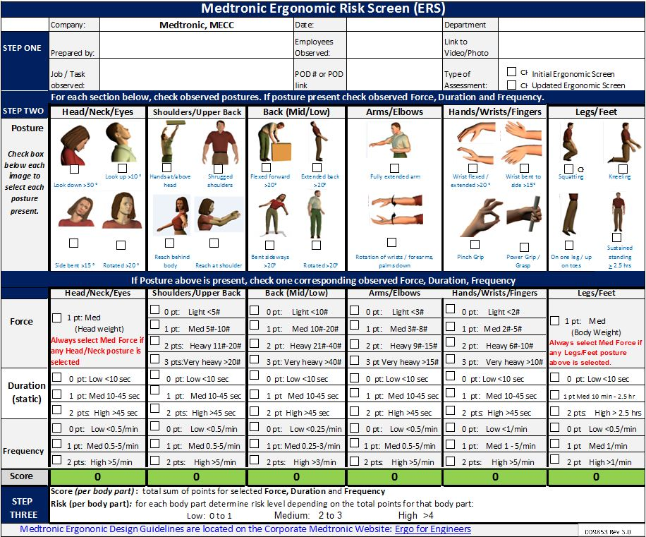
Training Modules and Objectives
Ergonomics Principles and Foundations Define Ergonomics within a Systems Design context Provide fundamental knowledge of ergonomics principles | Ergonomics Reference Guide Offers specific workstation guidelines | Ergonomics Risk Screen Specifically learn how to use the Ergonomics Risk Screen (ERS) Part of best practices in ergonomics design
Notes:
Ergonomics for Engineers consists of three training modules.
Module One: Ergonomics Principles and Foundations defines Ergonomics within a Systems Design context.
A set of ergonomics principles, with scientific basis, are introduced that provides fundamental knowledge to apply ergonomics in the design of products and manufacturing processes.
Module Two: Ergonomics Reference Guide introduces you to specific workstation design guidelines.
Module Three Ergonomics Risk Screen (ERS) builds on the information in Modules One and Two to provide a high level screen to identify significant ergonomics risk factors. You can use the ERS on existing workstations as well as those in development.
Each module takes about XX minutes to complete.
If you exit before you finish, your progress will be saved and you can resume where you left off.
For an explanation of the course features, resources, and navigation tools, click the Help tab in the upper right corner of the player.

Slide 5
Module One:
Ergonomics Principles and Foundations
Notes:
Module One: Ergonomics Principles and Foundations

Slide 6
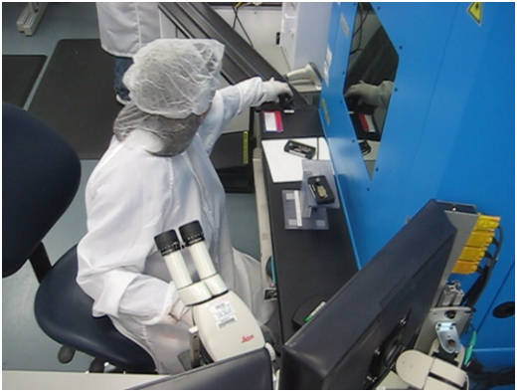
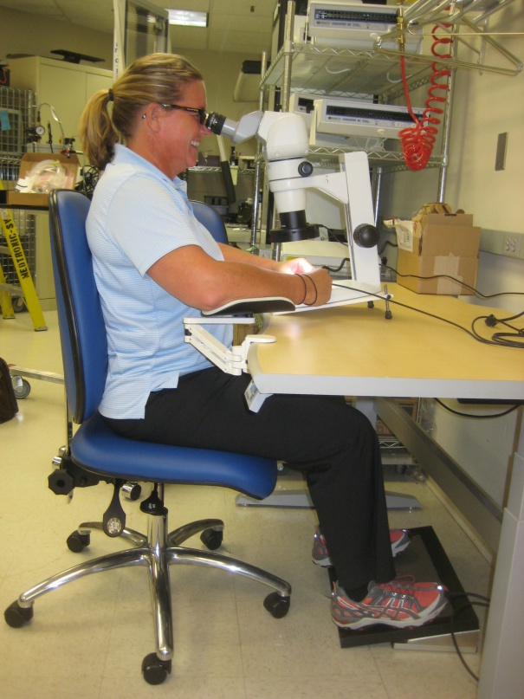
Ergonomics - Defined
Word “ergonomics” comes from the Greek
  ‘ergon’ means work
  ‘nomos’ means the laws or study of
So, ergonomics is literally the “laws or study of work”
Contemporary Definitions
“Fitting the job to the person, not forcing the person to fit the job!
“Working smarter, not harder!”
Context of Systems Design
Notes:
First of all . . . What is ergonomics?
The word ‘ergonomics’ was coined by a Polish scholar in 1857. In Greek ‘ergon’ means work and ‘nomos’ means the laws or study of.
So, ergonomics is literally the “the laws or study of work.”
In contemporary definitions, Ergonomics has been defined as, “Fitting the job to the person, not forcing the person to fit the job!” and “Working smarter, not harder!”
Let’s put these definitions into the context of ergonomics systems design.

Slide 7
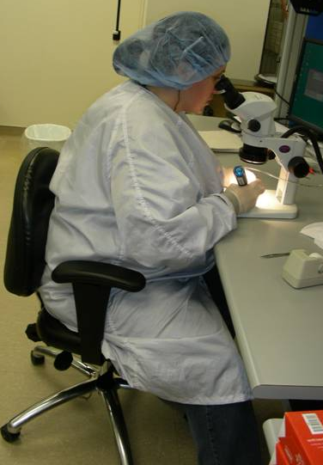
Ergonomics Systems Design
What do you think about this workstation and set-up?
  Out-of-neutral head and neck posture to use microscope
  Unsupported arms with stress into shoulders and upper back
  Lower back unsupported
  Feet not well supported on the floor
How safe and effective?
Why are these issues present?
  Inadequate design of the system!
Notes:
Take a look at this workstation.
What do you think? How well does the workstation fit the person? Is this person able to work smarter, not harder.
We see out-of-neutral head and neck posture to use the microscope, unsupported arms that result in stress into the shoulder and upper back, the lower back is unsupported and the feet not well supported on the floor.
How safe and effective is this workstation?
Why are these issues present? In a nutshell we can point to inadequate design of the system.
Let’s look at another workstation.

Slide 8
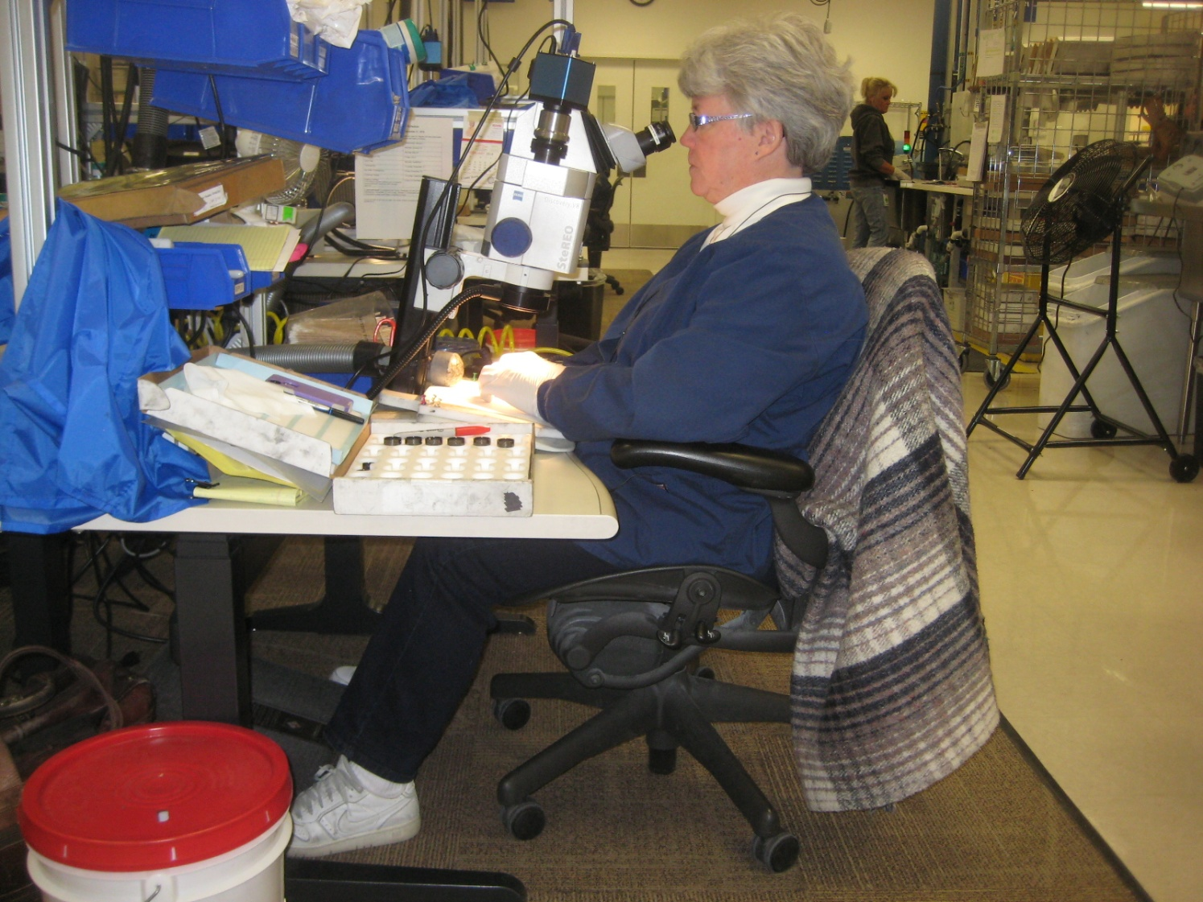
Ergonomics Systems Design
What do you think about this workstation and set-up?
  Neutral head and neck posture to use microscope
  Supported arms to relieve stress into shoulders and upper back
  Lower back supported
  Feet supported on floor
How safe and effective?
Notes:
Now take a look at this workstation.
What do you think? How well does the workstation fit the person? Is this person able to work smarter, not harder.
Now we see neutral head and neck posture to use the microscope, arms are supported to relieve stress into the shoulders and upper back, the lower back is supported and the feet are well supported on the floor.
How safe and effective is this workstation?

Slide 9
Ergonomics Systems Design
Compare the workstations side-by-side to see the night and day difference.
Notes:
Compare the workstations side-by-side to see the night and day difference!
With appropriate systems design, the user in the right side picture is able to obtain a neutral back and extremity position and support. The appropriate seating system, workstation and equipment are in place. Also the user has the knowledge needed to properly adjust the workstation to meet her particular requirements.

Slide 10

Ergonomics is all about the design of the system!
Poor design equals poor response
Improved design equals good response
Notes:
As you can see, ergonomics all about the design of the system.
Poor design in terms of the workstation, tools, equipment and work environment equates to a poor response in terms of health, safety and productivity.
On the other hand, improved design results in an improved response from the user’s perspective.
With this in mind we offer the following definition of ergonomics within the context of systems design.

Slide 11
Ergonomics . . .
Optimizing all aspects of job performance – safety, quality and productivity – through the appropriate systems design and use of workstations, work processes and the overall organization of work.
Notes:
Ergonomics . . .
Optimizing all aspects of job performance-safety, quality and productivity-through the appropriate systems design and use of workstations, work processes and the overall organization of work.

Slide 12
Ergonomics Principles
PROCESS – Promote effective work processes
POSITION/SUPPORT – Promote neutral body and limb position/support
MOVEMENT – Promote regular physical movement
MATERIAL HANDLING – Control manual material handling
REACH – Promote work in user’s reach zone
WORKSTATION/TOOLS/EQUIPMENT – Provide correct workstation, tools and equipment
TRAINING – Provide competency based training
ENVIRONMENT – Control exposure to work environment
HEALTH/WELLNESS – Promote personal health and wellness
FEEDBACK – Provide on-going feedback for continuous improvement
Notes:
Ten principles make up the foundation of ergonomics in systems design.
In summary they are:
PROCESS – Promote effective work processes
POSITION/SUPPORT – Promote neutral body and limb position/support
MOVEMENT – Promote regular physical movement
MATERIAL HANDLING – Control manual material handling
REACH – Promote work in the user’s reach zone
WORKSTATION/TOOLS/EQUIPMENT – Provide correct workstation, tools and equipment
TRAINING – Provide competency based training
ENVIRONMENT – Control exposure to the work environment
HEALTH/WELLNESS – Promote personal health and wellness
FEEDBACK – Provide on-going feedback for continuous improvement
Let’s take a closer look at the principles.

Slide 13
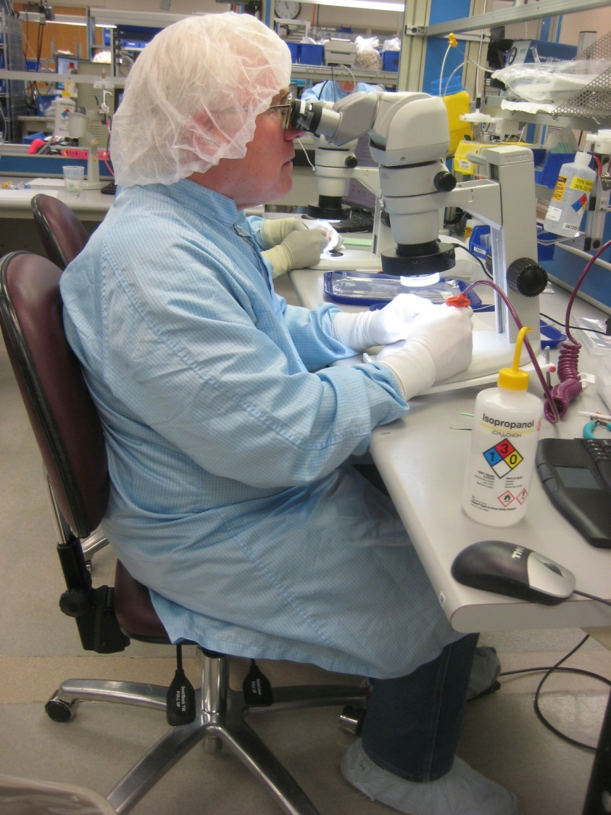
Promote effective work processes
Take step back and really examine why something is done as it is
If answer is. . . “Because it has always been done that way!”
Take fresh look
Is there better way to get it done?
Notes:
The overarching principle of ergonomics focuses on promoting the effectiveness of the work process itself. This principle is a wide ranging one that addresses the work process in total.
The goal is to take a step back and really examine why something is done as it is. If the answer is . . .
“Because it has always been done that way!”
It may be worth the effort to take a fresh look. Is there a better way to get it done?
What we see day after day becomes common place to use. We simply don’t pay attention anymore. We can’t see the forest because of the trees.
Take the step back and look at it with a fresh set of eyes!

Slide 14
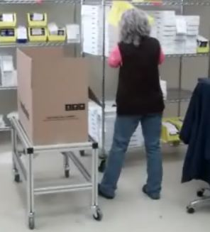
Promote effective work processes
Lean
Continuous Process Improvement
Value Sream Mapping
Kaizen Events
Six Sigma
5S = 1
Etc.
Notes:
The result of effective work processes is to optimize job performance through ergonomics system design. While buzz words come and go:
Lean
Continuous Process Improvement
Value Stream Mapping
Kaizen Events
Six Sigma
5S+1
Etc.
In one way or another, these strategies encompass the goal of promoting effective work processes.

Slide 15
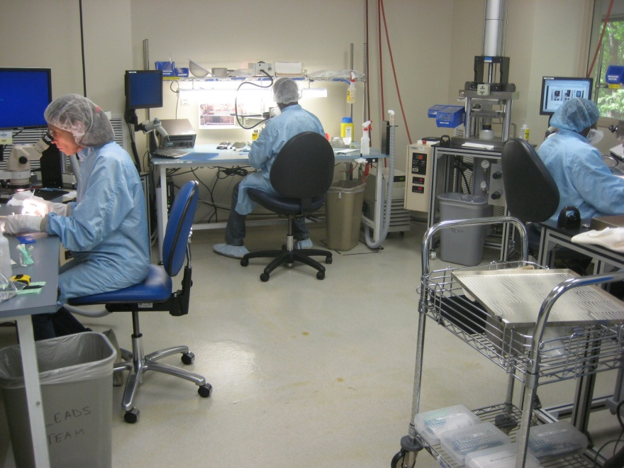
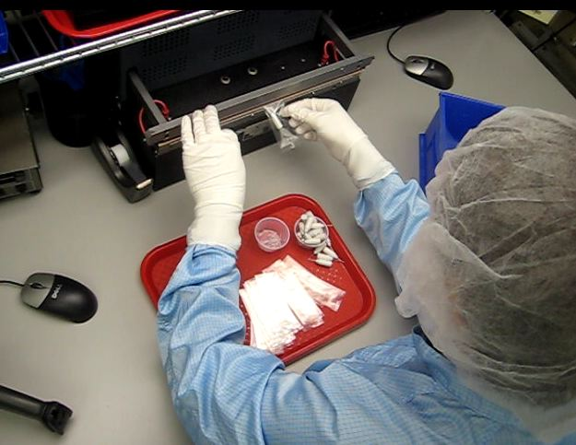
Look at whole picture
Goal is to:
  Design work to take into account basic predictable human behavior
  Provide an adequate level of job complexity and challenge
  Involve the worker in design process
  Implement engineering, work practice and administrative control as appropriate
Effective work process is central hub of ergonomics systems design!
Notes:
The effective work process ergonomics principle includes all of the ergonomics factors we will discuss and integrates them into the whole picture of a successful workplace.
Looking at the entire picture is an essential part of the ergonomics analysis and modification.
The goal is to:
Design work to take into account basic predictable human behavior
Provide an adequate level of job complexity and challenge
Involve the worker in the design process
Implement engineering, work practice and administrative control as appropriate
Focus on effective work process as the central hub of ergonomics systems design.

Slide 16
Position/Support in Neutral
What is the foundation of the body?
Sprain your ankle?
Pair of crutches, still get around
Sprain your back?
Can’t get out of bed!
Spine and pelvis are the body’s foundation
Directly relates to posture at work
PICTURE
Notes:
The next ergonomics principle is to promote neutral body and limb position and provide weight bearing support in a neutral position.
One way to think about the neutral position is to consider what really is the foundation of the body?
Is it the feet? Consider if you sprain an ankle . . . by using a pair of crutches you can still get around.
On the other hand what if you “sprain” your back? You might know someone who's been in this condition – they have a significant problem even getting out of bed to get to the bathroom.
The foundation or core of the body truly is the spine and pelvis. This directly relates to the position of the body in general and to posture in specific. With the spine and pelvis in a good position this allows us to make good use of our legs and arms.

Slide 17

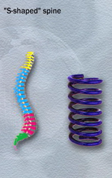
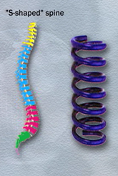
Neutral Spine Position
S-shape spine
Inward curve in lower back and neck
Outward curve in midback
Spring-like
Better able to deal with compression and shear stresses in spine
Benefits:
Decreased biomechanical strain
Increased respiratory function
Improved range of motion
Notes:
What is the neutral spine position?
A neutral spine is in an S-shape: inward curves in the low back and neck and an outward curve in the midback.
The advantage is that the spring like shape is able to better deal with compression and shear stresses in the spine.
Decreased biomechanical strain
Increased respiratory function
Improved range of motion
As possible the goal is to design workstation that promote and facilitate neutral position. Refer to Module Two: Ergonomics Reference Guide for specific workstation design criteria and to Module Three: Ergonomics Risk Screen to conduct an overview ergonomics analysis.

Slide 18
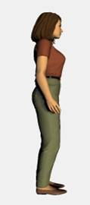
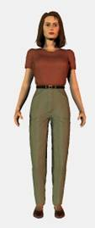
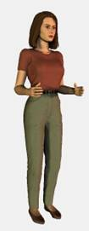
Neutral Arm/Hand Position
Neutral is midrange of joint position
For arms/hands:
Shoulders relaxed
Elbows at sides flexed to about 90 degrees
Hands positioned with the thumbs pointing up
Spending more time in neutral is the goal!
Notes:
What is the neutral position for the arms and hands?
Neutral is the midrange of joint position. For the arms/hands this is with the shoulders relaxed, elbows at the sides flexed to about 90 degrees and the hands positioned with the thumbs pointing up.
Is it possible to achieve neutral position 100% of the time?
Of course the answer is NO!
But how about 15%?
In many situations it is very feasible to significantly improve the workstation to increase neutral position and support by about 15%.
15% more time in neutral with good support can significantly decrease the level of stress into the body's tissue, enhance performance and increase comfort levels.
As possible the goal is to design workstations that promote and facilitate neutral position. Refer to Module Two: Ergonomics Reference Guide for specific workstation design criteria and to Module Three: Ergonomics Risk Screen to conduct an overview ergonomics analysis.

Slide 19
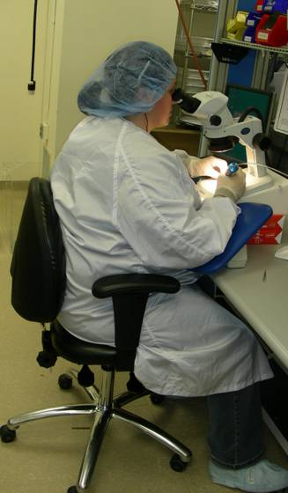
Support in Neutral Position
Seated
  Compression of soft tissues
  Decrease in blood flow and circulation
  Proper seated support is critical
Limbs
  Proper support for limbs
  Removes strain of weight bearing
  Unloads neck, shoulders and back
Standing
  Joint compression
  Fluid pools
  Limit sustained standing
PICTURE
Notes:
With the body and limbs positioned in neutral, the second part of the principle is to provide suitable support for the weight of the body and limbs.
Inadequate and improper seated support creates problems. People sit on their legs on the chair. They cross their legs for extended times.
Compression of the soft tissues occurs with a decrease in blood flow and circulation.
Proper seated support is critical.
Proper support for the limbs (for example, chair armrests) removes the strain of weight bearing and also unloads the neck, shoulders and back.
Unsupported standing for extended periods is not recommended. Joint compression occurs, actually decreasing the amount of joint space and not allowing adequate joint lubrication. Fluid tends to pool in the lower extremities.
The bottom line . . . it is tiring! Limit sustained standing and provide weight bearing relief.

Slide 20
Promote Dynamic Physical Movement
Stand or walk?
  50# back pack
  Stand for 20 minutes or
  Walk for 2 miles?
Walk!
  Intuitively we want to walk!
  We need to move to be comfortable
Sound physiological reasons
PICTURE
Notes:
Most people have carried a backpack at some point. Picture this scenario - you are with a group of friends going for an extended hike; your backpack weighs 50# and you have put it on your shoulders.
What would you rather do: stand in one place for the next 20 minutes OR take that same backpack and start to walk for a few miles?
To a person, everyone agrees that it is much better to walk – not to stand. We intuitively know that movement is superior to maintaining one position. In other words, we need to move to be comfortable.
That’s what this next ergonomics principle, Promote Dynamic Physical Movement, is all about and there are sound physiological reasons to support the principle. Let’s explore them.

Slide 21
Metabolism
Body takes in nutrients
  Converts into chemical energy
  Ultimately into mechanical energy and heat
  e.g., muscular contraction
Glucose and oxygen
  Relatively small amounts stored in muscle
  To sustain performance:
  Continuous flow of oxygen and energy-rich blood into tissue
  Removal of metabolic waste product
PICTURE
Notes:
To accomplish work, the body is able to take in nutrients and oxygen, convert them into chemical energy and then ultimately into mechanical energy, for example muscular contraction. This is called metabolism.
The nutrients and oxygen are stored in relatively small amounts within the muscle tissue. Consequently, to sustain performance continuous flow of oxygen and energy-rich blood into the tissue in addition to removal of metabolic waste products is required.

Slide 22
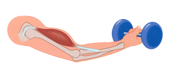
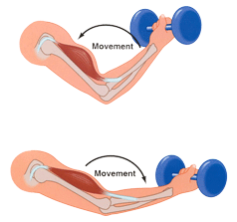
Factors Affecting Metabolism
Static muscle contraction
  Blood vessel compression
    Essentially occluded at 60% of Maximum Isometric Voluntary Contraction
  No blood, no oxygen and nutrition
  Waste products accumulate
Dynamic muscle contraction
  Muscle contracts and relaxes
  Promotes blood flow, acts like a pump
  Improved oxygen and nutrition
  Improved waste product removal
Notes:
Type of muscular effort has been shown to have a profound impact on blood flow.
Static muscle contractions (the muscle shortens but no joint movement occurs) results in blood vessel compression due to internal muscle pressure.
At contraction levels of 60% and greater of the maximum voluntary contraction of the muscle, blood flow actually ceases.
The muscle depends on the quite limited initial reserves stored internally. Waste products accumulate and only short duration contractions are possible.
On the other hand dynamic muscle contractions are the alternating contracting and relaxing of muscle groups to perform tasks.
In terms of enhancing performance and controlling fatigue, dynamic muscle contractions are a significant improvement over static muscle contractions.
Dynamic muscle activity promotes blood and fluid flow by acting as a pump to increase oxygen and nutrition to the working muscles and helps to remove the waste products of metabolism.
Avoiding sustained muscle contraction and promoting dynamic muscle contraction enhances physical performance!

Slide 23
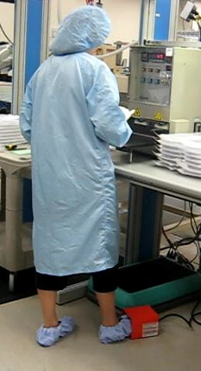
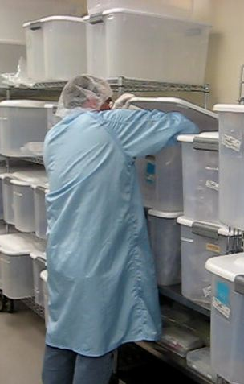
Factors Affecting Metabolism
Sustained neutral positions
  Blood flow—both volume and rate of flow—decreases
  Pooling of fluid in extremities occurs
Sustained awkward postions
  Muscular contraction to maintain position
  Decrease in blood flow due to internal impingement or external contact stress
Notes:
Metabolic fatigue also occurs as the result of sustained neutral position.
Blood flow, both volume and rate of flow, decreases.
Pooling of fluid in the extremities occurs.
The body’s tissues require ongoing nutrition even at low or minimal activity levels. The position of the body when sedentary has impact.
Sustained awkward positions result in:
Muscular contractions to maintain the position.
Potential decrease in blood flow due to internal impingement or external contact stress.

Slide 24
Physiology Principles
Movement/activity
  Promote dynamic not static muscle contractions
  Build-in adequate physical recovery times
    The 30/30 Rule
  Incorporate movement into the work process
Position and support
  Design for neutral positions
  Design for body/limb support at work stations
PICTURE
PICTURE
Notes:
To summarize the principles of physiology, the objective is to promote movement and activity. Consider the guidelines of:
Promote dynamic not static muscle contractions
Build-in adequate physical recovery times. Follow the 30/30 rule. Promote short (30 second) physically active micro-breaks about every 30 minutes.
Incorporate movement into the work process
Body position and support also play a major role. In the design process emphasize workstations that promote neutral positions and design for body/limb support at work stations.

Slide 25
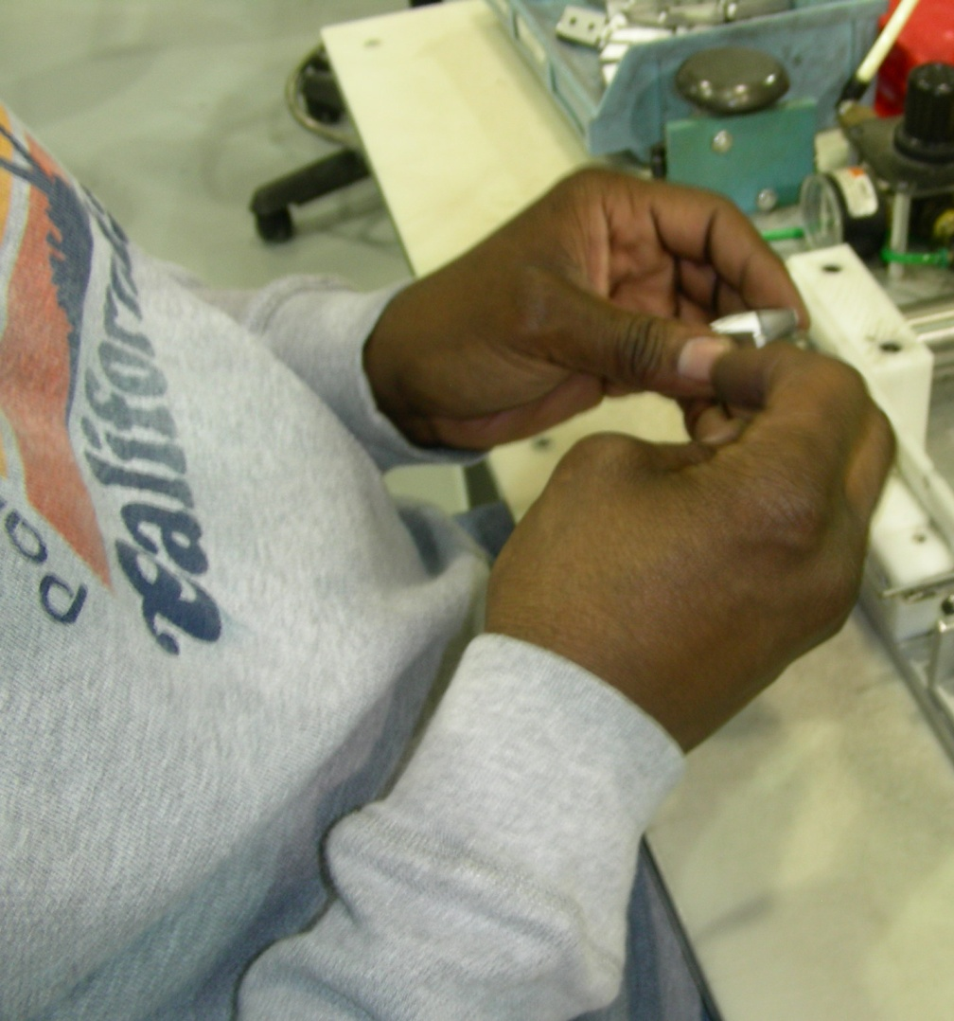
Work in Reach Zone
How much do we use our hands?
Where do you use them?
  Comfort Reach Zone
  Functional Reach Zone
Notes:
How much do we use our hands every day?
More than half the day? How about more than 75% of the day? Well in fact, most people will say they use their hands at least 99.9% of the day!
Where do we tend to use our hands?
For example does anybody work behind their back? Pretty hard to see what you're doing!
Because in most cases we need to see what we are doing we tend to use our hands in front of and to the sides of our body. We define two reach zones:
Comfort Reach Zone
Functional Reach Zone

Slide 26
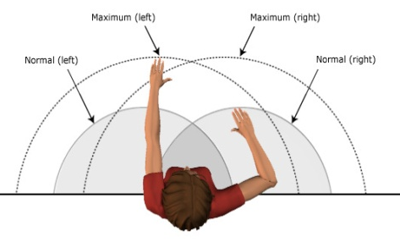
Comfort Reach Zone
Performing precise hand activity
  Determined by user’s forearm length (shaded area in the diagram)
  Three to 4 inches above and below elbow level
  Determine your Comfort Zone
Typical activities
  Keyboard and mouse use along with handwriting
  Precision assembly in manufacturing
Notes:
Think of the comfort reach zone as that area in front and to the side where you'd like to use your hands when you're doing precise hand activity.
The dimensions of the Comfort Reach Zone will be determined by your forearm length, identified in the shaded area of the diagram. To get a feel for this, position your elbows at your sides with your elbows bent at about 90°, swing your hands from side to side.
The height of this reach zone will be about three or 4 inches above and below elbow level. This is your Comfort Reach Zone.
Typical activities in the Comfort Reach Zone will include keyboard and mouse use along with handwriting. This also includes precision assembly in a manufacturing environment where you may exert a minimal downward force.

Slide 27
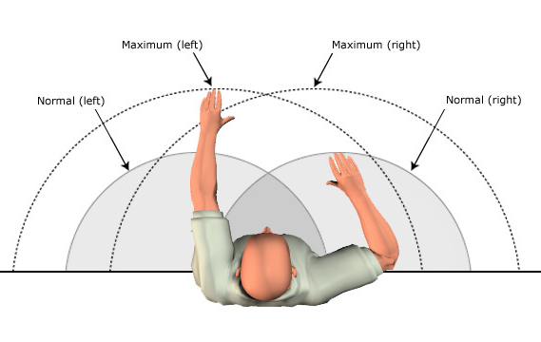
Functional Reach Zone
Reach to obtain parts and materials
  Determined by user’s arm length (area in outer circles in the diagram)
  Determine your Functional Reach Zone
Individual reach zones
  Set up workstation to promote reach in the appropriate zones
Anthropometry
  Details in Module Two, Ergonomics Reference Guide
Notes:
Think of the Functional Reach Zone as that area in front and to the side were you be able to comfortably reach to obtain parts and materials.
The dimensions of the Functional Reach Zone are determined by your arm’s length.
An easy way to get a feel for this is to:
Reach your arms out in front of your body with your elbows straight; from your shoulder to the middle of your hand is your forward functional reach.
Now swing your arms out to the side about 45° from the midline of your body; this is the side to side functional reach.
Drop your hands so they are relaxed at your sides; this is called knuckle height and is the bottom zone of the functional reach.
Finally with your arms extended raise them so they are about shoulder level; this is the upper zone of the functional reach.
Stature and arm’s length determine the reach zones. Determine the individual reach zones and set up the work station to promote reaches in the appropriate zones.
In Module Two: Ergonomics Reference Guide, we will discuss anthropometry – the study of the size and shape of humans. Specific workstation design guidelines are derived from this information.

Slide 28
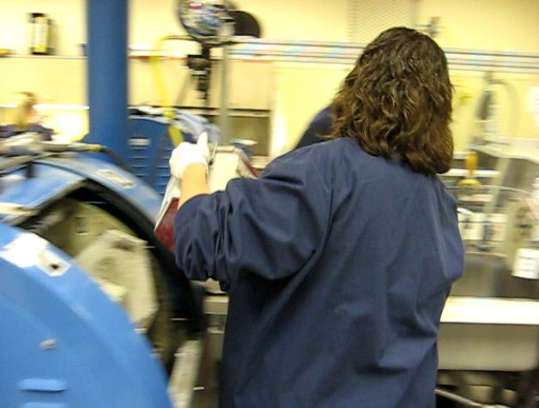
Control Manual Material Handling
How much can a person lift?
  Safe
  Effectively
  What factors affect manual material handling?
  Studied extensively
  No absolute limit
  Ideal lifting conditions
  99% of men and 75% of women could reasonably handle maximum of 51 lbs
Notes:
The next ergonomics principle details the specifics regarding manual material handling capabilities of individuals.
How much can a person lift in a safe and effective way? What are the factors involving the manual handling that need to be considered? These questions have been studied extensively over the past 30 years.
While there is no absolute limit, the NIOSH Work Practices Guide for Manual Lifting indicates that for healthy individuals, 99% of men and 75% of women could reasonably handle a maximum of 51 lbs in the ideal lifting situation: lifting at waist level with a balanced load held with both hands next to the body with no spinal rotation and handled with low frequency (lift 2 to 5 times per minute up to one hour total for an 8-hour shift). As the lifting situation varies from ideal the recommended maximum decreases significantly.

Slide 29
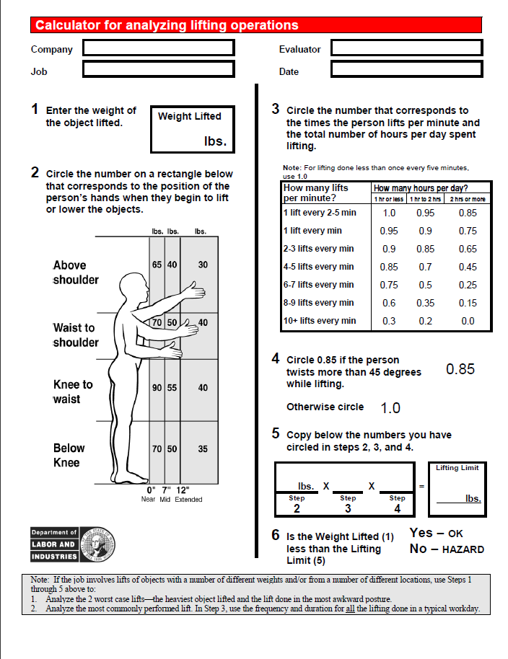
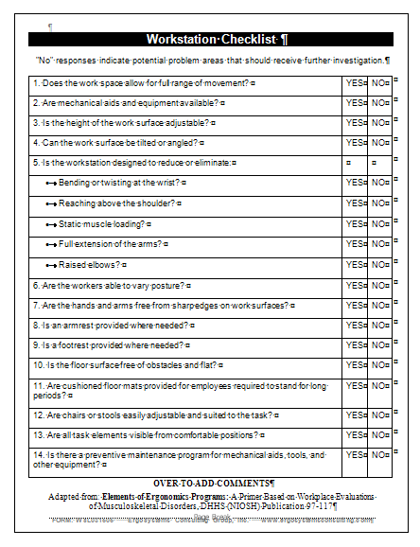
Control Manual Material Handling
Lifting Calculator
Manual Material Handling Checklist
Notes:
A simplified version of the NIOSH Work Practices Guide for Manual Lifting was developed by the State of Washington Department of Labor and Industries.
It is easy to use and provides valuable information. Refer to the Resources section to link to the Guide.
es.

Slide 30
Manual Material Handling Guidelines
Eliminate (as feasible) manual handling
  Make use of mechanical handling equipment (fork lifts, powered lifts, etc.)
Reduce physical stress of manual handling
  Make use of manual handing equipment (carts, two-wheelers, etc.)
  Design to allow sliding or rolling rather than lifting
  Design to allow lifting between waist to chest level
  Decrease frequency of manual handling
  Remove any physical barriers that increase manual handling distance from body
  Promote power lift techniques (wide foot base, neutral spine, load close, head-up)
Notes:
You can also use the Manual Material Handling Checklist found in the Resources section to help identify and correct manually material handling issues.
Here are some general guidelines.
Eliminate (as feasible) manual handling:
Make use of mechanical handling equipment (fork lifts, powered lifts, etc.)
Reduce the physical stress of manual handling:
Make use of manual handing equipment (carts, two-wheelers, etc.)
Design to allow sliding or rolling rather than lifting
Design to allow lifting between waist to chest level
Decrease frequency of manual handling
Remove any physical barriers that increase manual handling distance from body
Promote power lift techniques (wide foot base, neutral spine, load close, head-up)

Slide 31
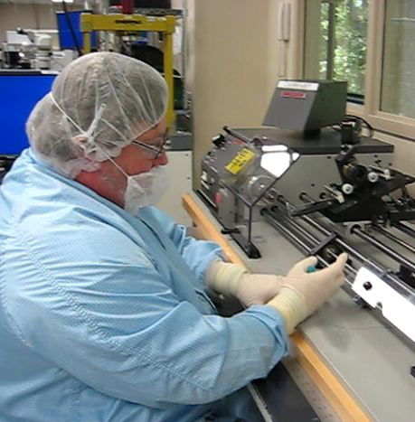
Provide Correct Tools,
Equipment and Workstation
Tangible results:
  Safer
  Faster
  Productive
Evaluate tools, equipment and workstations:
  Neutral position
  Reach zone
  Dynamic muscle movement
  Manual handling
Notes:
Providing the correct tools, equipment and workstation is a critical ergonomics principle. Safer, faster and more productive are the tangible results.
The correct workstation, tools and equipment can make the difference between getting the job done or not at all. And even worse, the wrong tool can result an injury to the user.
An effective method to evaluate tools, equipment and workstations is to apply the ergonomics principles of neutral position, reach zone, dynamic muscle movement and manual handling. If during use of the tool, equipment and workstation the body and limbs are NOT in neutral, OUTSIDE the reach zones, REQUIRE sustained muscle contractions and result in EXCESSIVE manual handling, there is probably an issue that needs to be addressed and corrected.

Slide 32
Correct Tools, Equipment and Facilities Chesklists
Checklists
  Work Station
  Tools
  Equipment
Notes:
Refer to the Workstation, Tools and Equipment Checklist in the Resources section for additional details.

Slide 33
Competency Based Training
Results not achieved?
  Spend thousands of dollars on ergonomically designed tools, equipment and workstations
  Workforce doesn't know how to make most of tool or equipment or furniture
Acquire new skills
  Need to correctly practice new techniques to acquire needed skill level
PICTURE
Notes:
A company spends thousands of dollars on ergonomically designed tools, equipment and workstations but desired results are not achieved. What happened?
In many situations the problem is the workforce doesn't know how to make the most of the tool or equipment or workstation. Essential to have the correct item AND the knowledge to use it properly. For the workforce to really get the benefits of ergonomics they need to be able to demonstrate competency in the setup and use of the tool or equipment.
To give you an example. A company purchased new fully featured ergonomics chairs. They were delivered and put into use. A short while later during an ergonomics audit it was determined that no one had adjusted the chairs for their specific needs. They hadn't received any instruction in how to use the chairs - they just sat down and went to work. In fact a number of individuals reported they actually felt intimidated by the chair and all of its "bells and whistles"!
Ergonomics is all about learning new skills; provide training sessions that involve a hands-on approach. Over time, with proper feedback and practice, the desired result will be accomplished.

Slide 34

Control Exposure to Environment
Factors:
  Light
  Noise
  Temperature
  Ventilation
Checklist
Notes:
Controlling exposure to the work environment including light, noise, temperature and ventilation is the next ergonomics principle.
Use the Environment Checklist as needed for the ergonomics analysis process.

Slide 35

Health and Wellness!
Health and wellness
  Diet and nutrition
  Body weight control
  Stress management
  Smoking cessation
  Blood pressure control
  Fluid intake - don’t get dehydrated
  Adequate rest/sleep
For example. movement helps to control fatigue
  Follow the 30/30 Guideline
Notes:
What is the most important tool we all own?
The answer of course is our minds and our bodies; in other words our physical and mental health.
The goal is to provide a workplace where regular health and wellness concepts and practices are built into the course of doing business.
Health and wellness factors include:
Diet and nutrition
Body weight control
Stress management
Smoking cessation
Blood pressure control
Fluid intake - don’t get dehydrated
Adequate rest/sleep
For example: movement helps to control fatigue by relieving awkward and sustained positions and promoting circulation to the body's tissues. Advocate for the 30/30 Guideline for physical movement throughout the day.

Slide 36
Provide On-going Feedback
100% correct the first time?
  Does any new process work 100% correctly out of gate?
    Unintended consequences
  Schedule formal follow-up sessions
    Document outcome of follow-up
    Alleviate issues identified in timely manner
Continuous Process Improvement and Ergonomics
  Continuous process improvement strategies have tremendous benefit
    Waste is reduced
    Productivity is enhanced
Applying ergonomics principles to overall continuous process improvement effort is integral to success of the process!
PICTURE
Notes:
The last ergonomics principle is to provide on-going feedback and follow-up regarding the ergonomics analyses and processes.
In your experience does any new process work 100% correctly out of the gate?
Even with the best up-front planning there will be unintended consequences, something will vary from the plan. This is why providing on-going feedback as part of the follow-up process is so critical.
Schedule formal follow-up sessions at regularly intervals; for example one week post-implementation and then one month, six months and one year. Document the outcome of the follow-up, very importantly alleviate the issues identified in a timely manner and publicize the lessons learned.
Applying ergonomics principles to the overall continuous process improvement effort is integral to the success of the process.
Ergonomics is focused on optimizing performance (enhancing safety and quality and productivity); the effort is made stronger when on-going feedback and follow-up is performed.

Slide 37
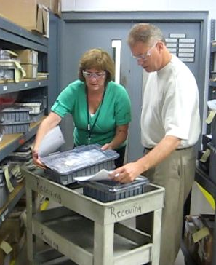
Ergonomics – A Potent Tool!
When the principles of ergonomics are applied the outcome is demonstrated improvements in quality, productivity, health and safety.
Thanks for completing Module One: Ergonomics Principles and Foundations
Notes:
Ergonomics is a potent tool!
When the principles of ergonomics are applied, the outcome is demonstrated improvements in quality, productivity, health and safety.
Thanks for completing Module One: Ergonomics Principles and Foundations .
In Module Two: Ergonomics Reference Guide you will be introduced to specific workstation design guidelines.
And Module Three: Ergonomics Risk Screen (ERS) builds on the information in Modules One and Two to provide a high level screen to identify significant ergonomics risk factors.

Slide 38
Module Two:
Ergonomics Reference Guide
Notes:
Welcome to Module Two : Ergonomics Reference Guide.

Slide 39
Our employees are central to our mission
This content will eventually be replaced by the VP video message
EHS partnering with businesses
to ensure health and safety are integrated into business processes
Training ensures employees
are aware of risks and are prepared
+
  CARDIAC AND VASCULAR GROUP
  Restorative Therapies Group
  Diabetes
  Group
+
Training!
Employees around the globe receive the same level of protection from risk
Notes:
Before we begin, let’s consider the importance of health and safety at Medtronic. Central to our Mission is the recognition of the personal worth of our employees. We are committed to providing all employees with safe and healthy work environments. Our Environmental, Health, and Safety teams are partnering with businesses to ensure health and safety are integrated into business processes. In addition, EHS training programs ensure employees are aware of workplace risks and are armed with strategies to minimize those risks.

Slide 40
Ergonomics Reference Guide
Ergonomics Reference Guide
  Provides ergonomics checklists, specifications and supporting information
  Assists in designing tasks, tools, equipment and workstations
  Enhances productivity and quality of work product and reduces risk of injury in the workplace
Help ensure jobs performed in safe, efficient and pain-free manner:
  “Work smarter not harder.”
  “Fit the task (i.e. tools, equipment, workstation,, etc.) to the worker rather than forcing the worker to fit the task.”
Provided within context of professional judgment of user
Notes:
The Ergonomics Reference Guide provides ergonomics checklists, specifications and supporting information to assist in designing tasks, tools, equipment and workstations that enhance productivity and quality of the work product and reduce the risk of injury in the workplace.
The Guide is based on ergonomics principles that will help to ensure jobs are performed by workers in a safe, efficient and pain-free manner.
The information contained in this training has been developed in good faith and is believed to present good ergonomics principles and practices. Persons using this information must make their own determination and professional judgment as to its suitability for their purposes.
Refer to the Resources section to access the complete Ergonomics Reference Guide in a pdf format.

Slide 41
Ergonomics Principles
PROCESS – Promote effective work processes
POSITION/SUPPORT – Promote neutral body and limb position/support
MOVEMENT – Promote regular physical movement
MATERIAL HANDLING – Control manual material handling
REACH – Promote work in user’s reach zone
WORKSTATION/TOOLS/EQUIPMENT – Provide correct workstation, tools and equipment
TRAINING – Provide competency based training
ENVIRONMENT – Control exposure to work environment
HEALTH/WELLNESS – Promote personal health and wellness
FEEDBACK – Provide on-going feedback for continuous improvement
Notes:
Recall in Module One we introduced the ten ergonomics principles that make up the foundation of ergonomics in systems design.
In summary they are:
PROCESS – Promote effective work processes
POSITION/SUPPORT – Promote neutral body and limb position/support
MOVEMENT – Promote regular physical movement
MATERIAL HANDLING – Control manual material handling
REACH – Promote work in the user’s reach zone
WORKSTATION/TOOLS/EQUIPMENT – Provide correct workstation, tools and equipment
TRAINING – Provide competency based training
ENVIRONMENT – Control exposure to the work environment
HEALTH/WELLNESS – Promote personal health and wellness
FEEDBACK – Provide on-going feedback for continuous improvement
Please refer to Module One for specific details.

Slide 42
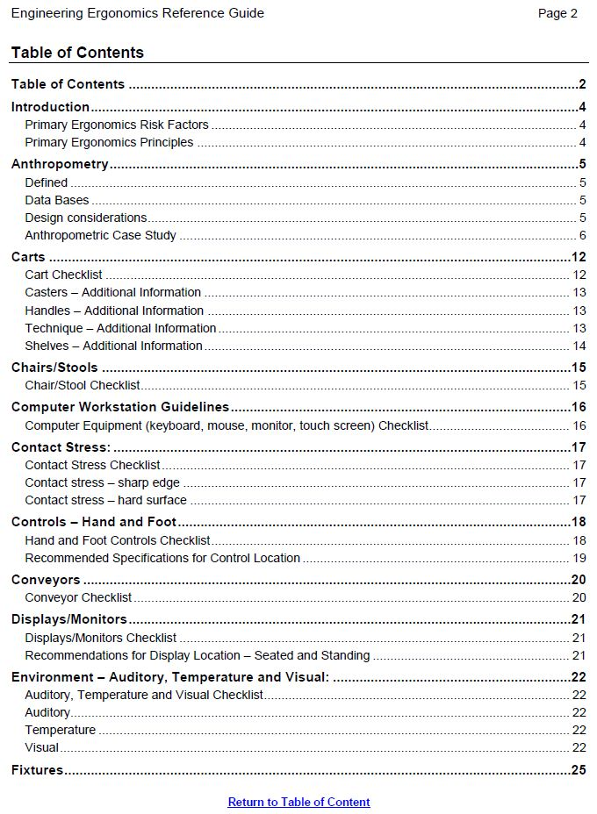
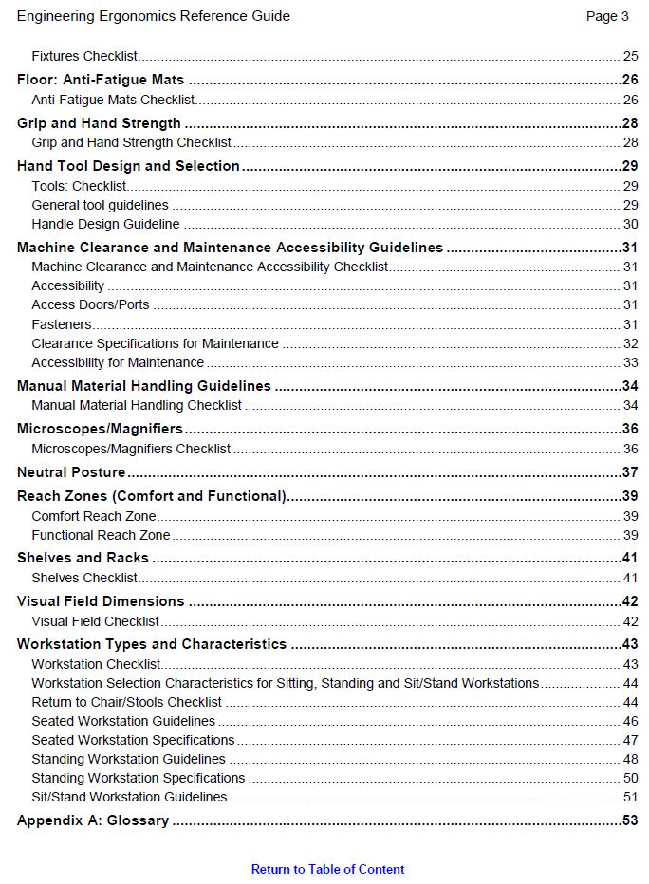
Guide Table of Contents
Notes:
As you see by examining the Ergonomics Reference Guide Table of Contents a number of topics are covered ranging from Anthropometry to Carts to Chairs to Fixtures to Material Handling to Microscopes to Workstation Type and Characteristics.
In this training our intent is to provide an overview of the contents and not necessarily touch on every topic.
In a practical application mode we will use a case study to demonstrate how the Guide can be used.

Slide 43
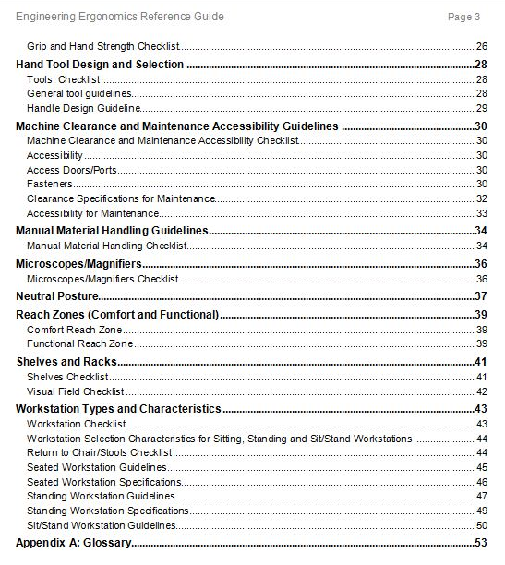
Case Study – Workbench
Workbench designed for assembly process
  Diverse user population
  Perform light weight (up to 10#) repetitive assembly job tasks
  Less than 5 minutes sustained task duration at one time
  Have to reach to materials, tools, etc. on the workbench
  Precise manipulation NOT required
  Hand work height at elbow level
Points of Interest
  Sit or stand?
  Workbench height and depth?
Access Reference Guide
  Table of Contents
Notes:
Our case study involves the design of workbench used for an assembly process.
We first define the design criteria:
Diverse user population
Perform light weight (up to 10#) repetitive assembly job tasks
Less than 5 minutes sustained task duration at one time
Have to reach to materials, tools, etc. on the workbench
Precise manipulation is NOT required
Hand work height at elbow level
We have specific points of interest.
Should this be seated or standing height workbench?
What is the recommended workbench height and depth?
Examining the Table of Contents in the Workstation Types and Characteristics section there is a specific guide for Workstation Selection Characteristics for Sitting, Standing and Sit/Stand Workstations.

Slide 44
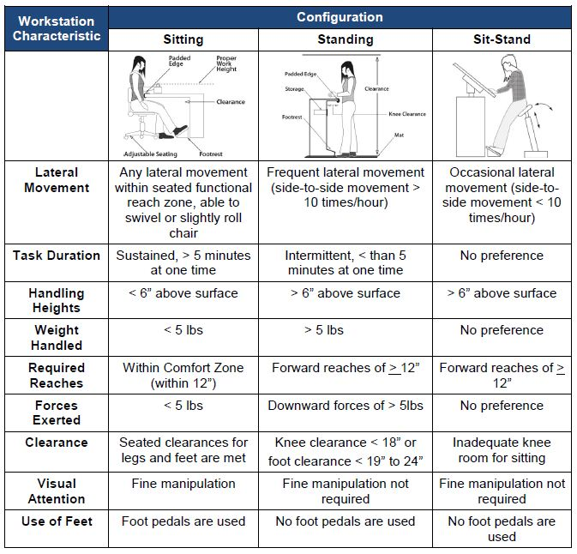
Sit or Stand?
Workbench designed for assembly process
  Diverse user population
  Perform light weight (up to 10#) repetitive assembly job tasks
  Less than 5 minutes sustained task duration at one time
  Have to reach to materials, tools, etc. on the workbench
  Precise manipulation NOT required
  Hand work height at elbow level
Notes:
As you see in the Workstation Selection Characteristics for Sitting, Standing and Sit/Stand Workstations guide you categorize the Workstation Characteristics in terms of:
Lateral Movement
Task Duration
Handling Heights
Weight Handled
Required Reaches
Forces Exerted
Clearance
Visual Attention
Use of Feet
As you compare the design criteria to the workstation characteristics, a standing configuration best fits.
So based on this information you would design a standing height workbench.
Please remember this is a guide only and it will never replace your professional judgment. You may have other factors you are considering that will influence your final decision.
For now we will go with the standing workbench. Next we need to answer the workbench height and depth question.

Slide 45
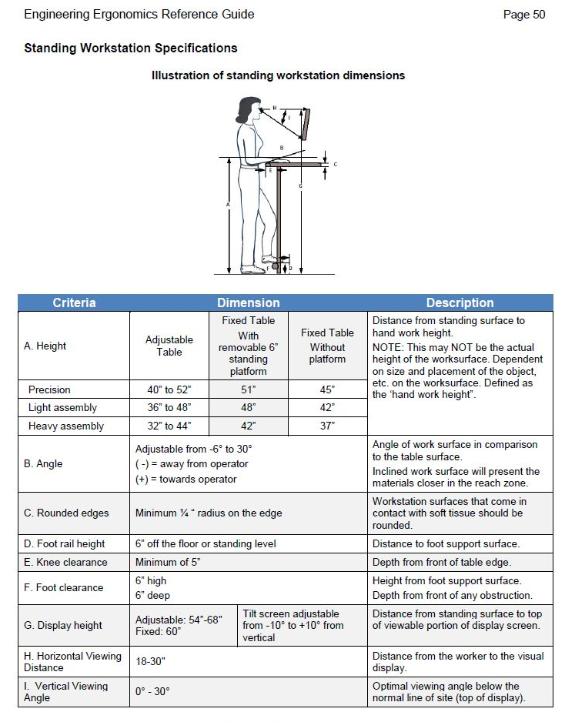
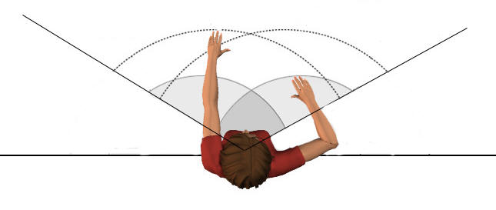
Workbench Height and Reach?
Criteria | Dimension | Description
Comfort Reach Zone | Max = 12” | Distance from table edge to hand grasping point with back straight and upper arm near vertical.
Functional Reach Zone | Max = 22” | Distance from table edge to hand grasping point with back straight and arm fully extended.
Notes:
Accessing the Ergonomics Reference Guide we find specific recommendations for Standing workstations and for Reach.

Slide 46
Case Study – Workbench
Standing height workbench
Criteria | Dimension |  |  | Description
Height | Adjustable Table | Fixed Table With removable 6” standing platform | Fixed Table Without platform | Distance from standing surface to hand work height. NOTE: This may NOT be the actual height of the worksurface. Dependent on size and placement of the object, etc. on the worksurface. Defined as the ‘hand work height”.
Precision | 40” to 52” | 51” | 45”
Light assembly | 36” to 48” | 48” | 42”
Heavy assembly | 32” to 44” | 42” | 37”
Reach Zones
Criteria | Dimension | Description
Comfort Reach Zone | Max = 12” | Distance from table edge to hand grasping point with back straight and upper arm near vertical.
Functional Reach Zone | Max = 22” | Distance from table edge to hand grasping point with back straight and arm fully extended.
Notes:
Here is the specific information we are looking for.
We have to make a design decision if the workbench will be fixed height or adjustable.
Recalling the job task is light assembly and performed at elbow height we determine an adjustable workbench height range to be 36” to 48”.
For a fixed workbench without a standing platform, 42” is the recommended height. If a 6” standing platform is incorporated, the recommendation is 48”. Typically we would not recommend a standing platform. However in some cases we may skew the workbench toward the taller user. We will discuss this in more detail when we discuss anthropometry later in the module.
We can also define the reach zones. A maximum of 12” is recommended for the comfort reach zone and 22” for the functional reach zone. We are accommodating the shorter arm individual.
Where did these recommendations come from?
Let’s pull back the curtain and discuss anthropometry.

Slide 47
Anthropometry – Defined
Anthropometry - science that defines physical measures of person’s size, form, and functional capacities
  How tall
  How short
  How big
  How small
PICTURE
Notes:
Anthropometry is a science that defines physical measures of a person's size, form and functional capacities. For example how tall, how short, how big, how small.

Slide 48
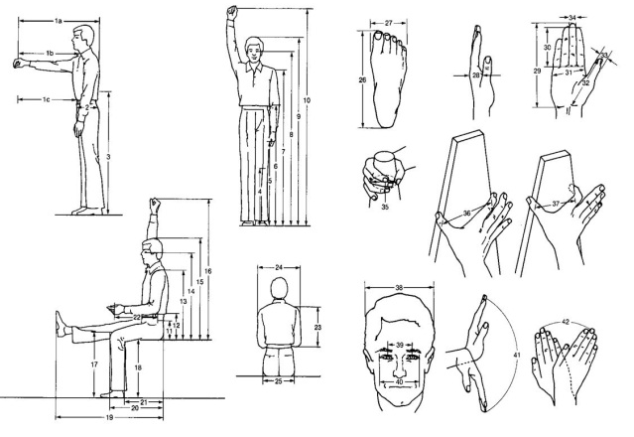
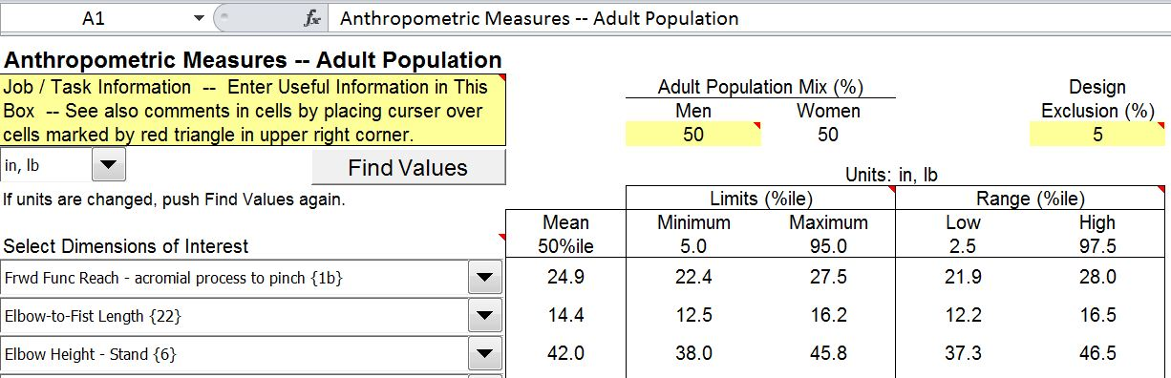
Anthropometry – Data Bases
Evaluate interaction of workers with tasks, tools, machines, workstations, vehicles, and personal protective equipment
Describe various populations typically in terms of percentiles based on statistical measures of mean and standard deviation
Notes:
Anthropometric measurements are used to evaluate the interaction of workers with tasks, tools, machines, workstations, vehicles, and personal protective equipment.
Data bases have been developed that describe various populations typically in terms of percentiles based on statistical measures of mean and standard deviation.
For example, the drawing to the right indicates a number of measures that relate to body segment length. Measurements including stature, reach, height from floor, width, etc. are commonly used.

Slide 49
Anthropometry – Design Considerations
In overview, two primary anthropometric design considerations come into play:
  Ensure taller individuals can fit
  Ensure shorter individuals can reach
Ask any tall person trying to fit into an airplane seat or a short person trying to reach to a higher shelf and they will confirm the design considerations!
PICTURE
PICTURE
Notes:
In overview, two primary anthropometric design considerations come into play:
Ensure taller individuals can fit
Ensure shorter individuals can reach
Ask any tall person trying to fit into an airplane seat or a short person trying to reach to a higher shelf and they will confirm the design considerations.

Slide 50

Anthropometry – Guidelines
General anthropometric guidelines promote design that attempts accommodation from the 5th percentile female to the 95th percentile male
Notes:
To make use of the data tables, the first design criterion is to define the user population. Is it predominately male or female? Northern European or Asian descent Or, more than likely, a diverse combination?
General anthropometric guidelines promote design that attempts accommodation from the 5th percentile female to the 95th percentile male. Going through an example will illustrate how to access the data base and interpret the results.

Slide 51
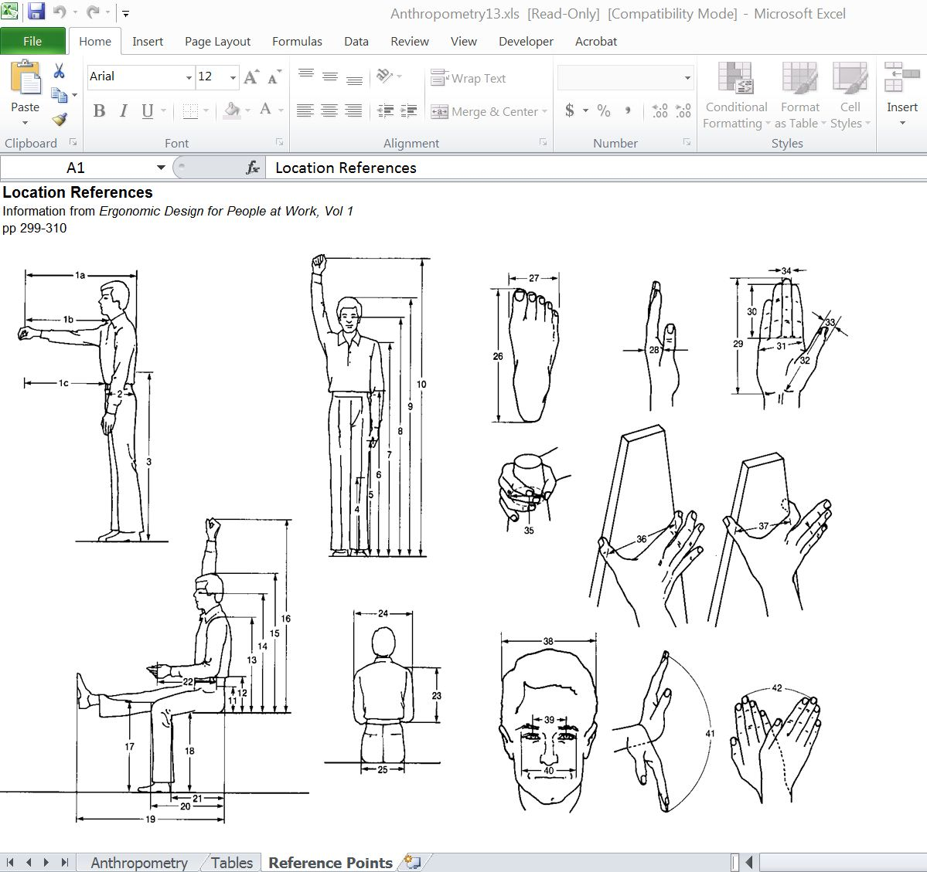
Anthropometry
Accessing the Anthropometric database, in Reference Points sheet in Excel spreadsheet identify metrics of interest:
Frwd Func Reach – acromial process to pinch (1b)
Elbow-to-Fist Length (22)
Elbow height – Stand (6)
Notes:
A workbench is being designed for an assembly process. A diverse user population will perform light weight (up to 10#) repetitive assembly job tasks at elbow level from a standing position. Workbench height and worksurface front-to-back depth are the points of interest. Using anthropometric data we can develop the design specifications for the workbench.
We have provided the link to an available anthropometric Excel database in the Resource section.
Accessing the Anthropometric database, in the Reference Points sheet in the Excel spreadsheet identify the metrics of interest:
Elbow height – Stand (6) (used to determine workbench height)
Frwd Func Reach – acromial process to pinch (1b) (used to determine workbench configuration for placement of parts bins, tools, etc.)
Elbow-to-Fist Length (22) (used to determine workbench configuration for performance of assembly tasks)

Slide 52
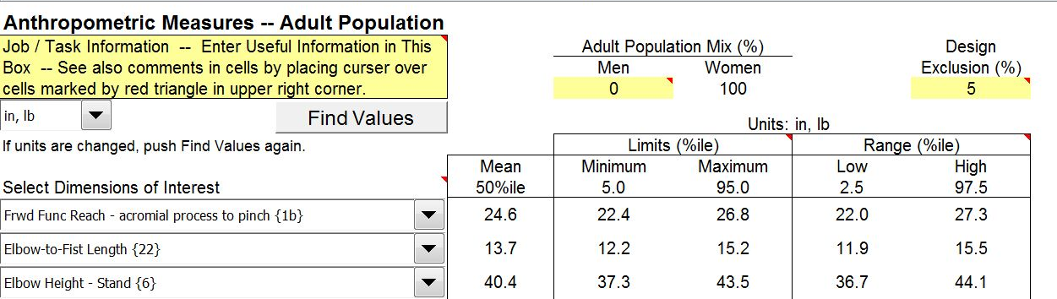
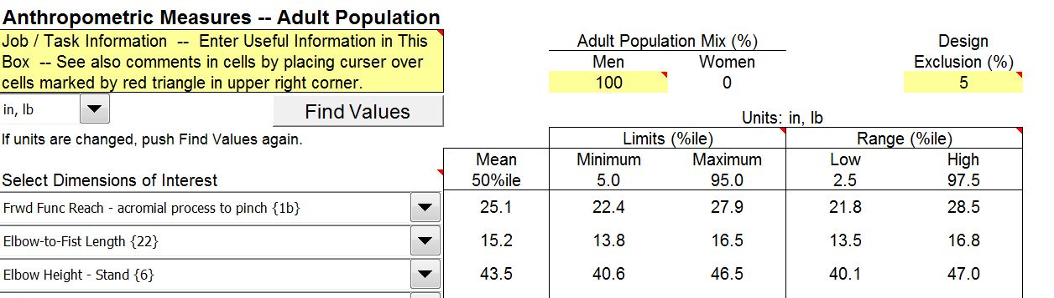
Workbench: Height and Reach
5th percentile female
95th percentile male
Notes:
5th Percentile Female calculation:
In the Adult Population Mix (%) input 0 for Men, Women 100 will be automatically input
In the Design Exclusion (%) input 5, this will calculate 5th and 95th percentiles
Click Find Values.
95th Percentile Male calculation:
In the Adult Population Mix (%) input 100 for Men, Women 0 will be automatically input.
In the Design Exclusion (%) input 5, this will calculate 5th and 95th percentiles
Click Find Values.
For the 5th percentile female and the 95th percentile male, we now have determined standing elbow height (Elbow height – Stand (6)), and two ranges of reach (Comfort (Elbow-to-Fist Length (22)) and Functional (Frwd Func Reach – acromial process to pinch (1b)).
Workbench Height – Adjustable
So with the 5th percentile female standing elbow height at 37.3” and the 95th percentile male at 46.5” we can specify the recommended range of adjustment of the workbench. Ideally the workbench will be height adjustable and controlled by the user in the range of 36” to 48” (about 1” buffer added to minimum and maximum height).
Workbench Height - Fixed
If a height adjustable workbench is not an option, we have to consider what will be the most beneficial fixed height for all operators. We would like the operator to maintain a neutral upright body position as possible and operate within their power zone to handle tools, parts and materials. Here are some considerations:
If the work bench height is set for the shorter individual at 37”, this will force the taller individual to bend at the waist to position their hands at the workbench. This places their hands lower than their recommended power zone and increases biomechanical stress into the spine and shoulders.
If the work bench height is set for the taller individual at 47”, this will force the shorter individual to reach their hands up to the work bench. This places their hands higher than their recommended power zone and increases biomechanical and physiological stress into the shoulders and arms.

Slide 53
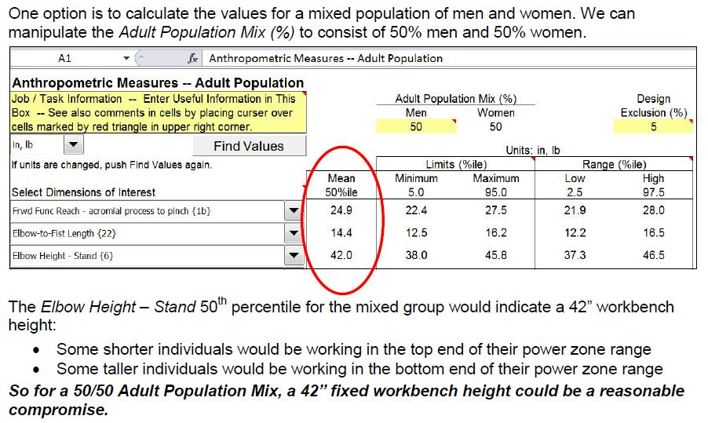
Workbench: Fixed Height and Reach
Notes:
One option is to calculate the values for a mixed population of men and women. We can manipulate the Adult Population Mix (%) to consist of 50% men and 50% women.
The Elbow Height – Stand 50th percentile for the mixed group would indicate a 42” workbench height:
Some shorter individuals would be working in the top end of their power zone range
Some taller individuals would be working in the bottom end of their power zone range
So for a 50/50 Adult Population Mix, a 42” fixed workbench height could be a reasonable compromise

Slide 54
Case Study – Workbench
Standing height workbench
Criteria | Dimension |  |  | Description
Height | Adjustable Table | Fixed Table With removable 6” standing platform | Fixed Table Without platform | Distance from standing surface to hand work height. NOTE: This may NOT be the actual height of the worksurface. Dependent on size and placement of the object, etc. on the worksurface. Defined as the ‘hand work height”.
Precision | 40” to 52” | 51” | 45”
Light assembly | 36” to 48” | 48” | 42”
Heavy assembly | 32” to 44” | 42” | 37”
Reach Zones
Criteria | Dimension | Description
Comfort Reach Zone | Max = 12” | Distance from table edge to hand grasping point with back straight and upper arm near vertical.
Functional Reach Zone | Max = 22” | Distance from table edge to hand grasping point with back straight and arm fully extended.
Notes:
So now you have an understanding of where the Workstation Configuration data points come from in the Ergonomics Reference Guide. Please refer to the Guide for additional details.
Let's take a look at another case study. This one is involved with display monitor placement.

Slide 55
Guide Table of Contents
Notes:
Please take some time to review the contents of the Ergonomics Reference Guide in some detail. We hope you will find pertinent information to assist you in using ergonomics to your advantage in the design process.

Slide 56
Ergonomics – A Potent Tool!
When the principles of ergonomics are applied the outcome is demonstrated improvements in quality, productivity, health and safety.
Thanks for completing Module Two: Ergonomics Reference Guide.
Notes:
Thanks for completing Module Two: Ergonomics Reference Guide .
In Module Three: Ergonomics Risk Screen information in Modules One and Two is used to provide a high level screen to identify significant ergonomics risk factors.

Slide 57
Module Three:
Ergonomics Risk Screen
Notes:
Welcome to Module Three: Ergonomics Risk Screen.

Slide 58
Our employees are central to our mission
This content will eventually be replaced by the VP video message
EHS partnering with businesses
to ensure health and safety are integrated into business processes
Training ensures employees
are aware of risks and are prepared
+
  CARDIAC AND VASCULAR GROUP
  Restorative Therapies Group
  Diabetes
  Group
+
Training!
Employees around the globe receive the same level of protection from risk
Notes:
Before we begin, let’s consider the importance of health and safety at Medtronic. Central to our Mission is the recognition of the personal worth of our employees. We are committed to providing all employees with safe and healthy work environments. Our Environmental, Health, and Safety teams are partnering with businesses to ensure health and safety are integrated into business processes. In addition, EHS training programs ensure employees are aware of workplace risks and are armed with strategies to minimize those risks.

Slide 59

Ergonomics Risk Screen
Ergonomics Risk Screen
  Specifically learn how to use the Ergonomics Risk Screen (ERS)
  Part of best practices in ergonomics design
ERS Assist you?
  Minimize ergonomics risk factors of posture, force, duration and frequency
  Safer workplace in conjunction with improvements in quality and productivity
Notes:
Welcome to the Medtronic Ergonomics Risk Screen. In this training session you’ll learn how to use the Ergonomics Risk Screen or ERS, as part of best practices in ergonomics design.
As you will see the ERS is available as a hardcopy pdf document or an interactive Excel spreadsheet.
How will the ERS assist you?
With appropriate ergonomics design of equipment, tools and work stations, you’ll minimize ergonomics risk factors of posture, force, duration and frequency.
The result is a workplace that is safer in conjunction with improvements in quality and productivity.

Slide 60
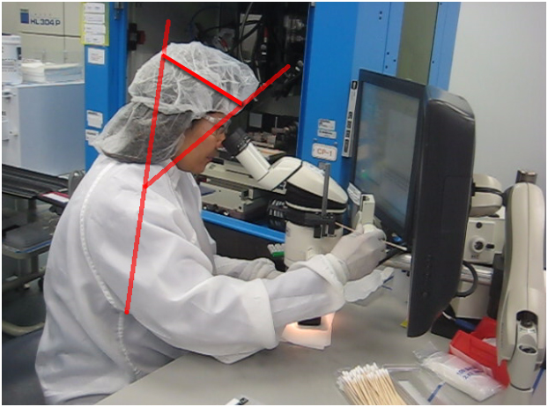
ERS Overview
Versions
  PDF format – complete form by hand
  Excel format – interactive
Format
  Two pages
  Six easy steps
  Takes about 15 to 20 minutes to fill out
  Existing workstation:
    Take video of workstation and work process in action
    Complete ERS by viewing video
  In development
    Complete ERS by anticipating required process steps
Notes:
The Ergonomic Risk Screen is found in the Resource section.
If you use the pdf version, you may complete the form by hand, without the assistance of formatting.
The Excel version is more user friendly allowing the user to complete the form electronically and save the document as a record of the assessment.
The form is two pages and divides the ergonomics screen into six easy steps, that typically take approximately 15 to 20 minutes to complete.
A third page is available for additional and expanded corrective actions.
The process is designed to be a high level screen to identify significant ergonomic risks.
If the workstation already exists, you typically will perform the ERS by viewing video you have taken of the workstation and work processes in action. The most effective manner to perform the ergonomics screen is to video at least 5-6 cycles of the work process or 3-5 minutes of repeating tasks. The detailed body movements and postures are more easily assessed by viewing video and assessing angles of postures.
If the workstation is in development, you can complete the ERS by anticipating the required tasks to accomplish the process.

Slide 61
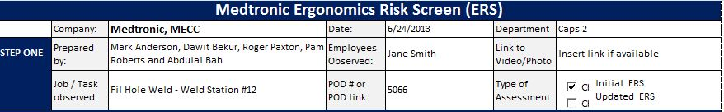
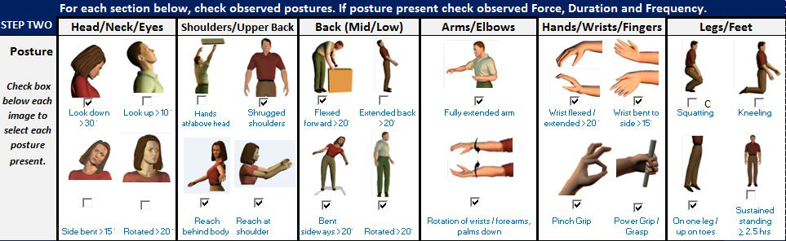
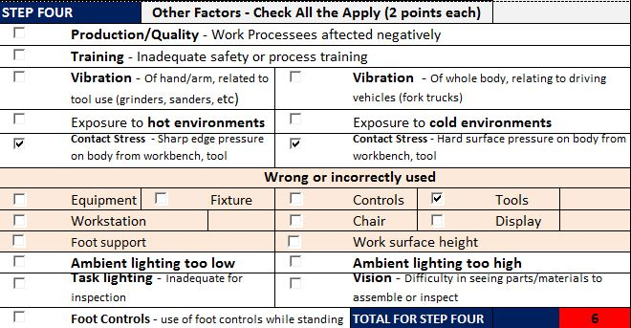
Six Steps to the ERS
Step 1 – General Information
Step 2 – Document high risk postures, force, duration and frequency
Step 3 – Rank risk from Step 2
Step 4 – Assess other potential factors
Notes:
There are six steps in the ERS process.
Step one provides general information about the work process being assessed.
Step two documents any high risk postures present in the work process.
These high risk postures include
Head/Neck/Eyes
Shoulder/Upper Back
Mid to Low Back
Arms/Elbows
Hands/Wrists/Fingers and
Legs/Feet
Continuing in Step two, if a high risk posture is present, it is important to assess if there is any force applied while the employee is using the posture, how long they hold that high risk posture (Duration) and how many times per minute they perform the high risk posture (Frequency.)
The risk ranking in Step Three is the sum of the risks in step two for high risk postures, force, duration and frequency.
Risk ratings of 0-1 are low risk requiring no corrective action.
Risk ratings of 2-3 are medium risk,
and any risk rating > 4 is a high risk.
Both medium and high risk rankings require corrective actions; this includes any factor with a score of 2 or higher.
Step four assesses other factors that are potential ergonomic risks. Presence of at least one of these “other factors” requires mitigation.
.

Slide 62
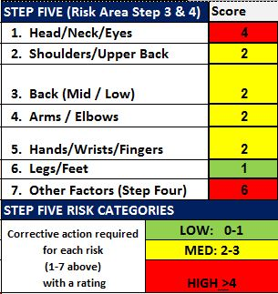
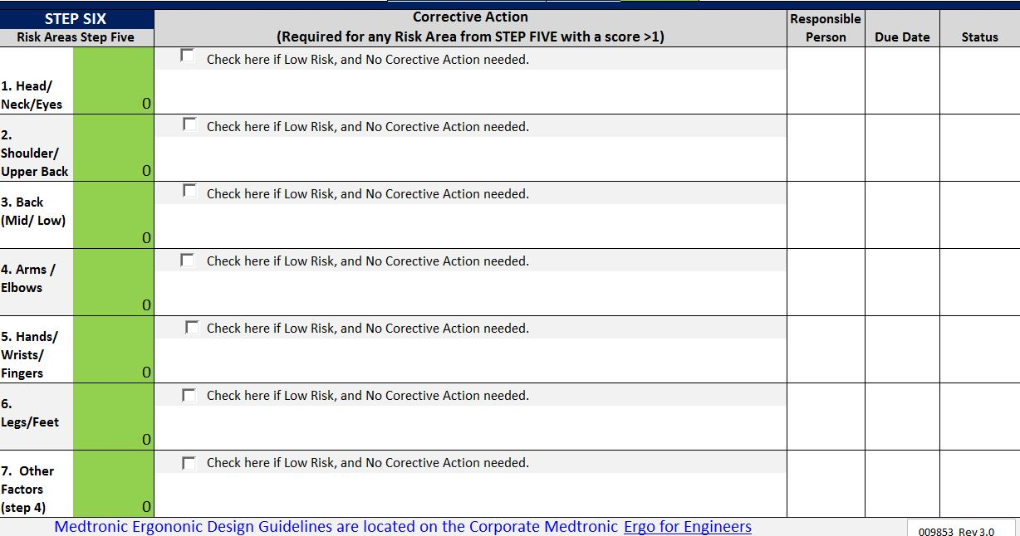
Six Steps to the ERS
Step 5 – Summarize the identified risk factors
Step 6 – Document corrective action to mitigate each of the medium and high risk postures and factors to a low risk
Notes:
Step five shows a summary of all the risk factors.
In Step six, Corrective actions, plans and status are documented to mitigate each of the medium and high risk postures and factors to a low risk.

Slide 63
ERS Case Study: Laser Welder
Notes:
We’ll walk through the use of the ERS using an example of a laser weld work station.
You can view the case study video clip, it is found in the Resources section.

Slide 64
ERS: Step 1
Notes:
Complete Step One by filling in the requested fields.
The Link to Video/Photo field allows you to link to associated video/photo files.
In the Type of Assessment field indicate if this is the initial ERS or an updated one.
Here’s an example of Step One completed.

Slide 65
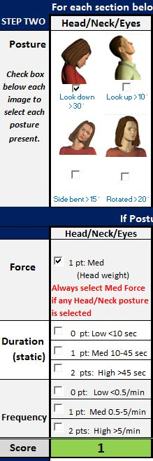


ERS Step 2
Notes:
In Step Two you will check observed postures to determine if they deviate significantly from neutral. If so, you will then quantitatively document the Force, Duration and Frequency of the observed posture.
Posture
Start with the Head/Neck/Eyes section. Identify if any of the out of neutral postures take place. An advantage of using video is to position a protractor on the video screen to actually measure the posture angle.
In this example we identified the Look down > 30° posture and checked it.
Force
You'll note in the Force section the box was automatically checked. This is always selected if any Head/Neck/Eyes posture box is checked. This takes into account the weight of the head. The Score field has turned to green with a 1 entered.
Duration (static)
In the Duration section the amount of static or sustained time in the observed posture was determined to be between 10 and 45 seconds. This scores 1 point.
The Score field has turned yellow with a 2 entered.
Frequency
In the Frequency section the frequency of the observed posture was determined to be greater than 5 times per minute.
This scores 2 points.
The Score field turns red with a total score of 4 for the Head/Neck/Eyes section.

Slide 66


ERS Step 2 (cont.)
Notes:
To complete Step Two, perform the same series of steps for each of the observed postures.
In the Shoulders/Upper Back section, 3 postures in our example were identified and the boxes checked: Shrugged Shoulders, Reach behind Body and Reach at Shoulder.
In this section the Score field remains green with a score of zero until the remainder of the factors are scored.
We need to document the remaining factors for the Shoulders/Upper Back section.
Force was determined to be Light at less than 5 pounds for 0 points.
Force levels are determined by the load imposed by the task on the particular body part. In this example handled parts and materials weigh less than 5 pounds.
Duration was Low at less than 10 seconds for 0 points.
Frequency was scored High at greater than 5 times per minute for a score of 2 points.
For the Shoulder/Upper Back section the cumulative score is 2.

Slide 67

ERS Step 2 (cont.)
Notes:
Let's score the remaining postures.
For the Back (Med/Low) three postures are checked including the Flexed forward > 20°, Bent sideways > 20° and Rotated > than 20°.
Force is less than 10 pounds of parts and materials handled.
Duration is less than 10 seconds and Frequency it is scored high > 3/min.
For the Back (Med/Low) section the cumulative score is 2.
For the Arm/Elbow section, Fully extended arm and Rotation wrist/forearms, Palms down posture boxes are checked.
Force is less than 3 pounds of parts and materials handled.
Duration is less than 10 seconds and Frequency it is scored high > 5/min.
For the Arm/Elbow section the cumulative score is 2.
.

Slide 68

ERS Step 2 (cont.)
Notes:
All four boxes are checked in the Hand/Wrists/Fingers section. This would indicate significant use of the hands to accomplish the tasks.
Force is rated at Light < 2#.
Duration is Low < 10 seconds.
Frequency is rated as High > 5/minute.
For the Hand/Wrists/Fingers section the cumulative score is 2.
In the Legs/Feet section 1 box is checked - On one leg/upon toes.
You'll note in the Force section the box was automatically checked. This is always selected if any Leg/Feet posture box is checked. This takes into account the weight of the body. The Score field has turned to green with a 1 entered.
In this example Duration is low as is Frequency.
The cumulative score is 1

Slide 69

ERS Step 3
Notes:
In Step Three you can examine the Risk (per body part) based on the cumulative score per body part.
The rating score is Low - 0 to 1 points, Medium - 2 to 3 points and High - 4 points and greater.
In our example Head/Neck/Eyes scored a 4. The remainder of the sections scored a 2 with the exception of Legs/Feet that scored a 1.

Slide 70
ERS Step 4
Notes:
In Step Four we identify other factors that have influence in the health, safety and productivity of the workstation.
Two points are awarded for each of these factors that are checked.
As you can see they include:
Production/Quality
Training
Vibration-hand/arm
Vibration-whole body
Hot environments
Cold environments
Contact stress-sharp edge
Contact stress-hard surface
Step Four
In Step Four we identify other factors that have influence in the health, safety and productivity of the workstation.
Two points are awarded for each of these factors that are checked.
As you can see they include:
Production/Quality
Training
Vibration-hand/arm
Vibration-whole body
Hot environments
Cold environments
Contact stress-sharp edge
Contact stress-hard surface
There is also a section that examines the incorrect use of:
Equipment
Fixtures
Workstation
Foot support
Controls
Tools
Chair
Display
Worksurface height
Other factors include:
Ambient lighting-too high or too low
Task lighting
Vision
Foot controls
In our example contact stress of both hard surface and sharp edge along with incorrect tool use was identified.
Each identified factor receives two points and the total for Step Four is 6 indicated by a red box.

Slide 71
ERS Step 5
Notes:
As we have been working through the steps the scores in Step Five have been aggregating.
The Step Five Risk Categories are outlined. Corrective action is required for any individual score greater than 1. In this example we have a number of factors that will require corrective action.

Slide 72

ERS Step 6
Notes:
The Corrective Actions to mitigate the identified ergonomics risk factors are outlined in Step Six.
This also includes identification of the Responsible Person, Due Date and ongoing monitoring of the Corrective Action Status.

Slide 73
Module Three:
Ergonomics Risk Screen
Notes:
Thanks for your time and attention as you learned to use the Medtronic Ergonomics Risk Screen.

