Slide 1
Ergonomics at Hennepin County Library
Hennepin County
Training created in partnership with
Hennepin County Libraries, Workplace Safety
and ErgoSystems Consulting
Notes:
Welcome to Ergonomics at Hennepin County Library.
Training created in partnership with Hennepin County Libraries, Workplace Safety and ErgoSystems Consulting.
.

Slide 2
The First Public Library
Benjamin Franklin:
Donated collection of books
Massachusetts town
Named itself ‘Franklin’
Franklin determined that "sense" was more important than "sound"
Residents voted donated books be freely available for town members
Nation's first public library was created
Benjamin Franklin
Notes:
In 1790, Benjamin Franklin donated a collection of books to a Massachusetts town that had named itself Franklin to honor him. Though the town initially asked Franklin to donate a bell, he determined that "sense" was more important than "sound."
Town residents voted those donated books be freely available for town members, thereby creating the nation's first public library.

Slide 3
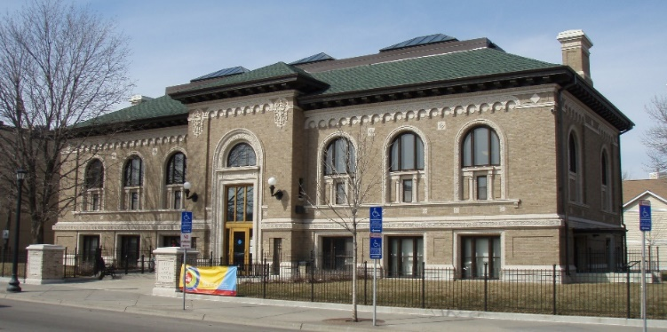
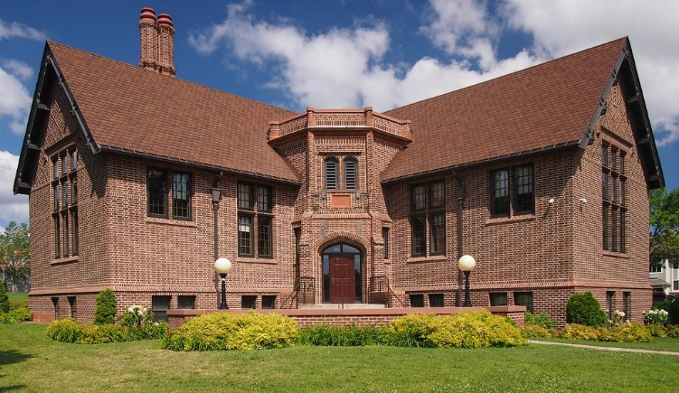
Carnegie Libraries
Andrew Carnegie:
"bring books and information to all people”
Between 1883 and 1929:
1689 Carnegie libraries built in U.S.
Including Hennepin County Libraries:
Franklin
Hosmer
Sumner
Notes:
In the years following, industrialist and philanthropist Andrew Carnegie envisioned that libraries would, "bring books and information to all people”. Between 1883 and 1929, 1689 Carnegie libraries were built in the United States, including Hennepin County Libraries of Franklin, Hosmer & Sumner.

Slide 4
Institutions of Public Value
Libraries became institutions of public value
Librarians transformed libraries into cultural centers at heart of towns
More and more public libraries opened with public funding
Notes:
Libraries became institutions of public value as librarians transformed their libraries into cultural centers at the heart of their towns. More and more public libraries were being opened with public funding.
By 2016, in the United States there were 16,766 libraries including branches; there are more public libraries than McDonald’s restaurants!

Slide 5
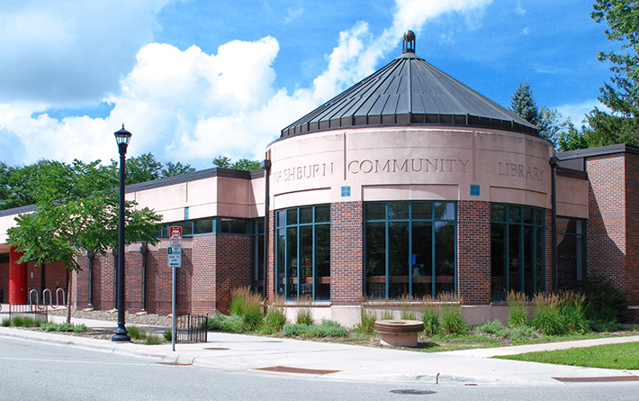
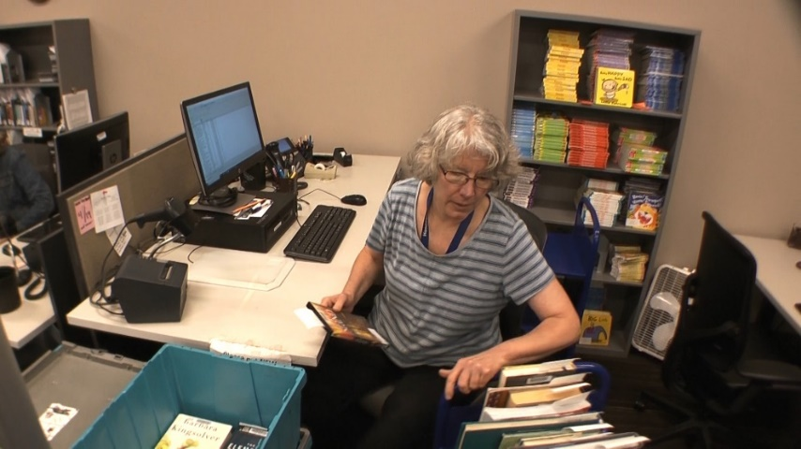
Hennepin County Library
Hennepin County Library
Services 1.2 million county residents over 611 square miles at library sites
Hennepin County Library staff
Provide invaluable support in person, online and through outreach
“to nourish minds, transform lives and build community together”
Notes:
Fast forward to the present-day, Hennepin County Library is a national leader of library service, innovation and excellence. With 41 libraries, website and outreach offerings, library service is provided to 1.2 million county residents over 611 square miles.
As a member of the Hennepin County Library staff you provide invaluable support to ensure the Library’s stated mission, “to nourish minds, transform lives and build community together” and to ensure every patron has the opportunity and resources to read, graduate, engage, work and learn.

Slide 6
Very First Book
IMAGE PLACEHOLDER
Making a difference
First book from library
What an exciting milestone in their life!
For many of you this is very likely vivid in your memories as well!
Child checking out first book
Notes:
Think for a moment about a child checking out their very first book from the library. What an exciting milestone in their life!
For many of you this is very likely vivid in your memories as well!

Slide 7
Caring Hands
Caring hands that touched that book!
Journey to become that milestone:
Book received into Technical Services
Unpacked from shipping box
Processed into system
Placed on a book truck
Wheeled to the library shelf
Placed for easy access and check-out by young patron
Returned to library into Book Return
Once again entered into system
Returned to shelf
Discovered by another inquiring patron
Notes:
Consider that one book. Consider all the caring hands that touched that book on its journey to become that milestone.
The book was received into Technical Services to be unpacked from a shipping box, it was processed into the system, placed on a book cart/truck and wheeled to the library shelf where it was placed for easy access and check-out by the young patron.
Once enjoyed by the patron it was returned to the library and dropped into the Book Return where it once again was entered into the system and returned to the shelf to be discovered by another inquiring patron.

Slide 8
Health and Safety Strategies
For all people who touch that one book
One among 500,000 new items entering library system every year
Workplace that is a healthy and safe place to work
Vital for Library to fulfill community role
Specific strategies:
Promote health and safety in your role at library!
Notes:
No doubt about it, for all of the people who touch that one book, one among the 500,000 new items that enter the library system every year, creating a workplace that is a healthy and safe place to work is vital for the Library to fulfill its role in the community.
That’s what this training is all about; specific strategies you can use to promote your health and safety in your role at the library.

Slide 9
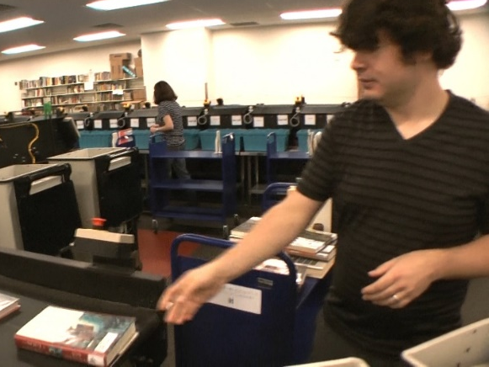
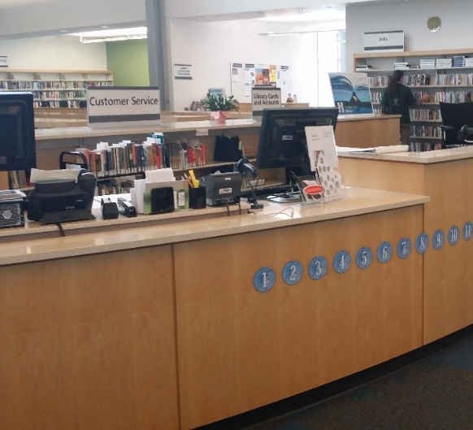
Ergonomics Improvements
Hennepin County values health and safety of staff
Ergonomics improvements:
Reduce reaching by lowering bookshelf heights
Height adjustable work stations
Automated material handling (AMH) system
Lifting devices (Lift Stik)
Improved lighting
Staff training
Notes:
Hennepin County values staff health and safety and has made a number of ergonomics improvements over the years at several library locations, such as reducing reaching by lowering bookshelf heights at several locations, installing height adjustable work stations, adding automated material handling (AMH) equipment, lifting devices, improved lighting as well as training.

Slide 10
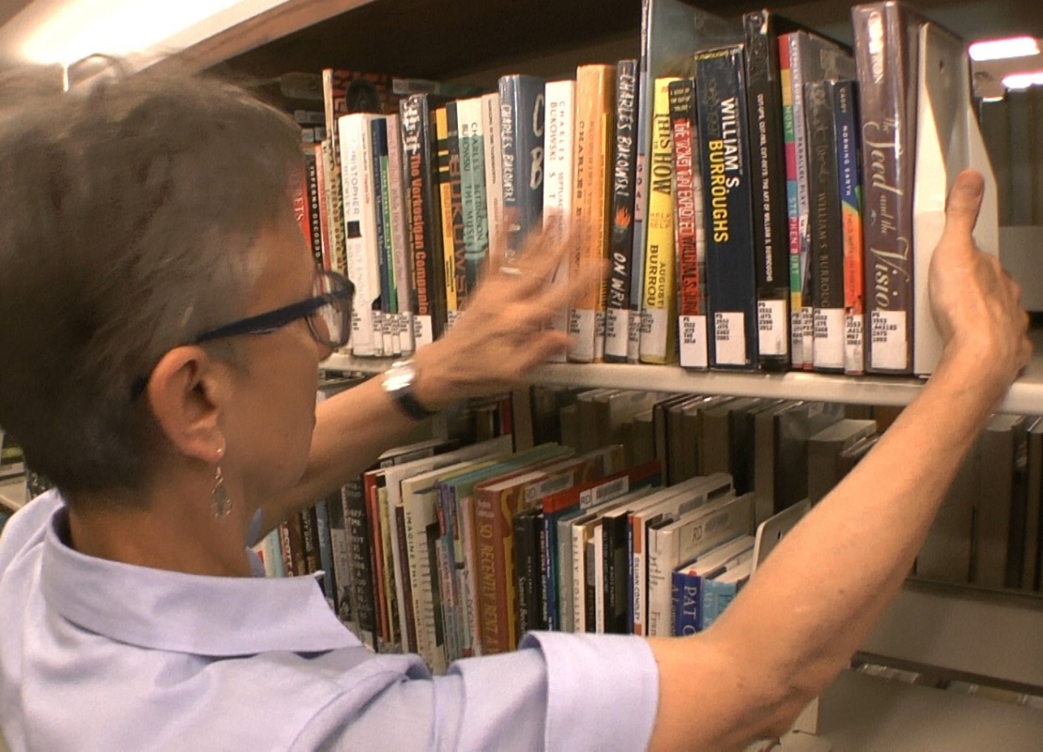
Work Smarter; Not Harder!
Activities:
Manual handling of library materials
Loading/unloading blue delivery tubs
Pushing book trucks
Use of Lift stiks
AMH system use
Specific shelving techniques
Personal health and wellness
Physical fitness
Stretching routine:
Promote blood flow and joint health
Understanding how to . . .
“Work Smarter; Not Harder!”
Notes:
Recognizing that there is always room for improvements, we will look at a variety of activities including manual handling of library materials, loading and unloading bins, pushing book trucks, using lift stiks and the AMH system and specific techniques for shelving materials.
We will also discuss topics of personal health and wellness along with physical fitness. You will learn how to safely and effectively perform a basic stretching routine to promote blood flow and joint health.
All of this is in the context of ergonomics – understanding how to “Work Smarter; Not Harder!”

Slide 11
What is Ergonomics?
Designing workstations and using tools and work techniques that help us:
“Work smarter . . . not harder”
Incredible capabilities:
Physically strong
Handle heavy loads
Very precise physical movements
But how we use our physical capabilities:
Huge difference in how body responds
Notes:
What is ergonomics? In essence, Ergonomics is designing workstations and using tools and work techniques that help us work smarter . . . not harder.
As human beings we have incredible capabilities. We are physically strong, able to handle heavy loads and yet are also capable of very precise physical movements
But how we use our physical capabilities makes a huge difference in how our body responds to the tasks we ask it to do.

Slide 12
Ergonomics Principles
Ergonomics
Neutral Position
Reach Zone
Power Position
Fatigue Control
Define set of ergonomics principles
Ensure work processes are most effective possible
Notes:
We’ll define a set of ergonomics principles to ensure the work processes we use are the most effective possible.
We’ll focus on four ergonomics principles:
Neutral Position
Reach Zone
Power Position and
Fatigue Control

Slide 13
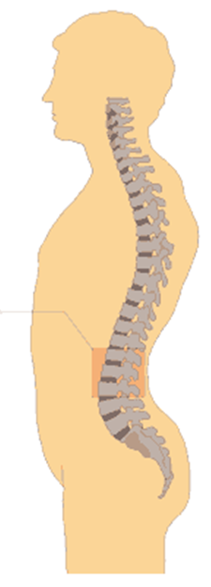
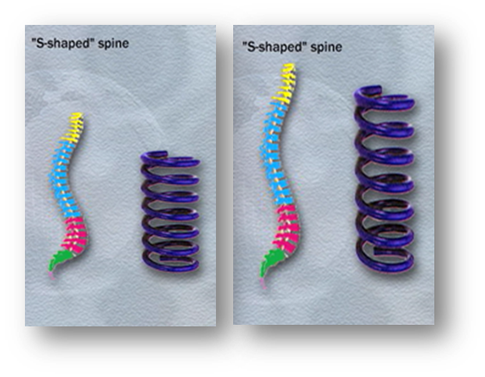
Neutral Position - Spine
Stand upright on feet:
Spine and pelvis provides foundation for our body
Neutral position:
Spinal column
S-shape configuration
Why S-shape?
S-shape allows spine to act like a spring
Notes:
The first ergonomics principle is Neutral Position.
Although we stand upright on our feet, it's really the spine and pelvis that provides the foundation for our body.
When you hold yourself in the neutral position, your spinal column, when viewed from the side, is actually in an S-shape configuration. An inner curve in the lower back and neck and an outer curve in the mid-back area.
Why S-shape? Think springs! The S-shape allows the spine to act like a spring and increases the spine’s ability to handle stress.

Slide 14
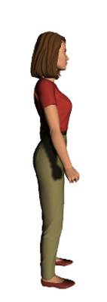
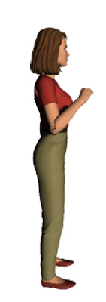
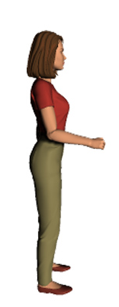
Neutral Position - Joints
Every joint has neutral position
“Mid-range of joint position”
Think about elbow:
What position of elbow is most functional?
With elbow straight or bent all the way?
Elbow most functional at about 90 degrees of bend
Greatest strength
Protects joint and surrounding soft tissues
Every joint has “mid-range of joint position”
Notes:
What about the other joints of the body? Every joint has a neutral position. We call it, “mid-range of joint position”.
Think about your elbow. From a physical performance standpoint, what position of the elbow is the most functional?
With the elbow straight or bent all the way?
The elbow is most functional at about 90 degrees of bend. This is the position of greatest strength and also protects the joint and surrounding soft tissues like muscles, tendons, ligaments and nerves.
Every joint of the body has a “mid-range of joint position”.

Slide 15
Spend More Time in Neutral!
Can’t spend all of time in absolute neutral position
Closer to “mid-range of joint position”, the better
Next time out-of-neutral position:
Identify why out of neutral?
Options to improve position
Spend 15% more time in neutral
Adjust worksurface height:
Using Neutral Position principle to your advantage!
Notes:
Of course, you can’t spend all of your time with your spine and joints in the absolute neutral position. However, the closer you can position your joints to the “mid-range of joint position”, the better.
The next time you find yourself in an out-of-neutral position, identify why you are out of neutral and consider options to improve the situation to allow you to be more in neutral.
Even if you can spend 15% more time in neutral, that 15% can make a big difference!
When you adjust the worksurface height at your workstation, you are using the Neutral Position principle to your advantage!

Slide 16
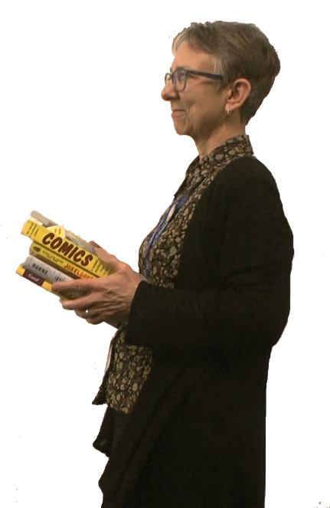
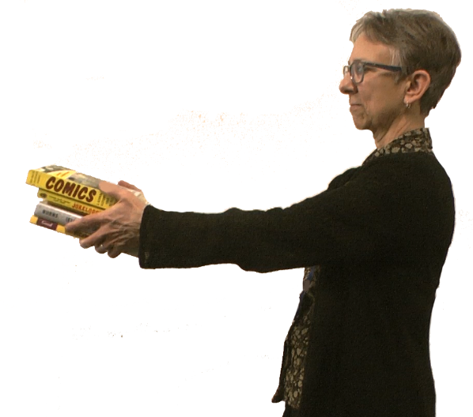
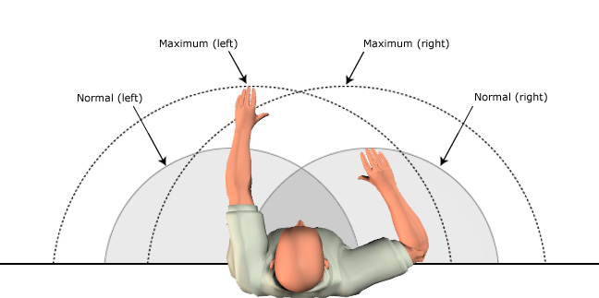
Reach Zone
How far away from body need to reach
How long hold 10# load at arm’s length?
Gets heavy quickly
Hold as close to body as possible
Specific operating range:
Determined by arm’s length
Sphere from hip to shoulder level
Within arm’s reach to front and side
Notes:
Reach Zone is the second ergonomics principle; it has to do with how far away from your body you need to reach.
For example, how long can you hold a 10# load at arm’s length?
Well, at arm's length, it gets heavy quite quickly. That’s why, in fact, if you have to hold the load at all, you know you want to hold it as close to your body as you can get it.
Structurally, the body is designed to function within a specific operating range. We call this the Reach Zone.
Determined by your arm’ length, it’s defined by a sphere from hip to shoulder level within arm’s reach to the front and side.

Slide 17
Work in Your Reach Zone!
Never reach outside reach zone?
Answer is NO!
Find yourself reaching:
Way outside reach zone
With heavy load
In awkward position
Decrease reach distance
Work within Reach Zone:
Top and middle shelves
Rather than bottom shelf
Notes:
Are we saying never reach outside your reach zone? Of course, the answer is NO!
But if you find yourself reaching way outside your reach zone with a heavy load in an awkward position think about ways to decrease the reach distance.
In general, set up as much as possible to work within your Reach Zone. For example, as possible use the top and middle shelves on the book trucks rather than the bottom shelf.

Slide 18
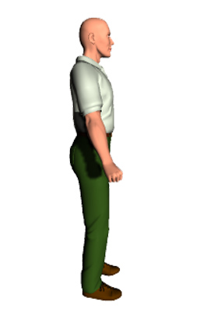
Power Position
If you have to lift or move something
Is Neutral Position best position?
As it turns out – it’s not!
From body’s perspective Power Position is better!
Notes:
So far, we have outlined the ergonomics principle of Neutral Position and Reach Zone.
But what about if you have to lift or move something.
Is the Neutral Position really the best position for this kind of activity?
As it turns out – it’s not.
From the body’s perspective the third ergonomics principle, Power Position is a better way to go.

Slide 19
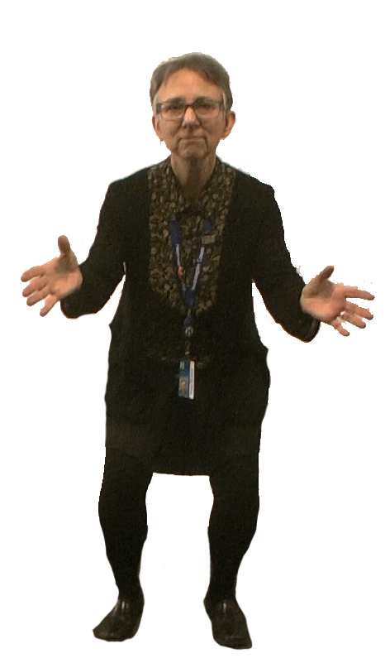
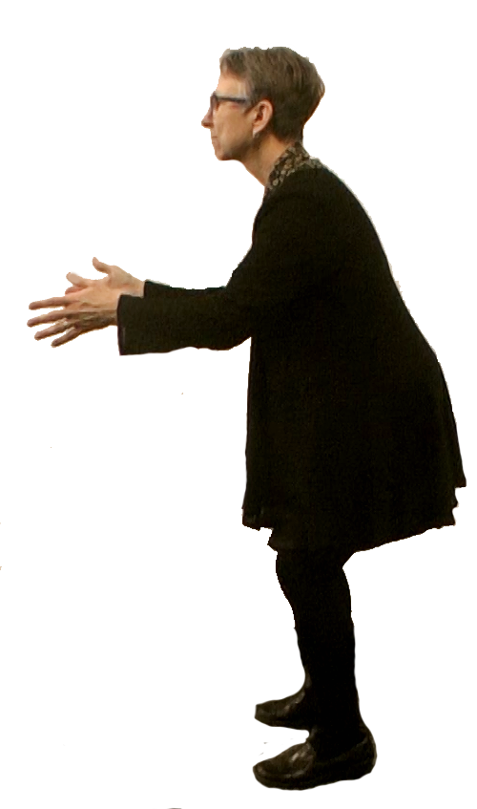
Power Position
Power Position:
Feet shoulder width or slightly wider
Good footing
Spine in neutral position
Hips/knees bent slightly
Head/shoulders upright
Notes:
Here’s what the Power Position looks like:
- Feet shoulder width or slightly wider.
- Good footing so you don’t slip.
- Spine maintained in neutral.
- Hips and knees bent slightly.
- Head and shoulders upright.

Slide 20
Use the Power Position!
In sports as a “ready” position
Power Position in many ways:
Lifting materials
Maneuvering book truck
Using tools/equipment
Setting up work area
Get drink at water fountain!
Rather than just bending over at waist with knees straight
Use Power Position.
Give it a try!
Tips and Techniques
Notes:
In fact, this position is used in just about any sport as a “ready” position.
You can use the Power Position in many ways – lifting materials
and maneuvering a book truck for sure but also, for using tools and equipment and setting up the work area.
You can even use the power position to get a drink at the water fountain! Rather than just bending over at the waist with your knees straight – stressing your lower back – use the power position. Give it a try!
We’ll go through specific examples in the Tips and Techniques section later in the training.

Slide 21
Fatigue Control
Using word “Control” and not “Eliminate”
Physical fatigue is a normal occurrence:
Not possible to eliminate fatigue
For overall health and wellness, recover from fatigue through appropriate:
Rest
Hydration
Nutrition
Notes:
So far, we have gone over the ergonomics principles of Neutral Position, Reach Zone and Power Position. The last principle is Fatigue Control.
You’ll notice we’re using the word “Control” and not “Eliminate” when discussing fatigue. Physical fatigue is a normal occurrence in the routine of our lives. It is not possible to eliminate fatigue.
For overall health and wellness, we need to recover from fatigue through appropriate rest, hydration and nutrition.

Slide 22
Recognize Fatigue?
How do you recognize fatigue?
Physical and/or repetitive tasks result in muscle tiredness
Decrease in general physical strength and coordination
More prone to making mistakes
May be more likely to experience injuries
Notes:
First, how do you recognize fatigue? Physical fatigue is demonstrated when physical and/or repetitive tasks result in muscle tiredness. We experience a decrease in general physical strength and coordination. We are more prone to making mistakes. We may be more likely to experience injuries.

Slide 23
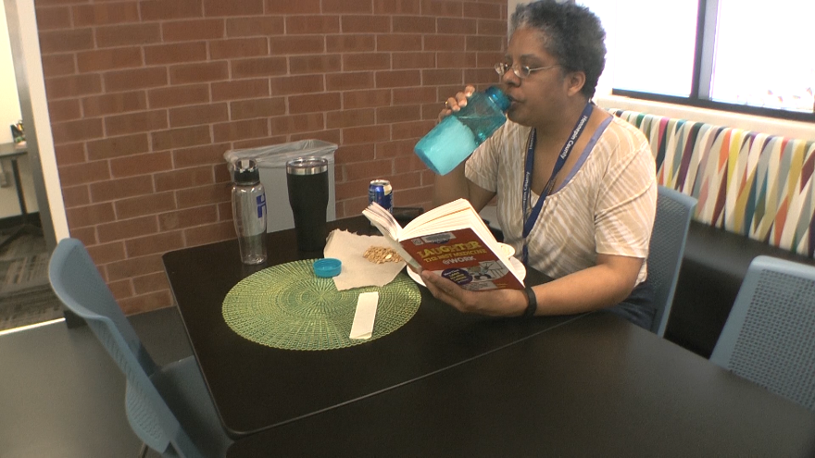
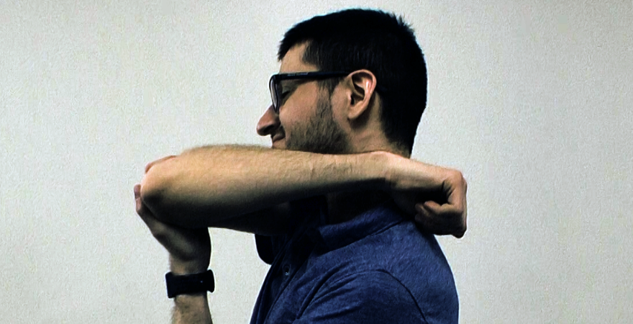
Ways to Control Fatigue
Job rotation
Break larger task into smaller tasks.
Recovery breaks:
Replenish energy supplies/fluid intake
Do not skip breaks and lunch
Stretch:
Blood circulation/joint lubrication
Physical Fitness, Health and Wellness and Stretching sections
Consciously work to identify and control fatigue
Notes:
During the work shift what can you do to control fatigue?
Try to mix up job tasks to provide a variety of physical activities. This is called job rotation. Break a larger task into smaller tasks.
Make sure you take appropriate recovery breaks to give your body a chance to replenish energy supplies and fluid intake. In other words, try to not skip breaks and lunch.
Drink plenty of fluid on a periodic basis. If you are thirsty you are on the way to dehydration.
Use stretching to promote blood circulation and joint lubrication through-out the shift. Look at the Physical Fitness, Health and Wellness and Stretching section for details about using stretching as a part of your overall fatigue control strategy.
Consciously work to identify and control fatigue at work.

Slide 24
If you are experiencing extreme or unusual symptoms please access appropriate medical treatment
Notes:
If you are experiencing extreme or unusual symptoms please access appropriate medical treatment.

Slide 25
Use Ergonomics Principles
“Working Smarter; not Harder”
Ergonomics principles:
Neutral Position
Reach Zone
Power Position
Fatigue Control
Help guide safe and effective work
Check out Tips and Techniques Section
Notes:
So, ergonomics is all about :Working smarter; not harder”.
We’ve discussed four ergonomics principles:
- Neutral Position
- Reach Zone
- Power Position and
- Fatigue Control
Use these principles to help guide how to safely and effectively do your work.
Check out the Tips and Techniques Section for additional examples.

Slide 26
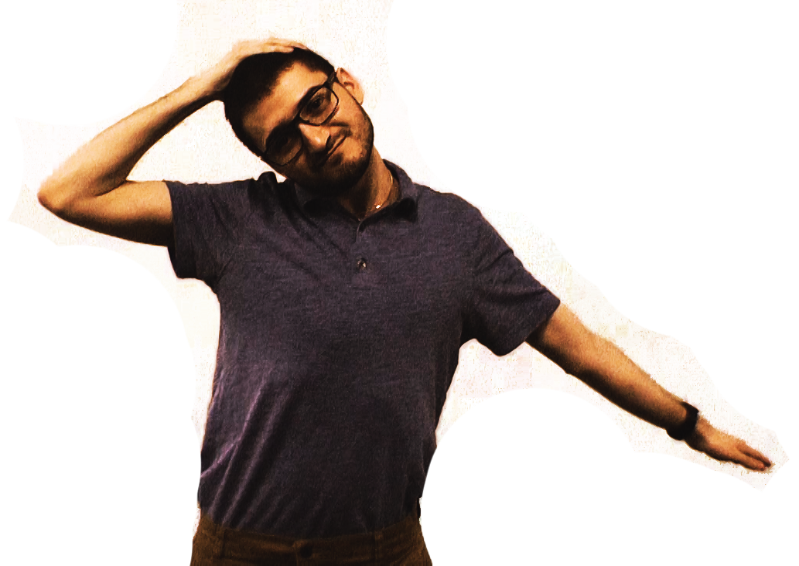
Stretching and Warm-up
Importance of warming up and stretching:
Minimizes likelihood of injury
Enhances performance
Doing specifically to warm up and stretch as part of job?
If the answer is . . . Nothing
Increase risk of musculoskeletal disorder
Limit job performance
Notes:
Anyone who plays a sport knows the importance of warming up and stretching for two primary reasons: It minimizes the likelihood of injury and enhances performance.
Your job certainly involves physical activity. What are you doing specifically to warm up and stretch as part of your job?
If the answer is . . . nothing, you are increasing the risk of suffering a musculoskeletal injury/disorder and limiting the level of your job performance.

Slide 27
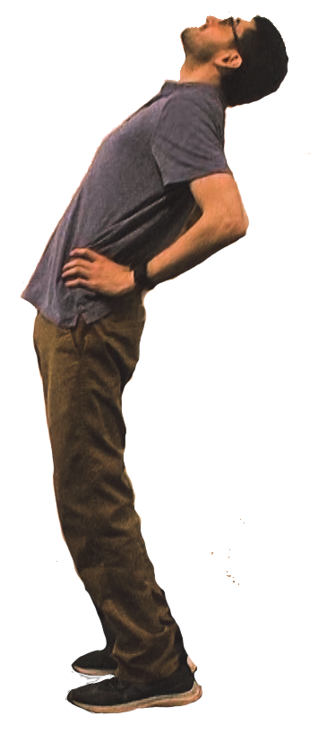
Benefits - Stretching and Warm-up
Stretching not only primes body:
Increases blood flow
Loosens joints
Improves alertness levels
All of this just from stretching!
Notes:
Stretching not only primes the body:
It also increases blood flow to the working tissues providing more oxygen and nutrition. It helps to loosen the joints to decrease stiffness and it helps to improve alertness levels through increased oxygen levels in the blood going to the brain.
Think of it, all of this just from stretching.

Slide 28
Guidelines - Stretching and Warm-up
Follow specific medical restrictions
Stop stretch if experience any numbness or tingling
Always start stretch from neutral position
Don't hold breath
Breathe in with stretch and out with relaxation
Use slow controlled movement
Push stretch only as far as comfortable
Notes:
Guidelines for stretching include:
- Follow any specific medical restrictions
- Stop the stretch if you experience any numbness or tingling
- Always stretch from the upright neutral position
- Don't hold your breath during the stretch – breathe in with the stretch and out with the relaxation
- Use slow controlled movement
- Push the stretch only as far as comfortable for you

Slide 29
Stretches
Insert stretches.
Reference additional resources found on the Workplace Safety Ergonomics Solution Center site
Notes:
Insert stretches Reference additional resources found on the Workplace Safety Ergonomics Solution Center site
Stretching routine of about 10 stretches that can be performed as a routine and individually

Slide 30
Physical Fitness
Job provide well-rounded, well-balanced physical fitness program?
More than likely answer is NO
Physical fitness is combination of:
Strength
Flexibility
Aerobic endurance
Better meet job demands
Exercise at home or a fitness center
Notes:
When we discuss overall personal physical fitness does your job provide all the components of a well-rounded, well-balanced physical fitness program?
Does it provide all the strength, flexibility and heart and lung fitness you need?
More than likely the answer is NO.
Many studies have shown that individuals with balanced personal physical fitness are less likely to sustain an injury.
So, physical fitness is a combination of strength, flexibility and aerobic endurance. To better meet your job demands you can perform a variety of exercises at home or a fitness center.

Slide 31
Health Concerns?
If you have any health concerns about starting a physical fitness program you should always consult with your health care professional before starting.
In this training, we aren’t able to provide specific details for you to start a physical fitness program.
If you need additional assistance please tap into available resources.
Hennepin County HealthWorks sponsors fitness center discounts and a number of onsite classes.
Notes:
HERE IS A VERY IMPORTANT POINT: If you have any health concerns about starting a physical fitness program you should always consult with your health care professional before starting.
In this training, we aren’t able to provide specific details for you to start a physical fitness program. If you need additional assistance please tap into available resources. Hennepin County HealthWorks sponsors fitness center discounts and a number of onsite classes.

Slide 32
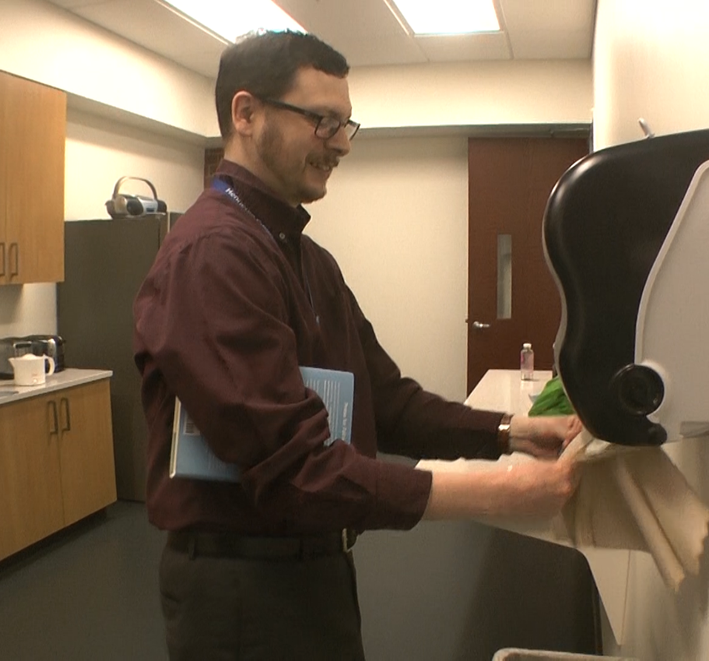
Health and Wellness
Health and Wellness factors:
Adequate diet and nutrition
Body weight control
Stress management
Smoking cessation
Blood pressure control
Adequate rest from sleep
Fluid intake to avoid getting dehydrated
Personal health and wellness:
Part of overall strategy for healthy and safe place to work
Notes:
In addition to physical fitness what about overall personal health and wellness?
It’s up to you: Your personal health and wellness, just like your personal physical fitness, is your personal business.
Here is a list of factors for you to consider:
- Adequate diet and nutrition
- Body weight control
- Stress management
- Smoking cessation
- Blood pressure control
- Adequate rest from sleep and
- Fluid intake to avoid getting dehydrated
These are all factors under our control that can help us be healthy and well. No doubt . . . personal health and wellness is part of the overall strategy for a healthy and safe place to work.

Slide 33
Safest Lift?
Manual material handling:
Lifting
Pushing
Pulling
Carrying
What is safest lift you can do?
Use equipment available
Lift Stik is a valuable tool
Notes:
Next let’s get into the specifics of using ergonomics principles for manual material handling. Lifting, pushing, pulling, carrying.
Here is a question for you . . . “What is the safest lift you can do?”
It’s the one you DON’T do!
As appropriate, make sure you use the equipment available to assist with or accomplish the material handling.
The Lift Stik has proven to be a valuable tool.

Slide 34
Personal Performance Limit
Up front planning:
Minimizes stress and strain
Listen to body and respect personal physical performance limit:
Exceed limit, significantly increase risk of injury
Quarter of a second for life-changing injury
Teamwork is critical:
Ask co-worker for assistance
If someone could use a hand, offer to assist
Know of equipment:
Aid in manual handling activities
Pass along to supervisor
Notes:
When you do need to accomplish a manual material handling task, up front planning goes a long way to minimize stress and strain and allows you to get assistance if you need it.
Listen to your body and respect your personal physical performance limit.
If you exceed your limit, you significantly increase your risk of injury. It can literally take only a quarter of a second for a life-changing injury to take place.
Teamwork is critical – If you need help, ask a co-worker for assistance, or if you see that someone could use a hand, offer to assist.
If you know of equipment that may aid in your manual material handling activities, pass that information along to your supervisor. It’s in everyone’s best interest to keep you healthy and performing at your best.

Slide 35
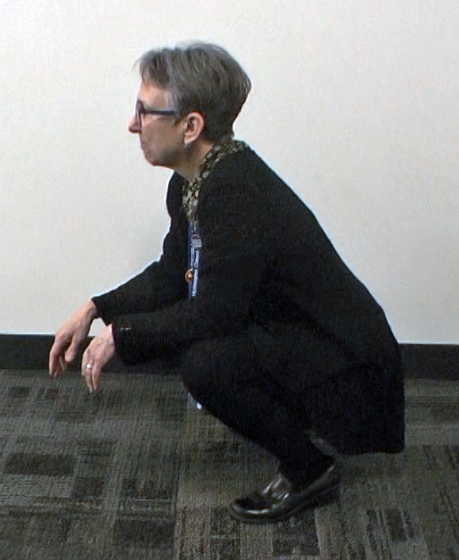
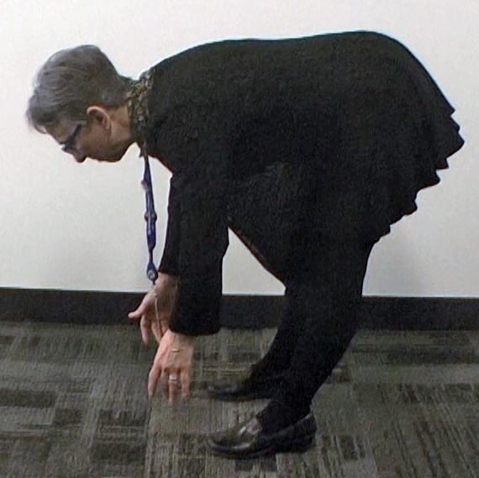
Best Lifting Technique?
Back bent, straight leg lifting technique is not good
Puts lot of stress into low back
Taught to lift with legs - not back
Picture deep squat lift
Is this best lifting technique?
Notes:
So, at this point you have determined the manual material handling task is within your personal performance limit and you are going to handle it.
What is the best technique to use?
Most people recognize that the back bent, straight leg lifting technique is not good. It can put a lot of stress into the low back.
Most people have been taught to, “Lift with your legs - not your back!” They picture this as a deep squat lift. What do you think? Is this the best lifting technique?

Slide 36
Best Lifting Technique?
Lot of people have hard time using deep squat technique:
Leg strength and sound knee joints
Quickly uses lot of energy
Because of these reasons:
Use back bent/straight leg technique
Increased stress into back and body in general
Notes:
Well, what we know is that for a variety of reasons a lot of people have a hard time using this technique. It requires a high degree of leg strength and sound knee joints. And for any repeated lifting it very quickly uses up a lot of energy.
In fact, because of these reasons many people tend to use the back bent, straight leg technique with the result being increased stress into the back and body in general.

Slide 37
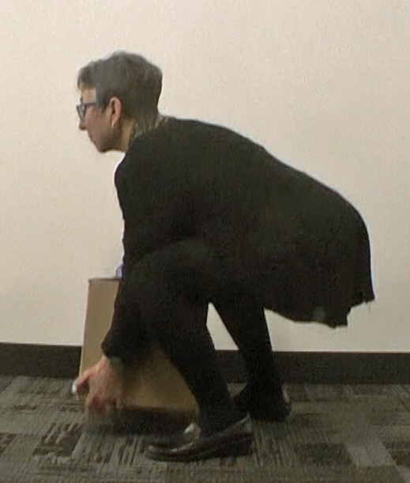
Power Lift Technique
Better technique
Used by professional weightlifters
Power Lift
Does not require troublesome deep squat lift
But also NOT back bent/straight leg technique
Notes:
What is a better technique? Let’s turn to the technique commonly used by professional weightlifters. They call it the Power Lift.
It does not require the troublesome deep squat lift but it is also NOT the back bent, straight leg technique.

Slide 38
Power Lift Technique
Up-front planning:
Need to use mechanical equipment?
Get someone to help?
Thought through where item is going to end up?
Anticipated any surprises?
Notes:
Here are the step-by-step details of the Power Lift.
Remember you have done your up-front planning to decide if you need to use mechanical equipment or get someone to help you. You have thought through where the material you are about to handle is going to end up. You have anticipated any surprises.

Slide 39
Power Lift Technique
IMAGE PLACEHOLDER
Step-by-step:
Approach object with feet slightly wider than shoulder width
Good footing
Bend hips and knees somewhat
Reach hands to speaker
Figure out best way to grip object
Build bridge with elbow on knee
Tighten up stomach muscles
You are now ready to lift!
One last critical step. . . at the moment of the exertion . . . LOOK UP
Looking up automatically puts you into Power Position
Insert Power Lift Demo Video
Notes:
All right, first step . . . approach the object with your feet slightly wider than shoulder width.
Make sure you have good footing.
Now bend your hips and knees somewhat and reach your hands to the object.
Figure out the best way to grip the object. This might be at a diagonal.
You can also build a bridge with your elbow on your knee to unload your back as you get your grip. Your goal is to keep the object as close as possible to you.
Tighten up your stomach muscles.
You are now ready to lift!
One last critical step. . . at the moment of the exertion . . . LOOK UP.
Look up as you lift.
Looking up will automatically put you into the Power Position and you will use the large muscles of your legs and thighs - not your back to accomplish the lift.
Your back muscles will work with your stomach muscles to stabilize your spine in the neutral position.

Slide 40
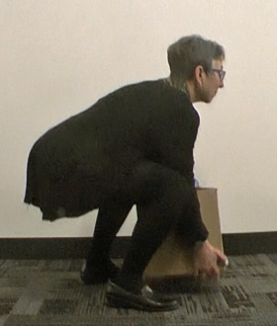
Look Up
LOOK DOWN
LOOK UP
Look down:
Round out back
Significant strain
Look up:
Back in neutral
Transfer force of lift to hips and legs
Use power lift technique to your advantage
Notes:
To condense this down to one paramount rule, to use the power lift technique properly, LOOK UP when you perform the exertion. Just look up!
If you look down, you’ll round out your back and place a significant strain on your back.
On the other hand, if you look up, automatically your back will stay in neutral and transfer the force of the lift to your hips and legs.
Use the power lift technique to your advantage.

Slide 41
Golfer’s Lift
IMAGE PLACEHOLDER
Lighter weight item:
Handle with one hand
Use Golfer’s Lift
Lift one leg back as bend over at hip to reach to item
Counterbalances trunk
Practice using Golfer’s Lift!
Insert Golfer’s Lift Video
Notes:
If you have a lighter weight item that you can handle with one hand use the Golfer’s Lift. Lifting one leg back as you bend over at the hip to reach to the item counterbalances the trunk and works well. Practice using the Golfer’s Lift as it makes sense for you.

Slide 42
Tips and Techniques
Apply concepts to everyday activities at library?
Tips and Techniques:
Shelving library materials
Working with AMH system
Working at Service Desks
Maneuvering book trucks
Using Lift Stiks
Processing library materials
Notes:
When you think about the concepts of Neutral Position, Reach Zone, Power Position, Power Lift, Stretching and Fatigue Control, a very good question is . . . “Can you actually apply these concepts to everyday activities at the library?”
In Tips and Techniques let’s take a close look at some common activities in the library like shelving library materials, working with the AMH system, working at the Service Desks, maneuvering book trucks, using Lift Stiks and processing library materials.

Slide 43
Shelving
Nice if library shelves between waist and shoulder height:
Walk up to shelf, maintain neutral body position to place materials
To make best use of space:
Some shelves at lower level and some at higher level
With library renovations:
Many shelves reconfigured so top shelf is maximum of about 60”
Helped to reduce amount of higher than head level lifting
Notes:
Now, wouldn’t it be nice if all of the library shelves were between waist and shoulder height so you could just walk up to the shelf and maintain a neutral body position as you shelf the materials within your reach zone!
In reality, we recognize to make the best use of the space, some shelves will be at a lower level and some will at a higher level. It is worthwhile to note that with library renovations, many shelves have been reconfigured so the top shelf is a maximum of about 60”. This has helped to reduce the amount of higher than head level lifting of materials. The bottom shelf is about 6 inches off the floor.

Slide 44
Shelving – Decisions!
How many books in hands at one time?
The answer is . . . It depends!
How large and heavy are books?
Ability to safely handle them?
May be one book?
May be several?
Use hands like a scoop, not like a crane
Notes:
When we talk about shelving, here is an important question.
How many books or other materials should you have in your hands at one time when you are shelving?
The answer is . . . It depends!
It depends on how large and heavy the books are and your ability to safely handle them. In some cases, this may be one and in other cases it may be several.
Whatever the number, work to handle the materials from the bottom, not from the top. Use your hands like a scoop not like a crane. We are stronger with the under hand grip rather than the overhand.

Slide 45
Lower Shelf Levels
Variety of techniques:
Squat down
Down to a knee
Bend straight over at waist keeping knees straight
One technique better than another?
Different levels of physical capabilities
Apply ergonomics principles
Notes:
All right let’s examine lower level shelves. Library staff use a variety of techniques to reach down closer to the floor to shelve materials.
Some individuals squat down . . .
some go down to a knee . . .
and some bend straight over at the waist keeping their knees straight.
Is one technique better than another? Should only one technique be used by everyone?
As it turns out we all have different levels of physical capabilities and we need to take that into account.
Let’s apply the ergonomics principles to see what we come up with.

Slide 46
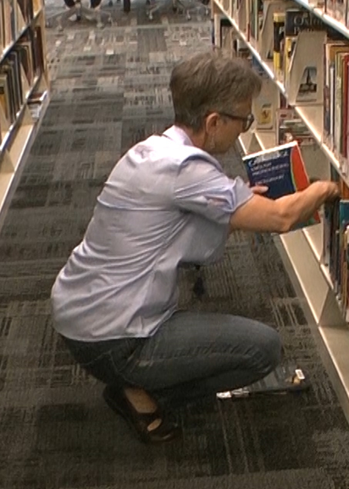
Deep Squat?
Squatting down?
Knees fully bent
Able to effectively use technique
Acceptable technique to use for them
For others deep squat will not work:
More strength, joint stability and balance than they may have
Resort to back bent/straight leg technique
Stress into lower back
For most people, do not recommend technique
Where does that leave us?
Notes:
How about squatting down? We call this a deep squat the knees are fully bent. Some people are able to effectively use this technique and if that is the case it is an acceptable technique to use.
However, honestly for a lot of people the deep squat will not work; it simply takes more strength, joint stability and balance than they may have.
So, if a deep squat doesn’t work; many people will resort to the back bent/straight leg technique. We recognize this may put stress into the lower back and for most people do not recommend this technique.
Where does that leave us?

Slide 47
Power Lift – Shelving at Lower Levels
IMAGE PLACEHOLDER
Use Power Lift based on the Power Position Ergonomics Principle
Power Lift is not deep squat lift
Allows you to reach down to a lower level
Notes:
One option is to use the Power Lift based on the Power Position Ergonomics Principle.
Recall the Power Lift is not a deep squat lift but still allows you to reach down to a lower level.
Here is an example of how the Power Lift works for shelving at lower levels.
With materials in hand approach the shelf. Depending on the situation it may make sense to stage the materials on an open space on a higher shelf and then access them once you are in position.
To use the Power Lift with a wide base of foot support, build a bridge with an elbow on your knee or your hand on a shelf to lower down to the shelf.
Make sure you have enough room for the materials on the shelf. Open up some space if needed.
Next place the materials on the shelf and adjust their position if needed.
Remember to pay attention to your head position. Concentrate on looking forward as much as possible.
Then return to an upright position by pushing up on your knee or the shelf.

Slide 48
Power Lift – Shelving at Lower Levels
IMAGE PLACEHOLDER
With materials in hand, approach shelf
Stage materials on open shelf space if needed
Access them once in position
Use Power Lift:
Wide base of foot support
Build a bridge with elbow on knee or hand on shelf to lower down to shelf
Ensure enough room for materials on shelf
Place materials on shelf, adjust position if needed
Pay attention to head position (LOOK UP):
Return to upright position by pushing up on knee or shelf
Notes:
One option is to use the Power Lift based on the Power Position Ergonomics Principle.
Recall the Power Lift is not a deep squat lift but still allows you to reach down to a lower level.
Here is an example of how the Power Lift works for shelving at lower levels.
With materials in hand approach the shelf. Depending on the situation it may make sense to stage the materials on an open space on a higher shelf and then access them once you are in position.
To use the Power Lift with a wide base of foot support, build a bridge with an elbow on your knee or your hand on a shelf to lower down to the shelf.
Make sure you have enough room for the materials on the shelf. Open up some space if needed.
Next place the materials on the shelf and adjust their position if needed.
Remember to pay attention to your head position. Concentrate on looking forward as much as possible.
Then return to an upright position by pushing up on your knee or the shelf.

Slide 49
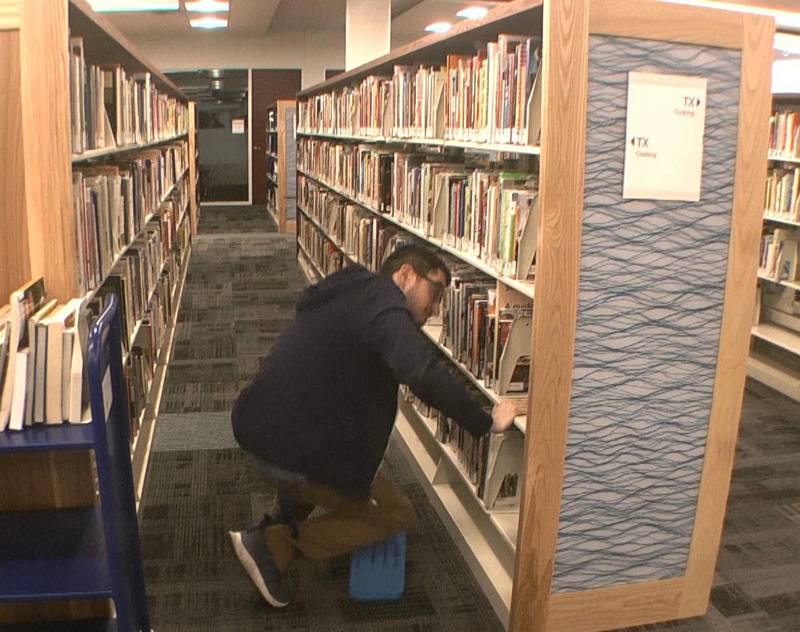
Down on Knee - Shelving at Lower Levels
Down to a knee to get to lower level
Two important components:
Kneeling pad to cushion knee
“Build a bridge” concept to make it easier to get down and particularly to get back up
Notes:
Another option is to go down to a knee to get to the lower level. If you are comfortable kneeling this can be effective.
To make this work for you, two very important components need to be integrated:
a kneeling pad to cushion the knee
and using the “build a bridge” concept to make it easier to get down and particularly to get back up.

Slide 50
Down on Knee - Shelving at Lower Levels
IMAGE PLACEHOLDER
With materials in hand approach shelf:
Stage materials on open shelf space on a higher shelf if needed
Access them once in position
Down on knee:
Build bridge with elbow on knee or hand on shelf
Position kneeling pad on floor
Lower down to one knee
Open up shelf space if needed
Place materials on shelf/adjust position if needed
Return to upright position by pushing up on knee or shelf or on the book truck
Pay attention to head position (LOOK UP)
Insert
Shelf Kneeling Pad Video
Notes:
Let’s examine how the Down on Knee technique works for shelving.
With materials in hand approach the shelf. Depending on the situation it may It may sense to stage the materials on an open space on a higher shelf and then access them once you are in the lower position.
Next build a bridge with an elbow on your knee or your hand on a shelf to position the kneeling pad on the floor and then lower down to one knee.
Make sure you have enough room for the materials on the shelf. Open up some space if needed.
Next place the materials on the shelf and adjust their position if needed.
Then return to an upright position by pushing up on your knee or the shelf. Remember to pay attention to your head position. Concentrate on looking forward as much as possible.
Some individuals use the book truck to build the bridge. Rather than leave the book truck at the end of a stack they maneuver it into the stack and then use it for support.

Slide 51
Sit on Stool or Chair - Shelving at Lower Levels
Use stool or chair
Allows work at lower level without:
Squatting
Kneeling
Bending straight over at waist
Make sure it is securely positioned
Don’t want it to roll away from you
Notes:
One last comment about going to the lower shelf levels. There may be a few individuals for whom none of the techniques we have discussed will work.
For whatever reason they can’t deep squat, use the power lift or down on one knee techniques.
They use the back bent/straight leg technique. What we understand is the most stress is placed in the lower back to get into and then out of the back bent/straight leg position. The actual position itself is less of an issue.
If this is the case, you can actually use the Power Position concept to your advantage.
.

Slide 52
Back Bent/Straight Leg
None of techniques seem to work:
Deep squat
Power lift
Down on one knee
Use back bent/straight leg technique
Most stress placed in lower back to get into and out of position
Actual position is less of issue
Use Power Position concept
Notes:
One last comment about going to the lower shelf levels. There may be a few individuals for whom none of the techniques we have discussed will work.
For whatever reason they can’t deep squat, use the power lift or down on one knee techniques.
They use the back bent/straight leg technique. What we understand is the most stress is placed in the lower back to get into and then out of the back bent/straight leg position. The actual position itself is less of an issue.
If this is the case, you can actually use the Power Position concept to your advantage.
.

Slide 53
Back Bent/Straight Leg
IMAGE PLACEHOLDER
To lower down:
Bend at hips, not lower back
Maintain lower back with inward curve and not let it round out
To get out of position:
Bend knees
Look up to assume Power Position
Push up with legs to return to upright position
Can also push up with a hand on a knee, shelf or book truck
Insert
Shelf Pelvic Tilt out of Straight Leg
Notes:
Here is precisely how this technique works for shelving.
To lower yourself down, bend at the hips, not the lower back. The goal is to maintain the lower back with the inward curve and not let it round out.
To get out of the position, bend the knees, look up to assume the Power Position and then push up with legs to return to an upright position. You can also push up with a hand on a knee, shelf or book truck.

Slide 54
Higher Shelf Levels: Two-Stage Lift
IMAGE PLACEHOLDER
Heavier materials or for someone not quite as strong
Use Two-Stage lift:
Notes:
Let’s move onto shelf levels at or above shoulder level. Some individuals have adequate upper body strength to safely and comfortably lift materials to the higher shelves and that works well for them.
However, for heavier materials or for someone not quite as strong, you can use the Two-Stage lift.
Essentially you stage the materials on an open shelf area at about mid-chest level. Then using the Power Position, you lower your body so the materials are about shoulder or head level. Grasp the materials and then come to a full standing position.
The materials will now be at a level closer to the higher shelf levels to be placed on the shelves. Legs are stronger than arms, so essentially you are using leg muscles to get the materials to the higher levels.

Slide 55
Higher Shelf Levels: Two-Stage Lift
IMAGE PLACEHOLDER
Use Two-Stage lift:
Using Power Position
Lower body so materials are about shoulder or head level
Grasp materials
Come to a full standing position
Use leg muscles to get materials to higher levels
Materials now at level closer to higher shelf levels
Notes:
Let’s move onto shelf levels at or above shoulder level. Some individuals have adequate upper body strength to safely and comfortably lift materials to the higher shelves and that works well for them.
However, for heavier materials or for someone not quite as strong, you can use the Two-Stage lift.
Essentially you stage the materials on an open shelf area at about mid-chest level. Then using the Power Position, you lower your body so the materials are about shoulder or head level. Grasp the materials and then come to a full standing position.
The materials will now be at a level closer to the higher shelf levels to be placed on the shelves. Legs are stronger than arms, so essentially you are using leg muscles to get the materials to the higher levels.

Slide 56
Repositioning Materials on Shelves
Repositioning steps:
Open up space on shelves for additional books
Close up space as needed
Front positioning stance:
Stand directly in front of shelf and push materials from side
Notes:
A very common activity is repositioning materials on shelves. This involves opening up space on the shelves for additional books or closing up space as needed.
Some individuals do this by standing directly in front of the shelf and pushing materials from the side.

Slide 57
Repositioning Materials on Shelves
Side positioning stance
Position yourself to side of materials
Use momentum and body weight to slide materials sideways
Requires less muscle strength
Reduces strain on shoulders
Notes:
Another technique is to position yourself to the side of the materials and then use momentum and body weight to actually slide the materials sideways. This technique requires less muscle strength and reduces strain on the shoulders compared with the other technique. Give it a try.

Slide 58
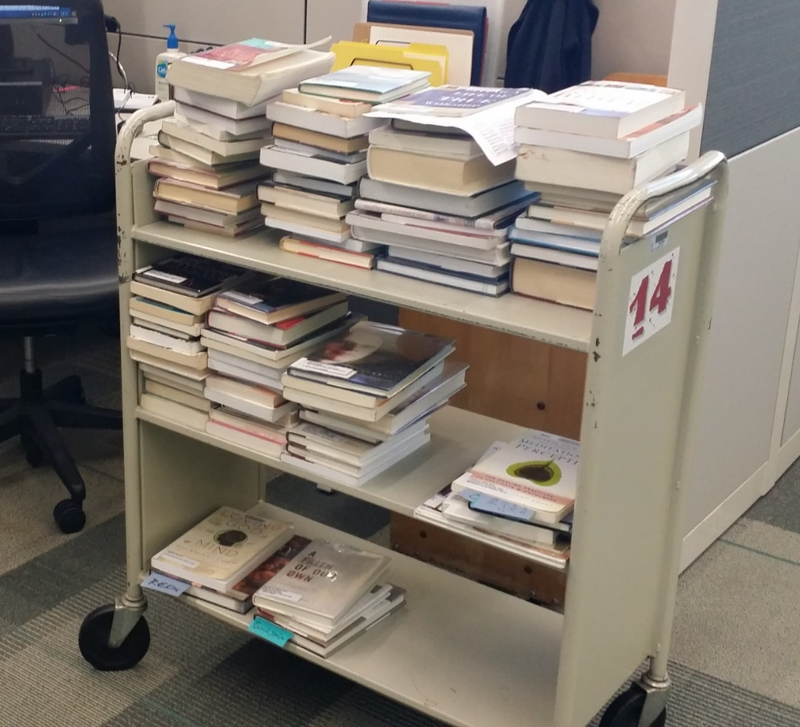
Book Trucks – Loading Shelves
Tips:
Use only top and middle shelves of book truck
Limit quantity of materials
Avoid awkward body and arm positions
Easier for person who unloads book truck
If use lowest shelf:
Put lighter, easier to handle materials on bottom shelf
Notes:
Book trucks are routinely used to stage and transport library materials.
Here are some tips:
When loading book trucks, as possible, use only the top and middle shelves, limit the quantity of materials as possible. You will be able to avoid awkward body and arm positions when the book truck is being loaded and also make it easier for the person who unloads the book truck.
If you do use the lowest shelf, try to put lighter, easier to handle materials on the bottom shelf.

Slide 59
Book Trucks - Maintenance
Service Request:
Wheels that are wobbly or hard to roll
Structural problems
Tag book trucks that have issues “out of service” for repair or replacement
Submit online HCL Facilities work request form
Notes:
Always be on the look-out for any book trucks that need service; wheels that are wobbly or hard to roll or any structural problems. Tag book trucks that have issues and pull them out of service for repair or replacement. Submit an online Facilities work request to repair or replace any damaged equipment.

Slide 60
Book Trucks - Maneuvering
Maneuvering book trucks:
Which example looks easier to handle? A or B
Less is more
IMAGE PLACEHOLDER
IMAGE PLACEHOLDER
Insert
Book Truck Example A Video
Insert
Book Truck Example B Video
Example A
Example B
Notes:
When maneuvering book trucks use the momentum of the truck to your advantage. Look at these two examples; which one looks easier to handle?
Example A on the left is being “muscled” around the corner.
Example B on the right, see how it is “spinning” on its wheels to get around the corner.
Use as little force as you can to maneuver the book truck.

Slide 61
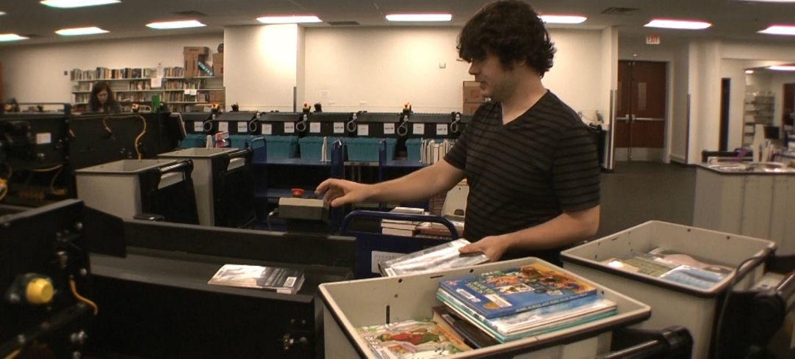
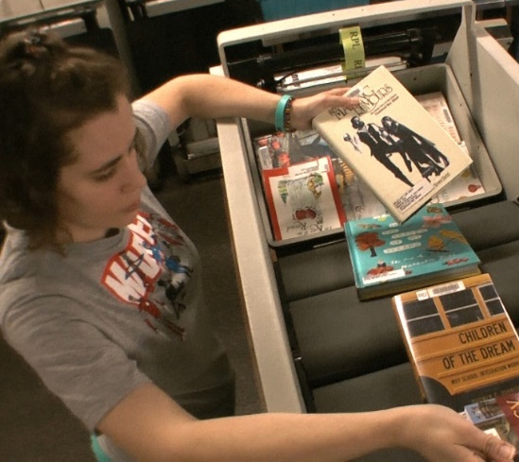
AMH Systems
AMH Systems
Let AMH do its job as much as possible
Equipment limitations:
Materials do occasional jam up
Tendency to “feed” conveyor from IA Bin
Repetitive reaching over side of conveyor is awkward position
Use reacher/gripper tool to free jammed materials
Notes:
AMH Systems have revolutionized materials handling in the library. Let the AMH do its job as much as possible.
All equipment has limitations and we recognize materials do occasional jam up on the conveyor. As a result, there may be a tendency to “feed” the conveyor from the IA Bin. Repetitive reaching over the side of the conveyor is an awkward position.
For materials that are jammed trained operators should stop the AMH and safely use the reacher/gripper tool to free them up.

Slide 62
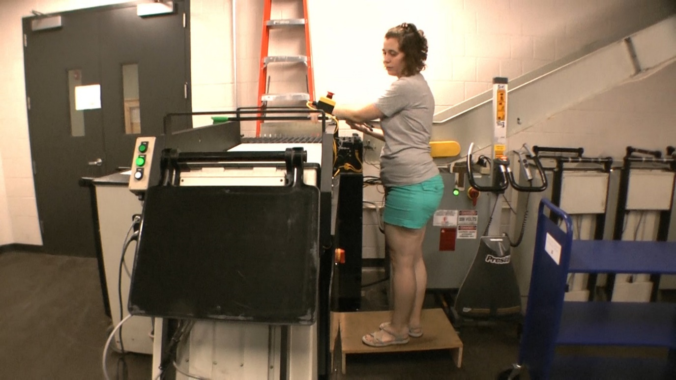
AMH Systems
If you do you need to reach in
Use available foot platform to minimize reach
Use a tool, not your hand
Notes:
If you do you need to reach in, use the available foot platform to minimize the reach. Use a tool, not your hand.

Slide 63
AMH Systems
To unload materials from IA bins always raise bottom of bin
Position materials in your reach zone
Promote your neutral body position
Notes:
To unload materials from the IA bins always raise the bottom of the bin to position the materials in your reach zone and promote your neutral body position.

Slide 64
Book Drops/Returns
Some Book Returns:
Bin under slot
Bin needs to be moved into position or to Work Room
Always be on look-out for any bins that need service:
Wheels wobbly or hard to roll
Structural problems
Tag bins and pull them out of service
Notes:
Some Book Returns drop materials directly onto the AMH conveyor.
For other Book Returns there is a bin under the slot. To process the materials in the bin it needs to be moved into position or to the Work Room.
Always be on the look-out for any bins that need service; for example, wheels that are wobbly or hard to roll or any structural problems. Tag bins that have issues and pull them out of service for repair or replacement.

Slide 65
Book Drops/Returns
When maneuvering bins, use momentum of bin to your advantage
Use Power Position to push and pull bin
Notes:
When maneuvering bins, use the momentum of the bin to your advantage. This is a chance to use the Power Position to push and pull the bin.

Slide 66
Book Drops/Returns
Some bins have floors:
Spring loaded to raise level of bin bottom for better access to materials
Neutral Position principle in action!
Reach to bottom of bin:
Use “build a bridge” technique to support body weight
Hand on side of bin as reach into bin
Notes:
Some bins may have floors that are spring loaded to raise the level of the bin bottom for better access to the materials. The Neutral Position principle in action!
If you do reach to the bottom of the bin, use the “build a bridge” technique to support your body weight with a hand on the side of the bin as you reach into the bin.

Slide 67
Lift Stiks
Lift Stiks embraced by library staff:
Proven to be a great benefit!
Lift Stiks :
Transporting blue delivery tubs eliminates lot of manual handling
Work height positioners, adjust height of tub stack to put in Reach Zone
Restack blue delivery tubs
Notes:
Lift Stiks have been embraced by library staff because they have proven to be a great benefit. Lift Stiks really have several purposes.
Transporting blue delivery tubs from area to area with Lift Stiks eliminates a lot of manual handling.
Second, Lift Stiks are work height positioners. When removing materials from the blue delivery tubs you can adjust the height of the tub stack to put it in your reach zone.
Third, Lift Stiks allow you to restack blue delivery tubs. For example, you can build up a stack of five tubs to be handled by the contractor.

Slide 68
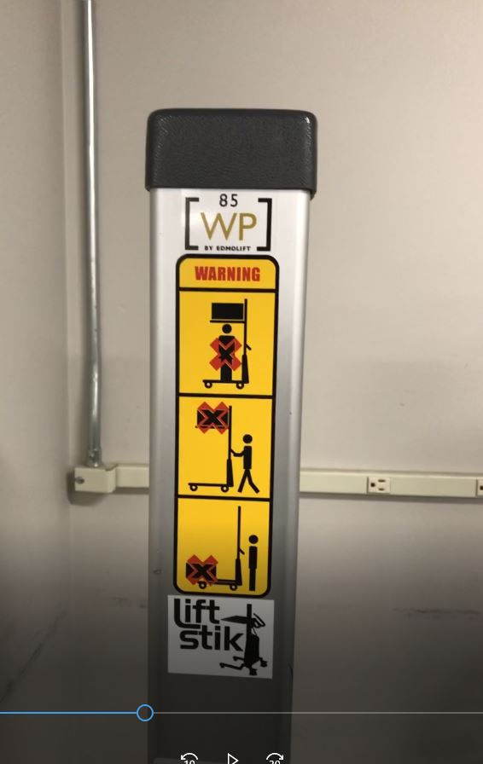
Lift Stiks
Lift Stik blue delivery tubs maximum capacity is four bins
Understand and follow all guidelines for safe and effective Lift Stik operation
Notes:
Remember the Lift Stik blue delivery tub maximum capacity is four tubs. Make sure you understand and follow all the guidelines for safe and effective Lift Stik operation.

Slide 69
Foot Wear
What is appropriate footwear?
Shoes that fit properly
Provide adequate support and cushioning
Necessary component to safe and healthy work environment
Notes:
Library staff are commonly on their feet throughout the day. Appropriate foot wear can add to the level of foot comfort. What is appropriate footwear?
Shoes that fit properly and that provide adequate support and cushioning are a necessary component to safe and healthy work environment. Rather than use standing mats, consider shoes insoles.

Slide 70
Work Rooms
Significant part of equipment:
User-controlled, powered height-adjustable worksurface
Allows flexibility to either sit or stand when processing materials
Always take a few seconds to set-up workstation for yourself
Notes:
Workstations in the work room are where you process library materials. A significant part of the equipment is the user-controlled, powered height-adjustable worksurface that allows you the flexibility to either sit or stand when processing the materials. Always take a few seconds to make sure you set-up the workstation for yourself.
Here is a step-by-step approach.

Slide 71
Work Room - Standing Workstations
Anticipate hand placement to perform tasks:
Adjust worksurface height to match hand position
Position equipment within reach zone
Position monitor
Position other equipment within reach zone
Fine-tune workstation set-up as needed:
Adjust worksurface height and equipment place to optimize it.
Stretches to help control fatigue
Notes:
First for a standing work height, stand at the worksurface with a comfortable upright neutral body position.
Anticipate where you will place your hands to perform the tasks at hand and adjust the worksurface height to match your hand position.
Next make sure all your equipment (keyboard, mouse, RFID pad, scanner and so on) is within your reach zone.
Make sure the monitor is positioned so you can maintain a neutral head position.
Position the other equipment like book trucks and blue delivery tubs within a reasonable reach zone to control excessive reaching.
Use the Power Position principle as you maneuver equipment in the workstation.
Don’t hesitate to fine-tune the workstation set-up as needed. You can always adjust the worksurface height and equipment placement to optimize it for you.
On a regular basis perform some of the stretches to help you control fatigue.

Slide 72
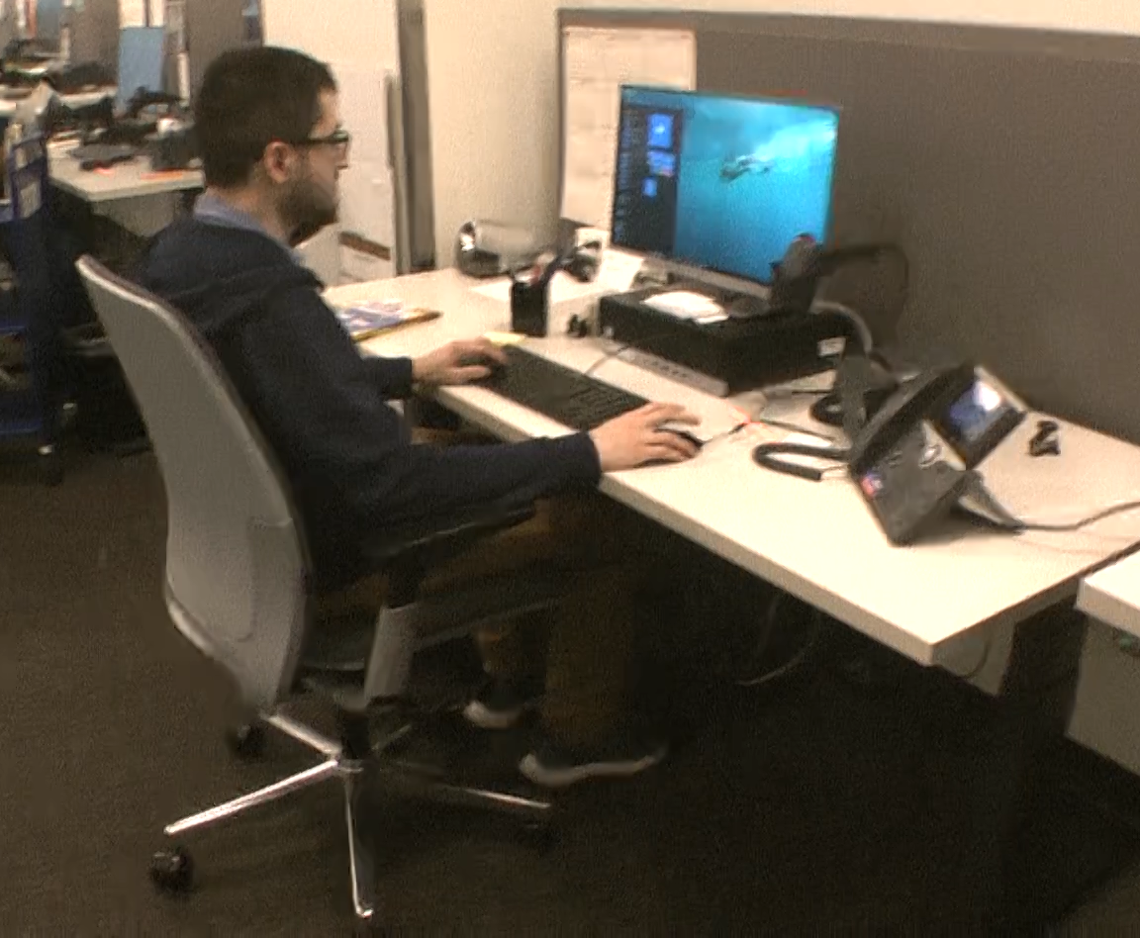
Work Room - Seated Workstation
Sit at workstation
Understand how to adjust chair:
Seat/back to provide body position and support
Worksurface height:
Adjust worksurface height to match hand position
Position all other equipment as needed
Set-up workstation to meet needs:
Good body position and support
Move into next good position with support
Notes:
Remember you can also sit at the workstation some of the time for a variety of position. Make sure you understand how to adjust the chair seat and back to provide adequate body position and support.
Once the chair is set-up, adjust the worksurface height to match your hand position and then position all the other equipment as needed.
Remember some of the stretches can also be performed from a seated position.
Overall your goal is to set-up the workstation to meet your needs with good body position and support and then on a regular basis move into the next good position with support.

Slide 73
Service Desks
Most Service Desks provide opportunity to sit or stand periodically:
User-controlled, powered height-adjustable worksurface
One worksurface at seated height and another at standing height
Set-up workstation for you
Here is a step-by-step approach
Notes:
Service desks are where the critical interaction between the library staff and the library patrons takes place.
Most Service Desks provide an opportunity to sit or stand periodically. It may be a user-controlled, powered height-adjustable worksurface or it may one worksurface at a seated height and another at a standing height.
Always take a few seconds to make sure the workstation is set-up for you uniquely.
Here is a step-by-step approach.

Slide 74
Service Desk - Standing
Anticipate hand placement to perform tasks:
Adjust worksurface height to match hand position
Position equipment within reach zone
Position monitor
Position other equipment within reach zone
Fine-tune workstation set-up as needed:
Adjust worksurface height and equipment place to optimize it.
Stretches to help control fatigue
Notes:
First for a user-controlled, adjustable standing worksurface, stand at the worksurface with a comfortable upright neutral body position.
Anticipate where you will place your hands to perform the tasks at hand and adjust the worksurface height to match your hand position.
Next make sure all your equipment (keyboard, mouse, RFID pad, scanner and so on) is within your reach zone.
Make sure the monitor is positioned so you can maintain a neutral head position.
Don’t hesitate to fine-tune the workstation set-up as needed. You can always adjust the worksurface height and equipment placement to optimize it for you.
On a regular basis perform some of the stretches to help you control fatigue.

Slide 75
Service Desk - Seated
Adjust chair seat and back
If height adjustable worksurface:
Set height to match hand position
Position all other equipment as needed
If worksurface is fixed height seated version:
Adjust chair seat height to match hand position
If feet no longer supported on floor
Add a foot rest; never let legs and feet dangle
Set-up workstation to meet your needs:
Good body position and support
Move into next good position with support
Notes:
Recall you can also sit at the workstation some of the time for a variety of position. Make sure you understand how to adjust the chair seat and back to provide adequate body position and support.
Once the chair is set-up, for a powered height adjustable worksurface adjust the worksurface height to match your hand position and then position all the other equipment as needed.
If the worksurface is a fixed height seated version, adjust the chair seat height to match your hand position based on the tasks performed.
If your feet are no longer supported comfortably on the floor you will need a foot rest. Never let your legs and feet dangle more than just a short period of time.
Remember some of the stretches can also be performed from a seated position.
Overall your goal is to set-up the workstation to meet your needs with good body position and support and then on a regular basis move into the next good position with support.

Slide 76
Invaluable Support!
Number of strategies:
Manual handling of library materials
Loading and unloading blue delivery tubs
Pushing book trucks
Using Lift Stiks and the AMH system
Techniques for shelving materials
Discussed topics:
Personal health and wellness
Physical fitness
Stretching routine
Invaluable support to every library patron and to co-workers
Notes:
We have covered a number of strategies including manual handling of library materials, loading and unloading blue delivery tubs, pushing book trucks, using lift stiks and the AMH system and specific techniques for shelving materials.
We also discussed topics of personal health and wellness along with physical fitness and how to safely and effectively perform a basic stretching routine to promote blood flow and joint health. All of this is in the context of ergonomics – understanding how to “Work Smarter; Not Harder!”
As a member of the Hennepin County Library staff you provide invaluable support to every library patron and to your co-workers.
We hope you will use the information to work safely and effectively.

Slide 77
Thank you for your time and attention!
Notes:
Thank you for your time and attention.

Slide 78
Menu - Ergonomics at Hennepin County Library
Title Page
The First Public Library
Hennepin County Library
Very First Book!
Health and Safety Strategies
Ergonomics Improvements
What is Ergonomics?
Ergonomics Principles
Neutral Position
Reach Zone
Power Position
Fatigue Control
Use Ergonomics Principles
Stretching/Warm-up
Physical Fitness
Health and Wellness
Safest Lift?
Personal Performance Limit
Best Lifting Technique
Power Lift Technique
Look Up!
Golfer’s Lift
Tips and Techniques
Shelving
Shelving – Lower Levels
Shelving - Higher Levels
Repositioning Materials
Book Trucks
AMH Systems
Book Drop/Return
Lift Stik Use
Foot Wear
Work Room
Standing Workstation
Seated Workstation
Service Desk
Standing Workstation
Seated Workstation
Close
Notes:
Menu

