Slide 1
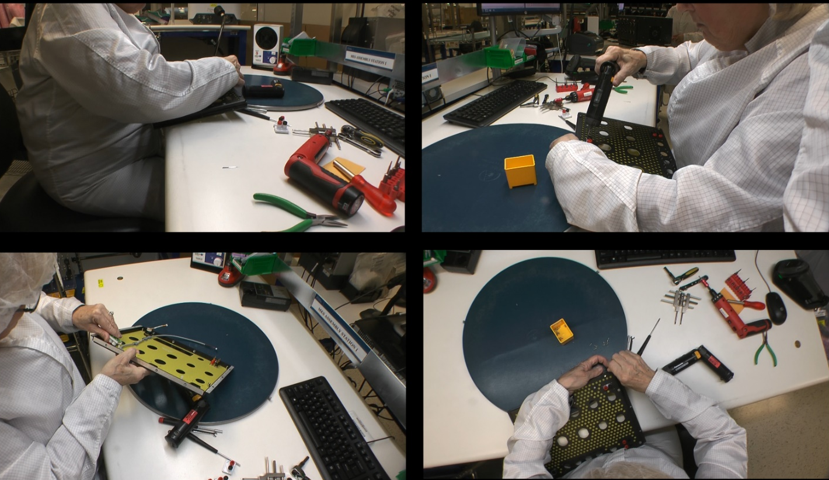
Ergonomics Case Studies

Slide 2
Ergonomics Case Study Guidelines
Step One – Delineate Case Study Groups
Form Project Groups (with assistance from Course Facilitators)
Group size between 3 and 5 members
Anticipate about 7 to 8 groups
Group composition will be via work areas and geographic locations (MN and CA)
Step Two – Choose Case Study Project
Case studies intended to focus on specific task issue as compared to entire process
Option One – Choose Pre-determined project
About five case study projects with video are available to select from
Up to three groups can choose the same project
Will lead to some interesting discussions as different groups may view same project differently with different recommendations
Option Two – Group chooses specific project
Group chooses project unique to their area of interest
Existing ergonomics issue or potential issue
The group will need to obtain descriptive video of project

Slide 3
Ergonomics Case Study Guidelines
Step Three – Perform Case Study
Using Workstation Ergonomics Design Worksheet and Engineering Ergonomics Reference Guide
Select and fill out Checklists pertinent to project
Analyze findings
Fill out Workstation Configuration Worksheet to document results
NOTE: Appreciate in time frames of course; may not be able implement proposed interventions but will be able to postulate recommendations
Step Four – Prepare Group Case Study Presentation
Each group prepares case study for presentation during debriefing session
Identify Checklists, Specifications and Guidelines
Prepare findings via Workstation Configuration Worksheet and other information you deem necessary
Step Five – Present and discuss Case Study (7 to 10 minutes allocated)
Introduce case study by showing video
Present Case Study Project findings to group
Course instructor will facilitate discussion

Slide 4
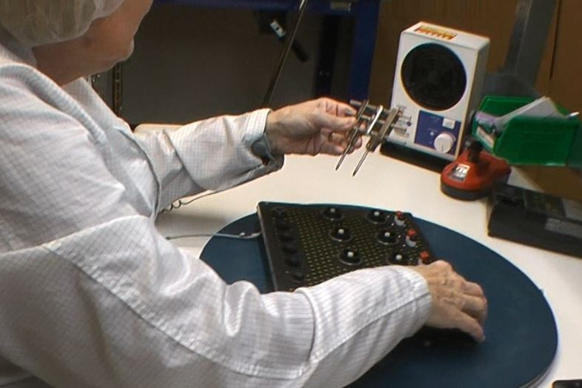
Case Study – Secure Retaining Rings
BEFORE
Manual retaining ring tool

Slide 5
Ergonomics Case Study Guidelines
Case Study – Secure Retaining Ring (click icon to open document)
Workstation Ergonomics Design Worksheet
Select and fill out Checklists pertinent to project
Guidelines Selection Characteristics for Sitting and Standing Workbenches
Specifications Seated Workstation
Checklist Workstation
Checklist Workbench
Checklist Chair Stool
Checklist Fixtures
Checklist Hand Tool Design and Selection
Workstation Configuration Worksheet

Slide 6
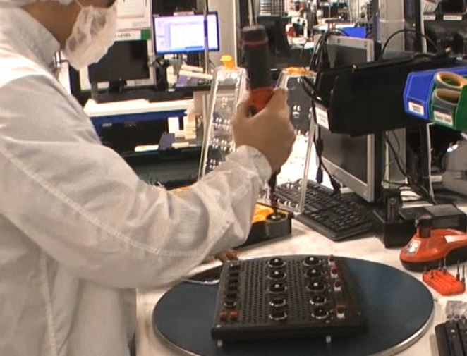
Case Study – Secure Retaining Rings
AFTER
Socket driver

